Slide 1

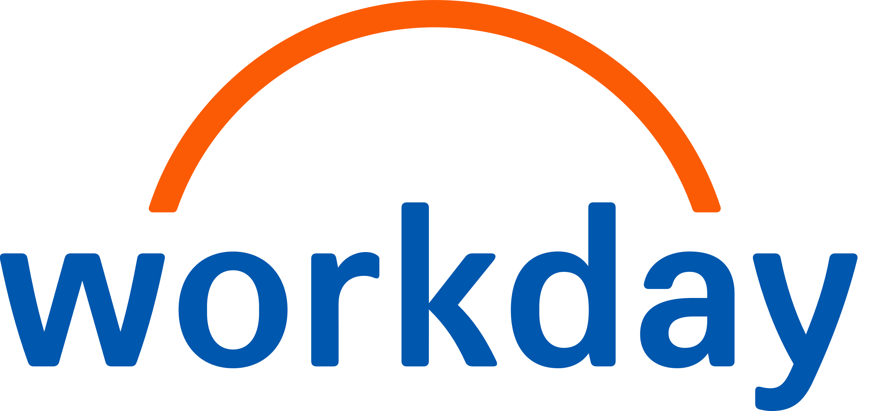
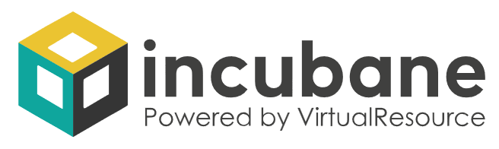

HRIS Agent Strategy Blueprint
Architect & Build

Slide 2




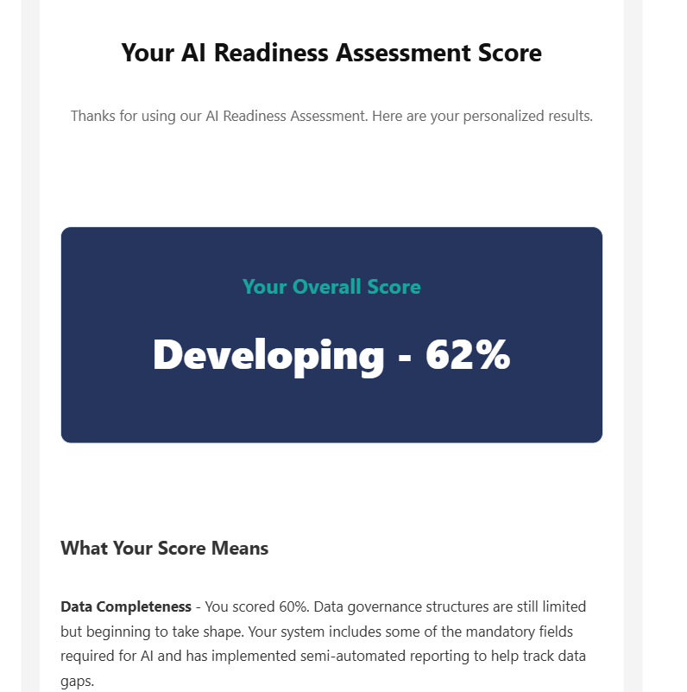
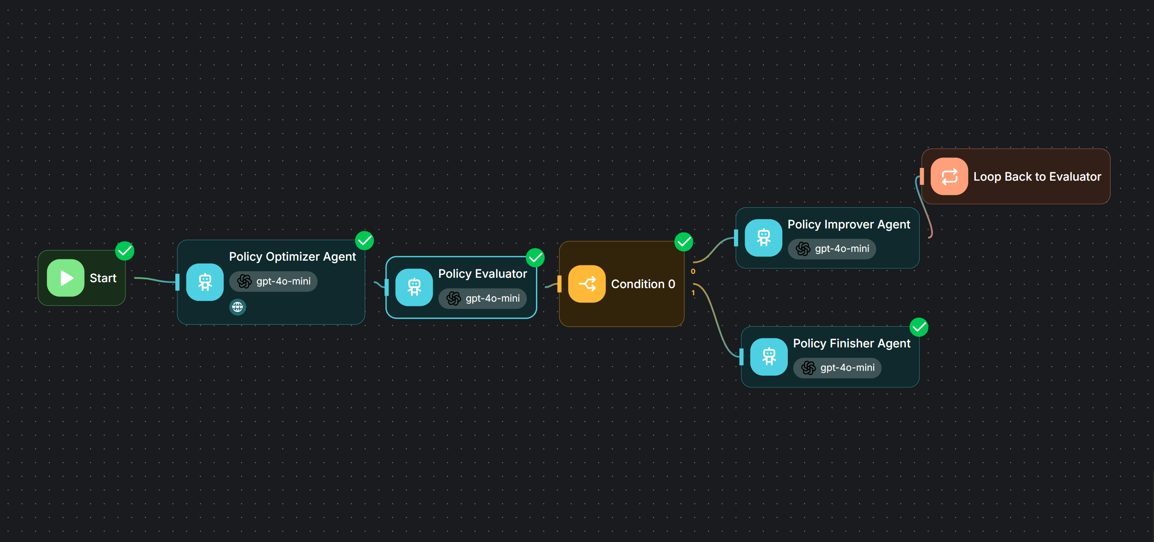
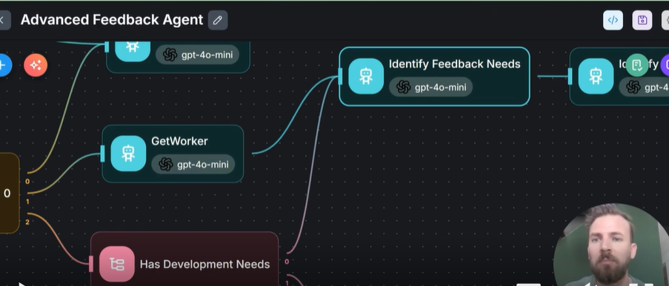
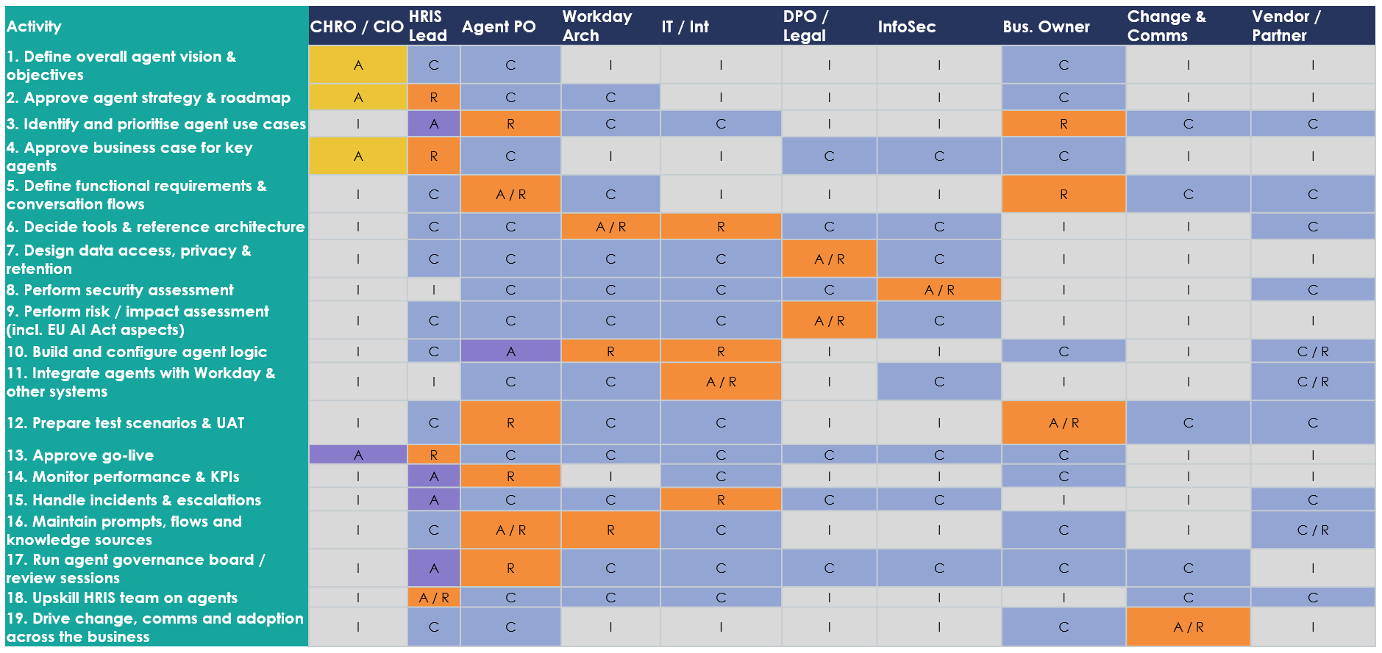
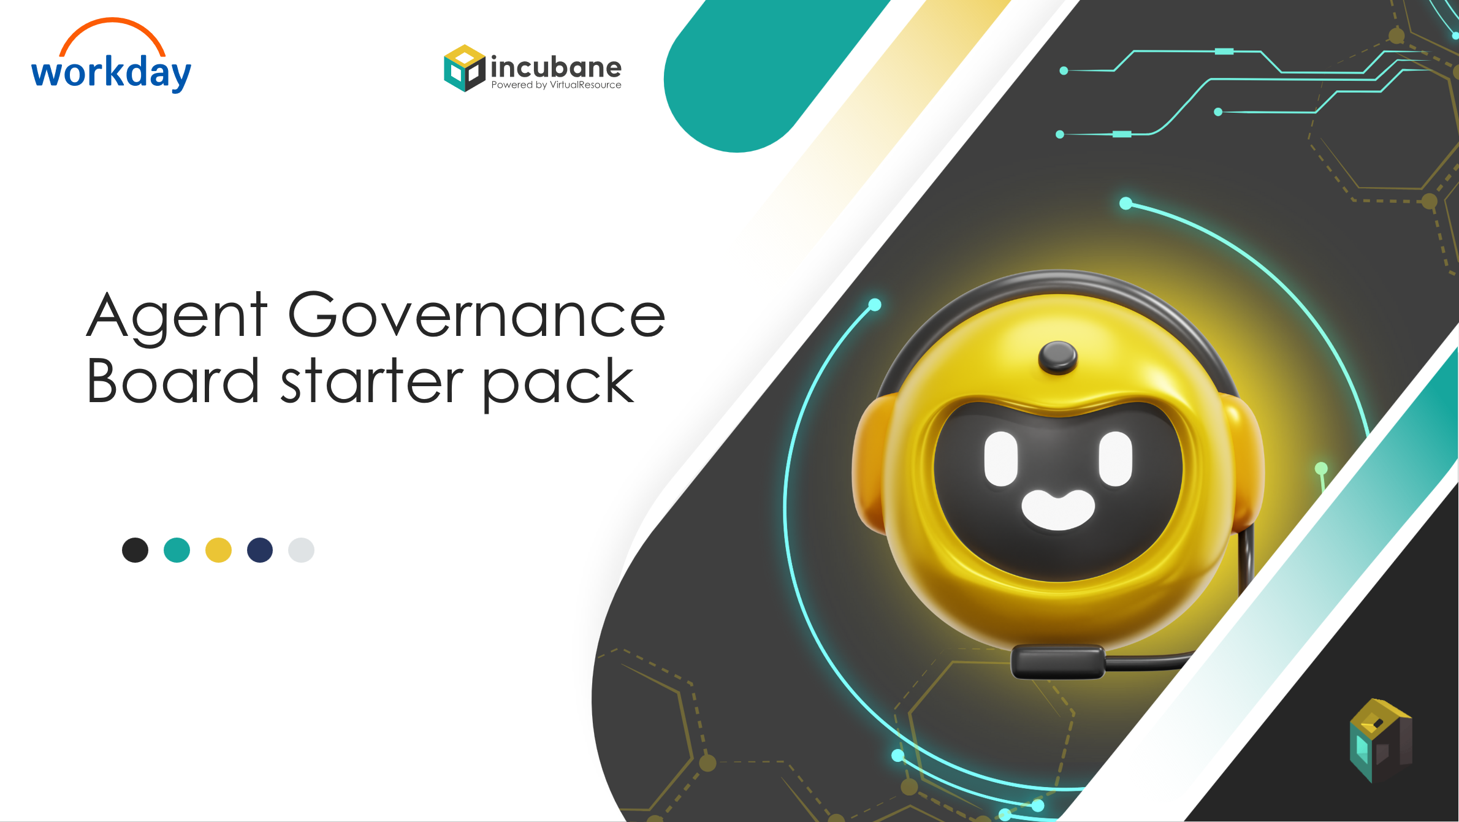
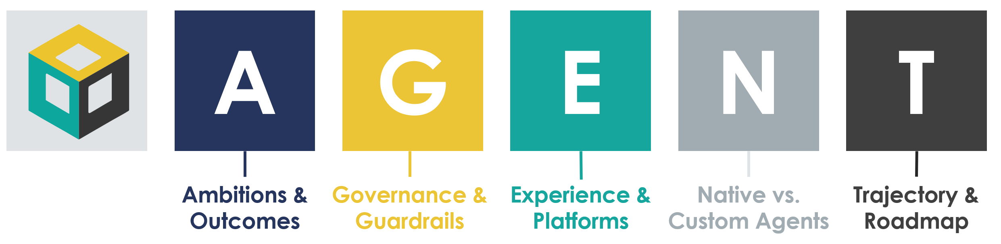
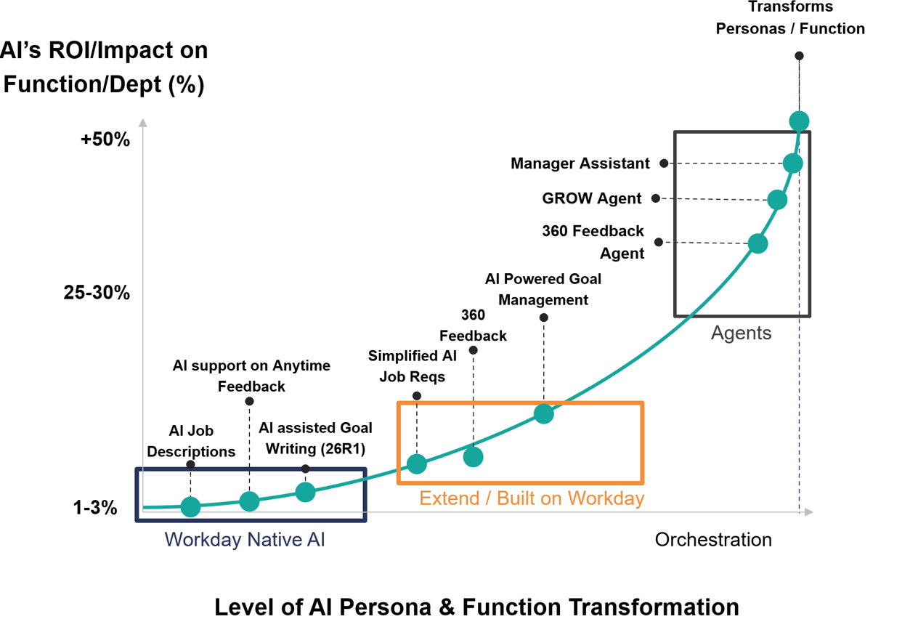
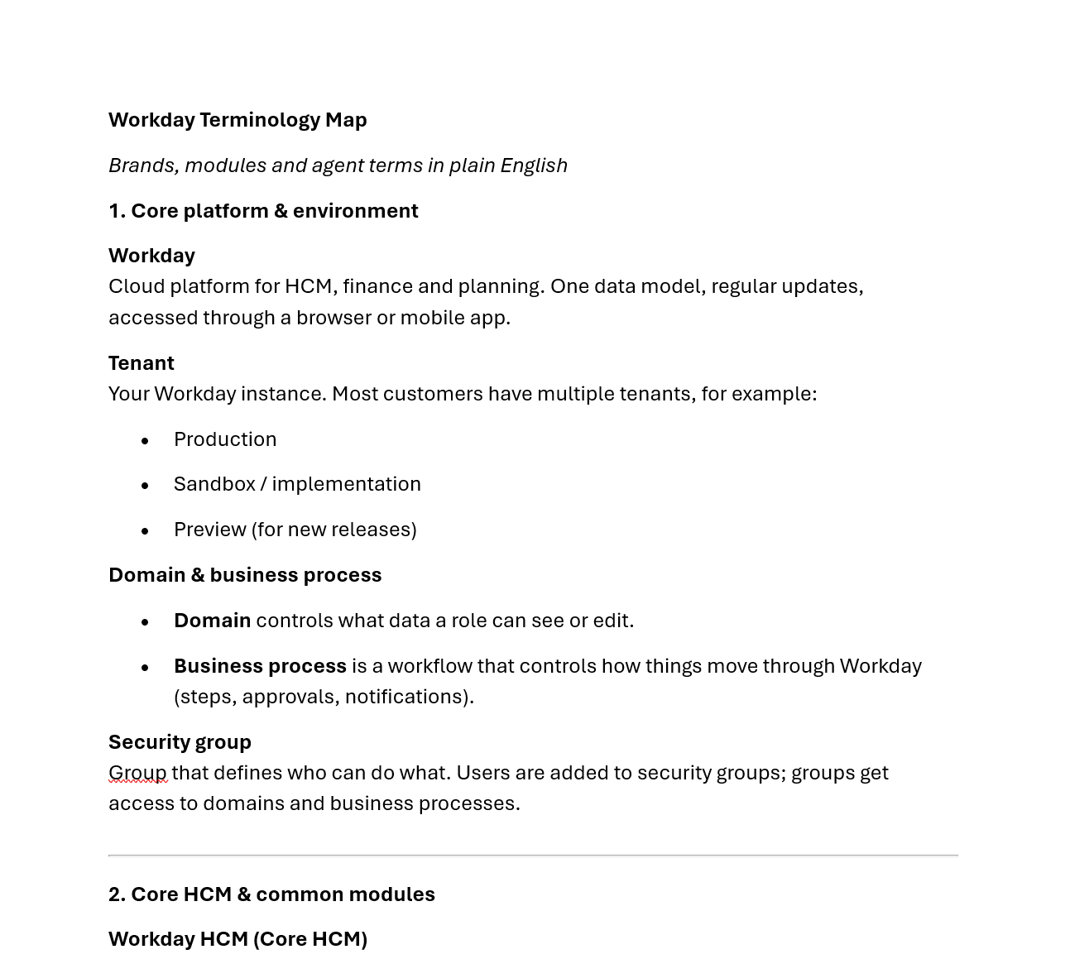
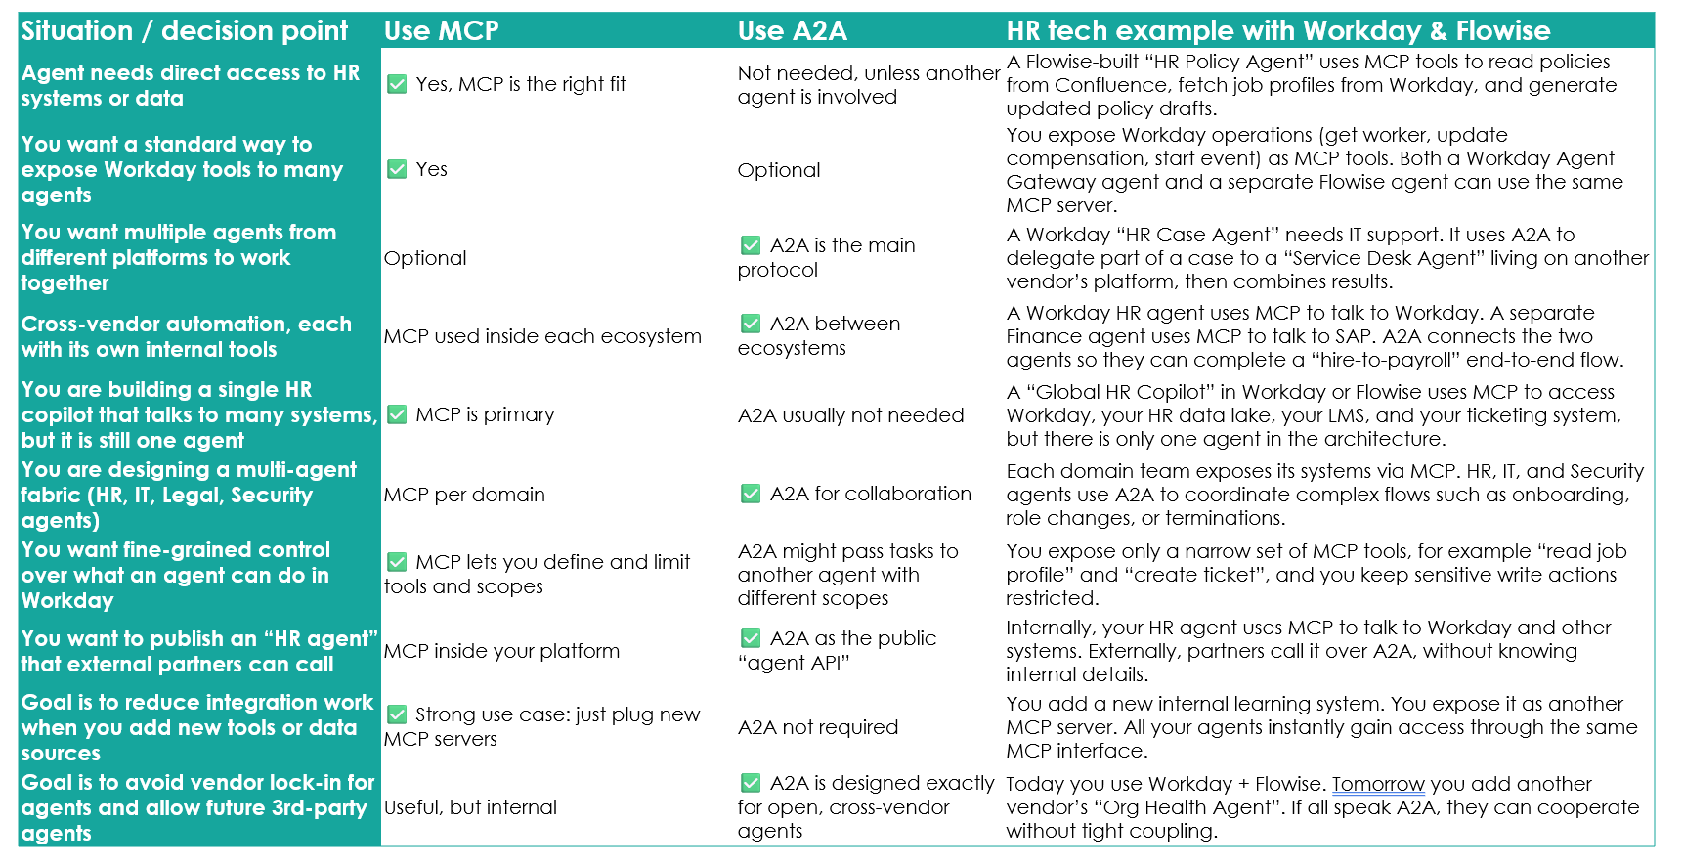
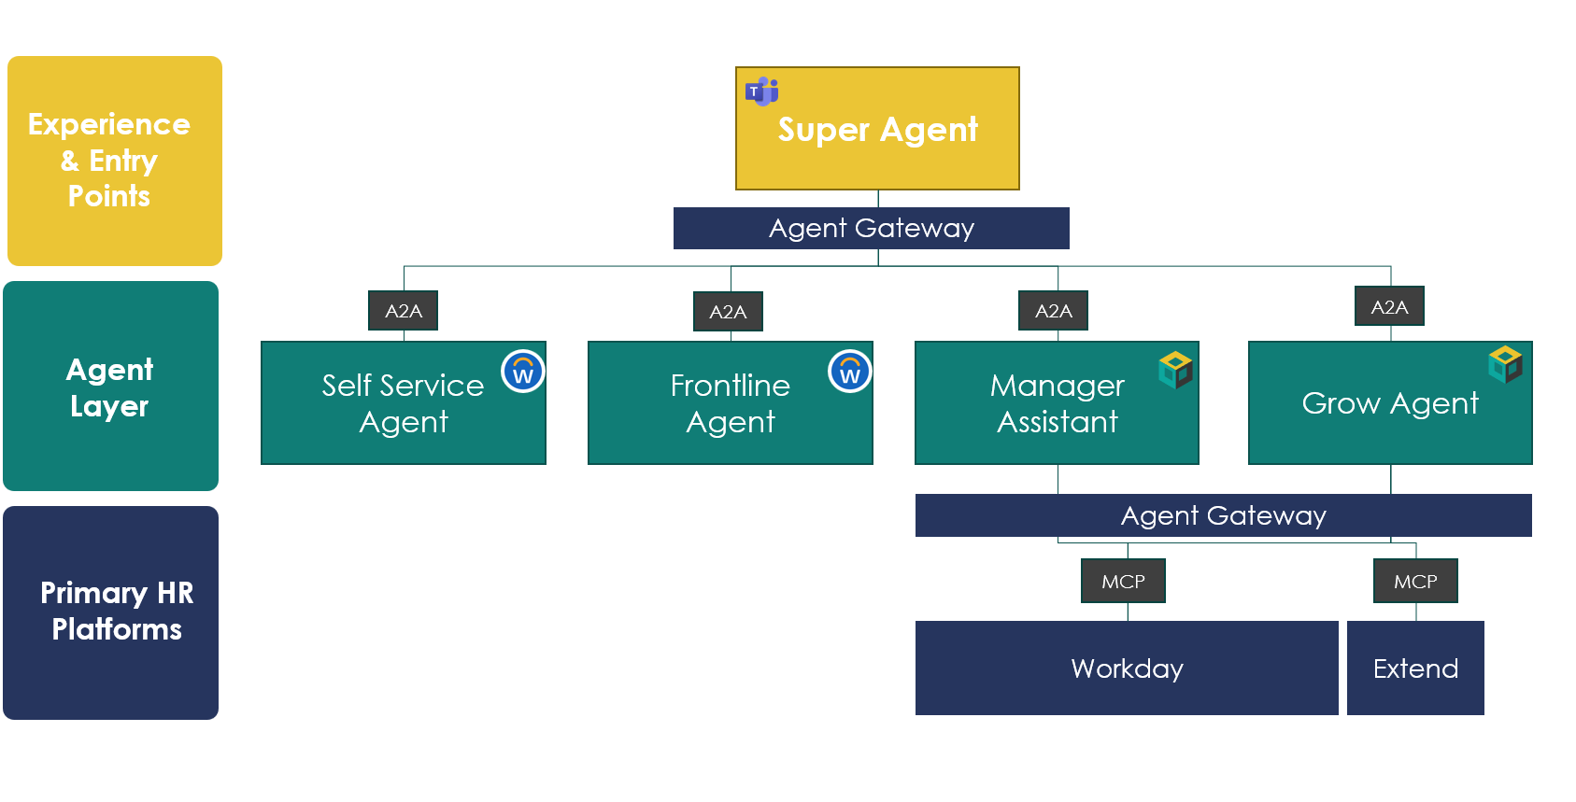
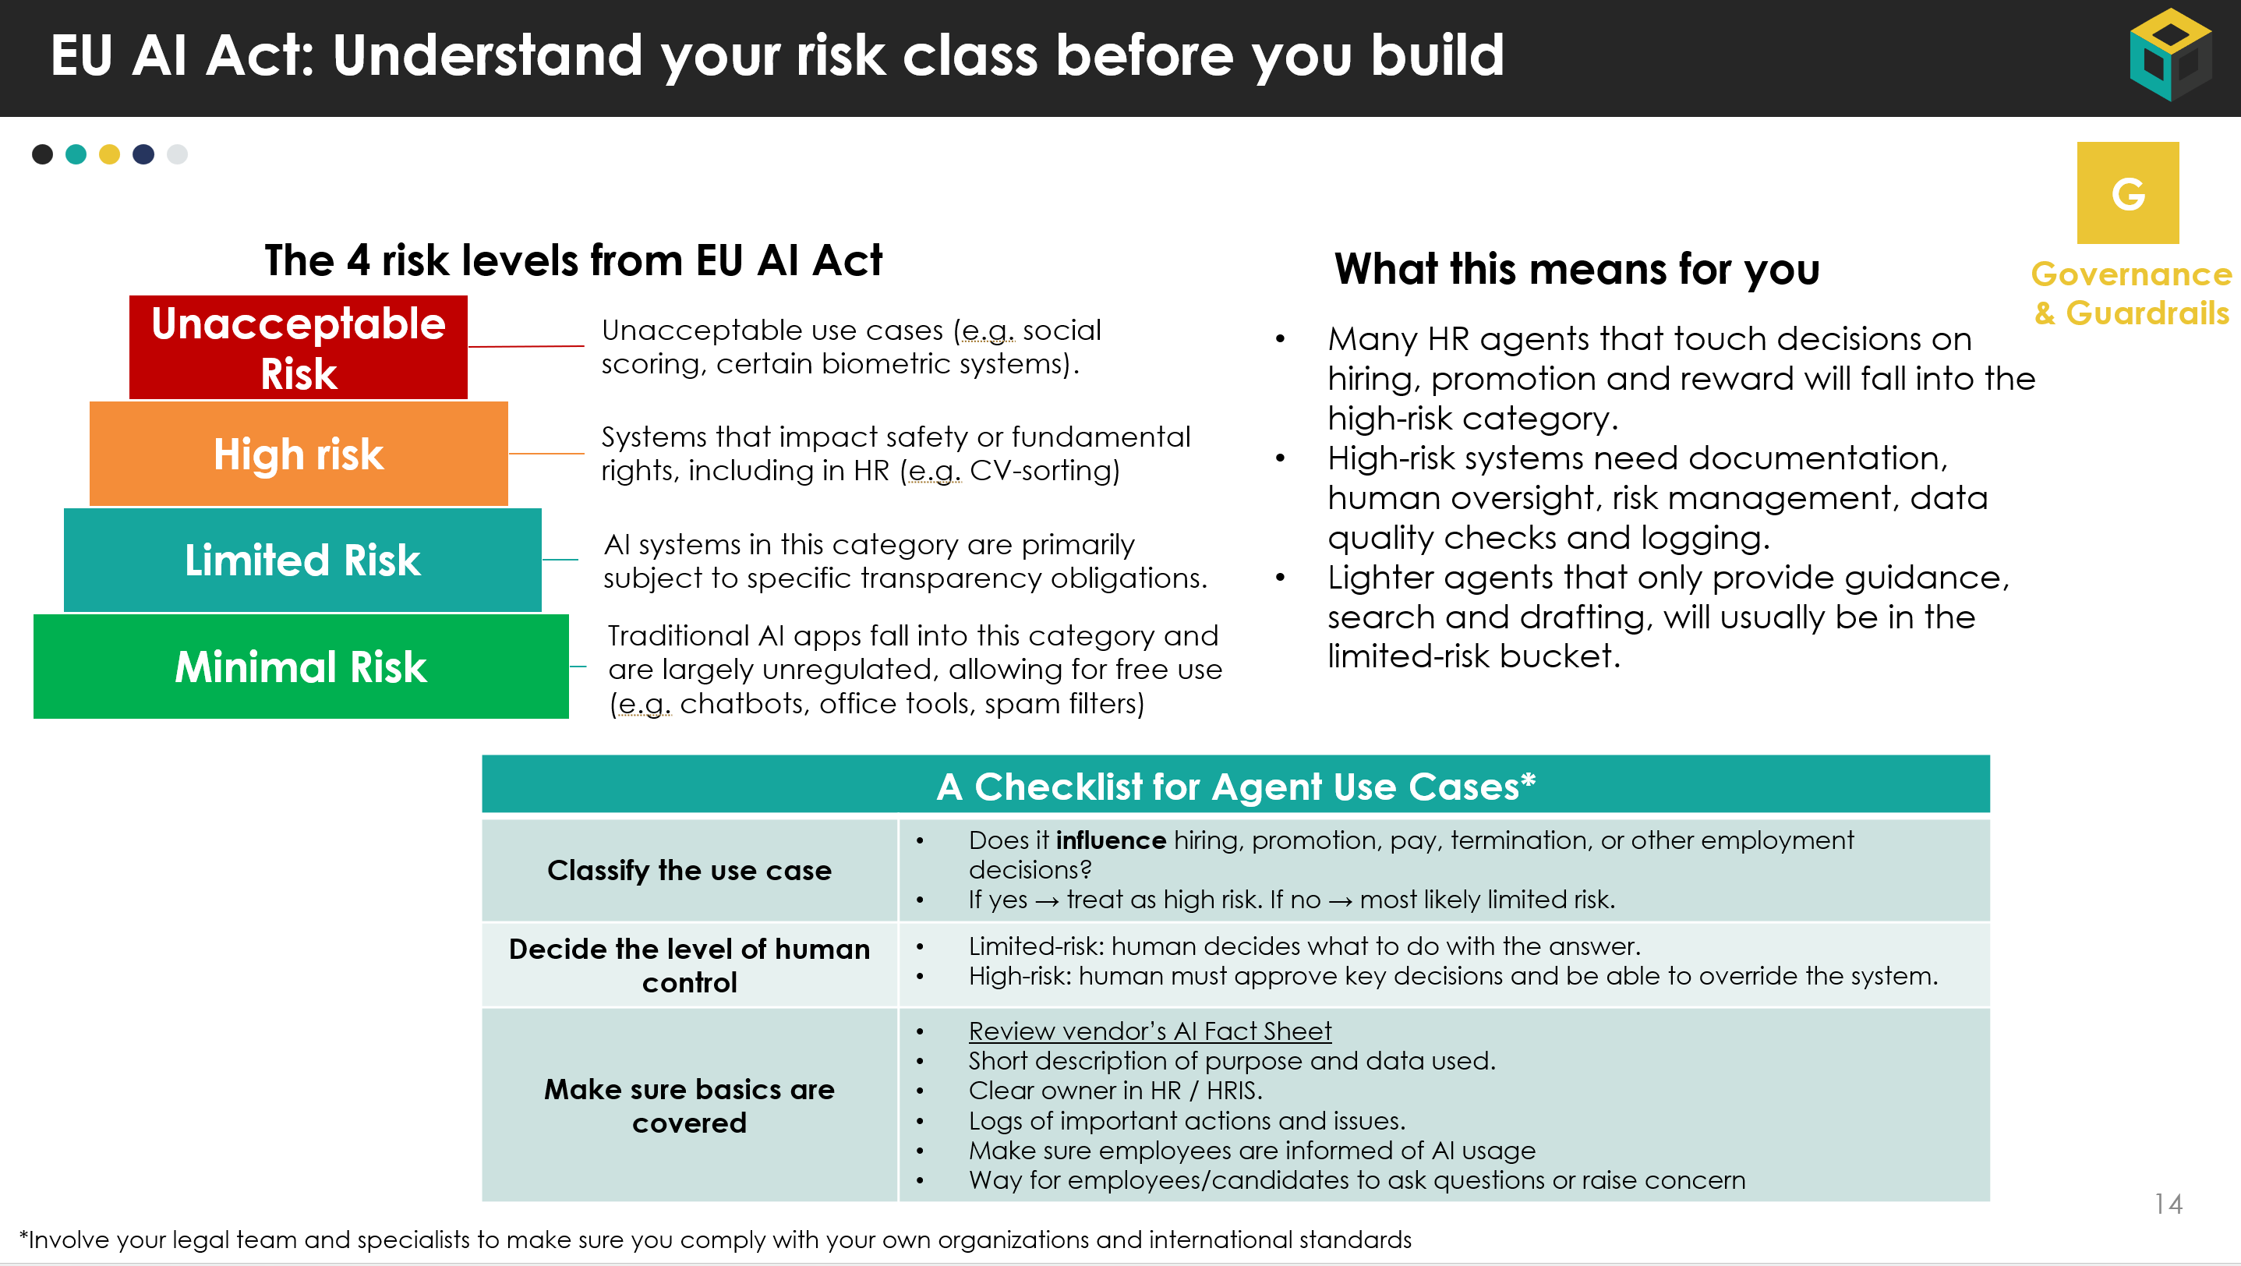
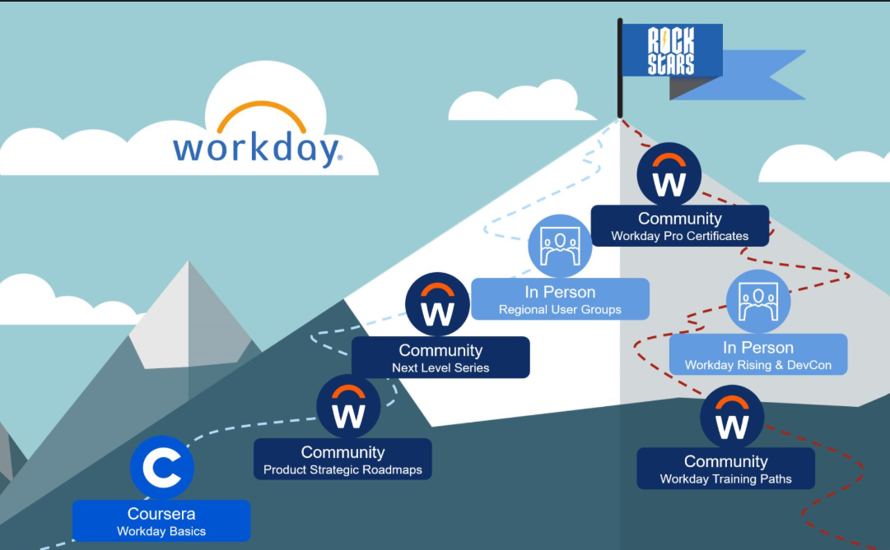
The HRIS Agent Strategy Blueprint
In line with our core value of Sharing Knowledge, we have built the HRIS Agent Strategy Blueprint. It will be released in three parts and is aimed to give you all necessary tools and templates to start your Agent Journey.
Click here to download
Release Date
12th of Jan
Strategy & Vision
Architecture & Build
Governance & People
Help HR tech lead define the vision and get buy in.
Show how to design and wire agents with Workday and Flowise.
Make it safe, compliant, and make sure people can run it.
Strategy & Vision
Strategy & Vision
Strategy & Vision
AGENT Framework & Templates
Agent Use Case Library for Workday
Business Case & Token Calculator Template
AI Readiness Assessment
Executive Pitch Deck template
On demand webinars
Workday & AI Glossary for HRIS Teams
Agent FAQ
Complex concepts simplified: Deterministic vs. Probabilistic, using RAG, Evals and more.
Guiding Principles for Agent Architecture
Agent Reference Architecture & MCP / A2A Explained and Decision Table
Multi-Agent Architecture Templates
Service request types & agent patterns
Flowise Patterns, Templates and Tutorials
EU AI Act Explained
Risk & Controls Checklist
Example RACI for Agents
Agent Governance Starter Pack for AI Board
HRIS Agent Upskilling Plan (Functional & Technical Track)

Slide 3
Table of Contents – Architect & Build
Title | Description | Page
How to use this document | Who this blueprint is for and how to use it in your Workday agent design and reviews. | 4
Probabilistic vs. Deterministic | We explain these important concepts and how we can combine both in agents and workflows | 6
Guiding principles for agents on Workday | Core design principles that should guide every agent and integration built on top of Workday. | 9
Service request types & agent patterns | Mapping of HR / Workday request types to preferred agent patterns and risk considerations. | 11
The Power of RAG | Explains how to improve the output of agents using RAG, so that it better understands the context and policies of your organization. | 14
Agent reference architecture & MCP / A2A | Recommended HR agent reference architecture plus an overview of MCP and A2A concepts and scenarios. | 19
Multi-agent architectures | Overview and pros / cons of different multi-agent patterns (single, network, supervisor, hierarchical). | 25
Evals Explained | How to test and measure your agents in a repeatable way, including key eval dimensions for HR use cases and a ready-to-use eval template with example test cases. | 29
Flowise patterns & use cases | Library of Flowise design patterns with concrete Workday examples (chaining, routing, HITL, etc.). | 33
Flowise Tutorials | Start understanding how to work with Flowise by following our introduction tutorials | 42

Slide 4


This deck in simple terms for HRIS
What this deck is for
This part of the HRIS Agent Blueprint shows how agents sit on top of Workday. It gives you standard patterns for entry points, integrations, MCP / A2A and Flowise. You can use it to make sure every new agent idea fits into one clear, agreed architecture.
What you as HRIS should focus on
Use the service request types to label your use cases (transaction, knowledge etc.) Pick a simple agent pattern for each use case, using the pattern slides. Check that agents use Workday as source of truth, respect security and approvals, and that you know which KPIs to track.
How to work with architects (and the icons)
Bring your top 3–5 use cases and this deck to a joint session with architecture and IT. Use the architecture scenario and MCP / A2A slides to let them choose how agents connect to Workday and other systems, while you own process and value.
HRIS focus
Architect/IT focus
HRIS + Architect

Slide 5




How to Use the Architect & Build Blueprint
HRIS + Architect
Who this document is for | HRIS leads and Workday product owners. Enterprise / solution architects and integration teams. Data & AI engineers and partners who help build agents on Workday.
When to use it | When you design or review agent architectures on top of Workday. When you need to decide where MCP, A2A and Flowise fit in your landscape. When you move from “we want agents” to concrete technical patterns for real HR / Finance use cases.
How to work with it | Start with the Guiding principles for agents on Workday to align your team on the rules of the game. Use the Architecture scenarios & reference architecture to choose your target landscape and position Workday in it. Apply the MCP & A2A overview and decision table to decide how agents will talk to Workday and other systems. Use the Multi-agent architecture patterns to pick the right structure (single, supervisor, hierarchical, etc.) for each solution. Map your HR service request types (transaction, knowledge, status, advice, problem cases) to the suggested agent patterns. Use the Flowise patterns & examples as a library when you design or review concrete flows and proof-of-concepts.
Incubane’s Agent Webinar Series
Age of Agents
(intro to Flowise)
Link to webinar
Build Your Agent Strategy & Business Case
Link to webinar
Technical Deep Dive into Flowise & Agents
Link to webinar
5
Link to slides
Link to slides
Link to slides

Slide 6
Probabilistic vs. Deterministic

Slide 7


Deterministic vs probabilistic, in plain language
HRIS + Architect
The difference between probabilistic and deterministic is an important concept to understand in the world of AI and Agents.
Agents are built on probabilistic models, so they are powerful but not fully predictable. HR and IT need to decide where we are OK with variability (advice, drafting, coaching) and where we need strict, repeatable rules (pay, hiring, terminations).
Aspect | Deterministic Systems | Probabilistic Systems
Behavior | Predictable, repeatable, same input gives same output | Creative, flexible, output can vary for the same input
Strengths | High reliability, easy to test and audit | Handles nuance and complexity, adapts to new questions
Weaknesses | Limited to predefined rules, struggles with new situations | Risk of unexpected or inconsistent answers if not constrained
Typical HR examples | Merit rules in Workday, eligibility checks, routing logic | Drafting performance summaries, PIP plans, coaching messages
Role in AI and agents | Final decisions, approvals, policy enforcement | Understanding intent, reasoning, personalised guidance
Integration strategy | Act as guardrails, validations and fixed steps in flows | Act as the “brain” that calls tools and proposes next actions

Slide 8
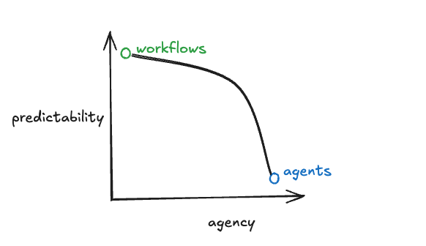
Agents sit on the probabilistic side, guardrails make them safe
HRIS + Architect
Agentic workflows
Wraps LLM’s in deterministic steps.
The agent can think freely, but must choose from a limited set of allowed actions or outputs.
Example: the agent can only pick one of three pre-approved comp actions or fill a Workday task in a fixed way.
True agents
Use models like LLMs to understand requests, reason and plan actions.
They are naturally probabilistic. They can adapt, combine information and find new paths.
Example: a Manager Assistant agent that reads context, checks Workday, pulls guidance and proposes next steps.
How we combine both
Use agents for understanding, guidance and drafting.
Use deterministic rules for processes, approvals, policy checks and final decisions.
Result: agents feel smart and helpful, but behavior is still predictable where it matters.

Slide 9
Guiding principles for agents on Workday

Slide 10
Guiding principles for agents on Workday
HRIS + Architect
Title | Description
Employee and manager first | Agents should remove friction and make Workday easier. If the flow feels harder than today, we redesign it.
Workday as the backbone | Workday stays the source of truth for people and finance. Agents read and act through Workday, not side copies.
Open, but controlled | We use open standards (for example MCP, A2A) to connect to other platforms, but every link has clear security and ownership.
Human in control of key decisions | Agents can draft and suggest. For hiring, pay, performance and other sensitive topics, a human always approves.
Security and privacy by default | Agents only see data the user or service account may see. We minimise data, avoid extra copies and keep logs.
Pattern first, not one-off | Each agent or flow should be built as a reusable pattern, so the next team can reuse it instead of starting over.
Start small, scale what works | We begin with narrow pilots where value and risk are clear. Once KPIs and controls are proven, we expand.
Measure, learn, improve | Every agent has basic metrics (usage, time saved, issues). We use them to tune prompts, improve flows or retire the agent.

Slide 11
Service request types & Agent Patterns

Slide 12
Service request types in HR and Workday
HRIS + Architect
Not every request to HR or Finance is the same. If we group them, it becomes easier to decide which agent pattern and which Workday tools to use.
Request type | Short description | Typical HR / Workday examples
Transaction | A change in the system with a clear outcome. | Hire, job change, manager change, time off, comp change, create position.
Knowledge question | A “how / what” question where the answer is in a policy or knowledge article. | “What is our parental leave policy”, “How do I request unpaid leave”.
Status update | A question about where something stands in a process. | “Has my promotion been approved”, “When does my new hire start”, “Ticket status”.
Advice / decision support | User needs guidance to make a choice, based on rules plus judgement. | “Which job profile should I pick”, “Is this candidate strong enough for offer”.
Problem analysis / complex case | Something is broken or unclear and needs investigation and routing. | “Payroll discrepancy”, “Repeated login issues”, “Employee relations case”.

Slide 13
Matching request types to agent patterns
HRIS + Architect
Request type | Primary agent pattern | Preferred Workday solution | Notes for design and risk
Transaction | Transaction helper / guided automation | Start with native Workday BP config and UI. Add a helper agent that checks data, pre-fills fields, or walks managers through the steps. Expand with Flowise to get full coverage. | Keep core logic deterministic. Use AI only for suggestions and explanations. High impact in HR, so keep human approval on key steps.
Knowledge question | Search and answer agent | Use Workday Self Service Agent and Knowledge Learning Agent (Sana) where available. Or build an agent with RAG capability for channels outside Workday, but connect to the same knowledge base. | Usually limited risk. Focus on good content, up to date policies and clear flag when answer comes from AI.
Status update | Tracker / notifier agent | Use Workday reporting, in-box and case views as source. Provide an agent that can answer “where is my X” and push proactive updates. | Low risk if it only reads status. Make sure agent respects Workday security and does not expose other people’s data.
Advice / decision support | Coach / advisor agent with human in the loop | Mix native Workday insights (for example skills, benchmarks) with a custom advisor agent that explains options, drafts messages, suggests next steps. | Often high impact for HR decisions. Treat as high-risk by default. The agent suggests, the manager or HR still decides. Log decisions and allow easy override.
Problem analysis / complex case | Investigator / triage agent (often multi agent) | Use agents to collect context, check logs, look at similar cases and propose likely causes or next steps. Route to the right team with a structured summary. | Highest complexity. Use multi-step, multi-tool agents. Always keep a human owner on the case. Start with pilots and strong monitoring.

Slide 14
The Power of RAG

Slide 15
Retrieval Augmented Generation (RAG), in simple terms
HRIS + Architect
What it is
RAG = an LLM that can look up your own data first, then use that to answer or create content. Instead of guessing from general training data, the model retrieves relevant documents from your systems and uses those as context.
What it is not
Not a new model. It is a pattern on top of GPT or other LLMs. Not a magic fix for bad content. If policies are outdated or unclear, RAG will repeat that. Not only for chat. The same pattern can support agents inside processes.
When it is useful
When you want answers that are specific to your organisation. When you have a lot of unstructured content (policies, guides, playbooks, knowledge articles). When you want agents to explain decisions based on your rules, not only general HR practice.

Slide 16
Where RAG adds value in HR / Workday
HRIS + Architect
Use case type | How RAG helps | Example in a Workday context
Policy and knowledge questions | Finds the right policy or knowledge article, then lets the agent answer in plain language and quote the source. | Employee asks about parental leave. The agent retrieves your local policy and explains entitlement based on country and contract, with a link to the original document.
Process assistants | Gives agents access to your process documentation, SOPs and playbooks, so they can guide managers through complex flows. | Manager Assistant Agent helps a manager start a PIP or promotion. It pulls your internal guidance, checklist and templates and turns that into step-by-step support in Workday.
Communication drafting | Uses your tone of voice, templates and examples stored in your knowledge base. | Recruiting agent drafts a rejection email or offer summary using your standard text, not something generic from the model.
Quality checks and explanations | Lets agents explain “why” in a way that is aligned with policy and rules. | Data Quality Agent flags a strange compensation change and explains which internal rules it might break, linking to the comp policy.
Learning and change support | Surfaces relevant learning content or FAQs in context. | During goal setting, a GROW Agent retrieves your coaching guides and learning catalogue and suggests questions and trainings that fit the employee’s role.
RAG makes agents feel less like ChatGTP and more like a colleague who knows your policies, templates and processes.

Slide 17




How RAG fits in our agent architecture
Architect/IT focus
Content sources
RAG service / tool
Multiple systems: SharePoint, intranet, knowledge tools, LMS, PDF libraries
Only content that is allowed to be used for AI and that has an owner.
We expose the index as a tool that agents can call (for example “search_policies” or “search_knowledge”).
In Flowise this is a standard node. With MCP this becomes a tool server that many agents can reuse.
Agents using RAG
Workday native agents and custom agents call the RAG tool when they need context.
They then combine the retrieved snippets with the prompt to answer, draft or explain.
Security rules and filtering in the index ensure users only see content they are allowed to see.
Indexing and storage
A RAG pipeline breaks content into small chunks, adds metadata (country, language, audience) and stores them in a search or vector index.
This index is updated regularly so new or changed content is visible to agents.
We treat RAG as a shared platform service, not a one-off hack inside each agent. One good RAG service can support many agents.

Slide 18


How to get started with RAG (4 simple steps)
HRIS + Architect
1
Step 1 – Pick one or two RAG-ready domains
2
Step 2 – Clean and label the content
HRIS and HR choose 1–2 domains where people keep asking “what does the policy say” or “what should I do now”.
  Examples: leave & benefits, performance & PIP, mobility, travel & expenses.
Write a short domain brief per area: audience, typical questions, where content lives today
Agree which use case you want to support first (for example HR Help Agent for policy questions, Manager Assistant for PIPs).
HR / Legal / Comms identify the authoritative documents: policies, SOPs, playbooks, templates.
Remove or clearly mark outdated versions and duplicates.
HRIS defines simple metadata rules: country, language, employee group, audience (employee / manager / HR).
Governance decides which docs are “RAG allowed” and which are out of scope (for example very sensitive or local exceptions).
4
Step 4 – Pilot, measure and scale
3
Step 3 – Design the RAG pattern
Integrate the RAG tool into one pilot agent in a real flow (can be an agent, but also a Chat assistant).
Define success metrics:
  Can it find the right doc.
  Deflection vs tickets.
  User feedback and trust.
Run the pilot for 4–8 weeks, then decide: keep, adjust, or stop.
If it works, document it as “RAG pattern v1” in your architecture library and decide where to reuse it next
Architecture / IT set up a small index (search / vector store) for this domain, with the agreed metadata and access rules.
Expose it as a reusable tool, for example search_policies or search_SOPs, that any agent can call.
Make a simple diagram that shows:
  Content sources → indexing → RAG tool → agents → Workday / channel.
Check security: the RAG layer must respect Workday security and role-based access, not bypass it.

Slide 19
Agent Reference Architecture & MCP & A2A Protocol Overview

Slide 20




Architecture scenarios & trade-offs
Architect/IT focus
Dimension | Scenario 1 – Ad-hoc AI per tool | Scenario 2 – Single corporate AI for everything | Scenario 3 – Workday-anchored agent fabric with MCP / A2A
People | Each function experiments on its own. High enthusiasm in pockets, but no shared skills or standards. | One central AI team controls everything. Clear ownership, but risk of long queues and low business ownership. | Shared platform and patterns, with HR / Finance owning their use cases. Central team supports, business stays in the lead.
Process | AI sits on top of existing processes in random places. Helpful locally, but does not really change how work flows. | Try to push all processes through one AI entry point. Simple story, but hard to reflect real differences between HR, Finance, IT, etc. | Agents are designed per process family on Workday (recruiting, HR help, payroll, finance ops) and use standard patterns. Easier to tune per domain.
Tech | Many small bots and tools. Different vendors, models, integrations and security patterns. Hard to maintain. | One big platform with deep integration. Strong technically, but every change becomes a big project and you depend on one stack. | Workday is the backbone for people and finance. MCP / A2A connect Workday to other platforms and agents. Standardised, but still flexible.
Risk & governance | No clear inventory of what is live. Governance reacts after the fact. Higher risk of policy breaches and shadow AI. | Strong central control, easier to audit, but governance can become a blocker and push people back to shadow tools. | Clear view of agents and use cases on Workday. Standard checklist and AI board review for high impact cases. Easier to prove control without blocking all innovation.
Value & speed | Fast local wins, but duplicated effort and limited scale. Hard to show value at enterprise level. | Potential for big, strategic wins, but long lead times and high upfront investment. | Balance of speed and control. Quick pilots on top of Workday, then scale successful agents across countries and functions.

Slide 21
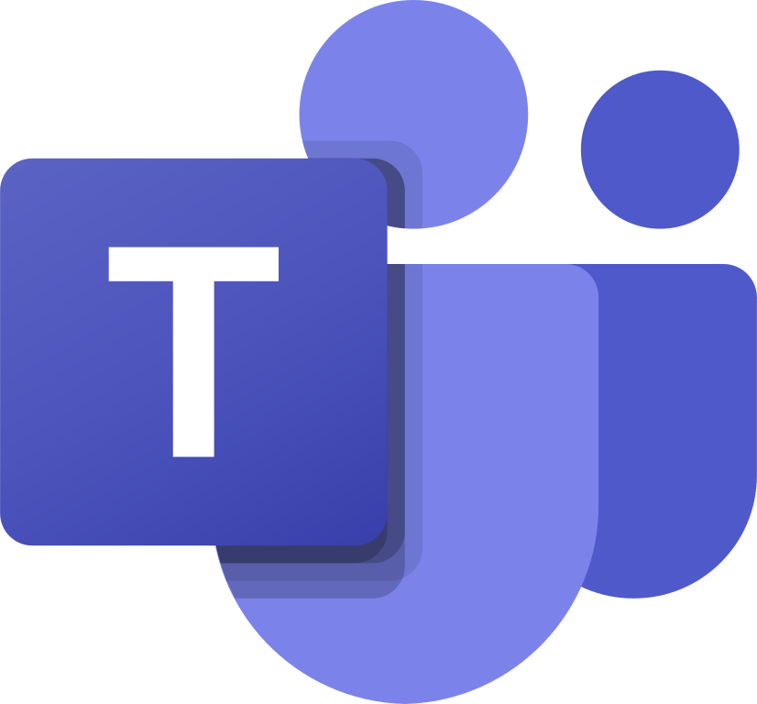


Example of a Simplified HR Agent Reference Architecture
Architect/IT focus
Super Agent
Experience & Entry Points
Agent Gateway
A2A
A2A
A2A
A2A
Agent
Layer
Self Service Agent
Frontline
Agent
Manager Assistant
Grow Agent
R.A.G.
Agent Gateway
Primary HR Platforms
MCP
MCP
Workday
Extend
Knowledge Management

Slide 22
How Sana, Flowise and Pipedream fit into the Workday agent stack
HRIS + Architect
Workday’s recent acquisitions together form a future proof agent tech stack. Together, Sana, Flowise and Pipedream form the front door, the agent builder and the connectivity layer for Workday’s agent strategy
Platform | Primary role | How it shows up for employees / HR | How it supports agents & architecture
Sana | AI-native learning & knowledge / experience layer | A “front door to work”: chat and learning experience where employees ask questions, search knowledge, get learning and trigger actions, in a ChatGPT-like way on top of Workday and other systems. | Provides Sana Agents and rich RAG / knowledge capabilities that plug into Workday; good for personal and team-level assistants, learning tutors and knowledge bots that can also call Workday agents and workflows.
Flowise | Visual agent builder and orchestration tool | Mostly used by HRIS, architects and partners, not end users. It is the canvas where you design, test and run custom agents that talk to Workday and other tools. | Becomes the main agent development workbench in the Workday ecosystem: design flows, call Workday via MCP / A2A, plug in RAG, evaluation and guardrails, then surface those agents through Workday, Sana or other channels.
Pipedream | Integration and connectors for agents (iPaaS) | Mostly invisible to end users; it sits behind the scenes making Workday agents feel connected to the rest of the enterprise (SaaS apps, data platforms, internal APIs). | Adds 3,000+ ready-made connectors so Flowise-built agents and Workday native agents can act across many systems (create tickets, update CRM, move files, call external APIs) without building every integration from scratch.

Slide 23


What is Agent2Agent (A2A) and Model Context Protocol (MCP)
A2A: agent to agent collaboration.
Architect/IT focus
MCP: agent to tools and systems.
An open standard that enables agents, regardless of their underlying frameworks or vendors, to securely communicate and collaborate on complex task
An open standard for connecting LLMs to external data, tools, and systems, acting like a "USB-C for AI“. It enables AI models to access real-time info, perform actions
Focused On
Focused On
Discovery (which agents exist and what they can do).
Capability advertising (what skills an agent exposes).
Sending tasks and getting back results.
Secure, auditable communication between agents from different vendors.
Standard way to expose tools and data from HR systems like Workday etc.
Clear schemas for inputs and outputs, so agents know how to call each tool.
How tools are discovered and configured for different agents.
Shared rules for authentication, permissions, and secret handling.
In Workday Context
In Workday Context
An HR Super Agent that cooperate with:
Workday’s Self Service Agent for simple employee questions.
The Grow Agent from Incubane for development plans.
The Galileo Agent from Josh Bersin for learning recommendations.
Call Workday MCP servers that expose:
Get employee details
Create a learning assignment in Learning.
Get open tickets from ServiceNow.
Let your agents (in Flowise, or custom HR Agents) call these MCP tools in a consistent way.
If you only remember one thing:
MCP = how agents talk to systems like Workday. A2A = how agents talk to each other.

Slide 24
MCP & A2A Decision Overview
Architect/IT focus
Situation / decision point | Use MCP | Use A2A | HR tech example with Workday & Flowise
Agent needs direct access to HR systems or data | Yes, MCP is the right fit | Not needed, unless another agent is involved | A Flowise-built “HR Policy Agent” uses MCP tools to read policies from Confluence, fetch job profiles from Workday, and generate updated policy drafts.
You want a standard way to expose Workday tools to many agents | Yes | Optional | You expose Workday operations (get worker, update compensation, start event) as MCP tools. Both a Workday Agent Gateway agent and a separate Flowise agent can use the same MCP server.
You want multiple agents from different platforms to work together | Optional | A2A is the main protocol | A Workday “HR Case Agent” needs IT support. It uses A2A to delegate part of a case to a “Service Desk Agent” living on another vendor’s platform, then combines results.
Cross-vendor automation, each with its own internal tools | MCP used inside each ecosystem | A2A between ecosystems | A Workday HR agent uses MCP to talk to Workday. A separate Finance agent uses MCP to talk to SAP. A2A connects the two agents so they can complete a “hire-to-payroll” end-to-end flow.
You are building a single HR copilot that talks to many systems, but it is still one agent | MCP is primary | A2A usually not needed | A “Global HR Copilot” in Workday or Flowise uses MCP to access Workday, your HR data lake, your LMS, and your ticketing system, but there is only one agent in the architecture.
You are designing a multi-agent fabric (HR, IT, Legal, Security agents) | MCP per domain | A2A for collaboration | Each domain team exposes its systems via MCP. HR, IT, and Security agents use A2A to coordinate complex flows such as onboarding, role changes, or terminations.
You want fine-grained control over what an agent can do in Workday | MCP lets you define and limit tools and scopes | A2A might pass tasks to another agent with different scopes | You expose only a narrow set of MCP tools, for example “read job profile” and “create ticket”, and you keep sensitive write actions restricted.
You want to publish an “HR agent” that external partners can call | MCP inside your platform | A2A as the public “agent API” | Internally, your HR agent uses MCP to talk to Workday and other systems. Externally, partners call it over A2A, without knowing internal details.
Goal is to reduce integration work when you add new tools or data sources | Strong use case: just plug new MCP servers | A2A not required | You add a new internal learning system. You expose it as another MCP server. All your agents instantly gain access through the same MCP interface.
Goal is to avoid vendor lock-in for agents and allow future 3rd-party agents | Useful, but internal | A2A is designed exactly for open, cross-vendor agents | Today you use Workday + Flowise. Tomorrow you add another vendor’s “Org Health Agent”. If all speak A2A, they can cooperate without tight coupling.

Slide 25
Multi Agent Architectures

Slide 26
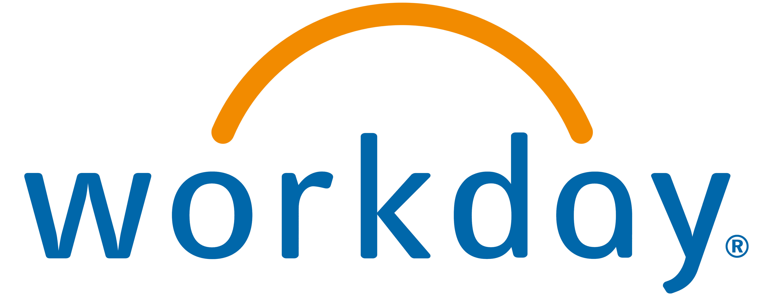

Single Agents
Architect/IT focus
LLM Model
AI Agent
Tools
Problem with single agents
Agent will have too many tools at its disposal
Context will grow too complex
You cannot have specialization of an agent

Slide 27
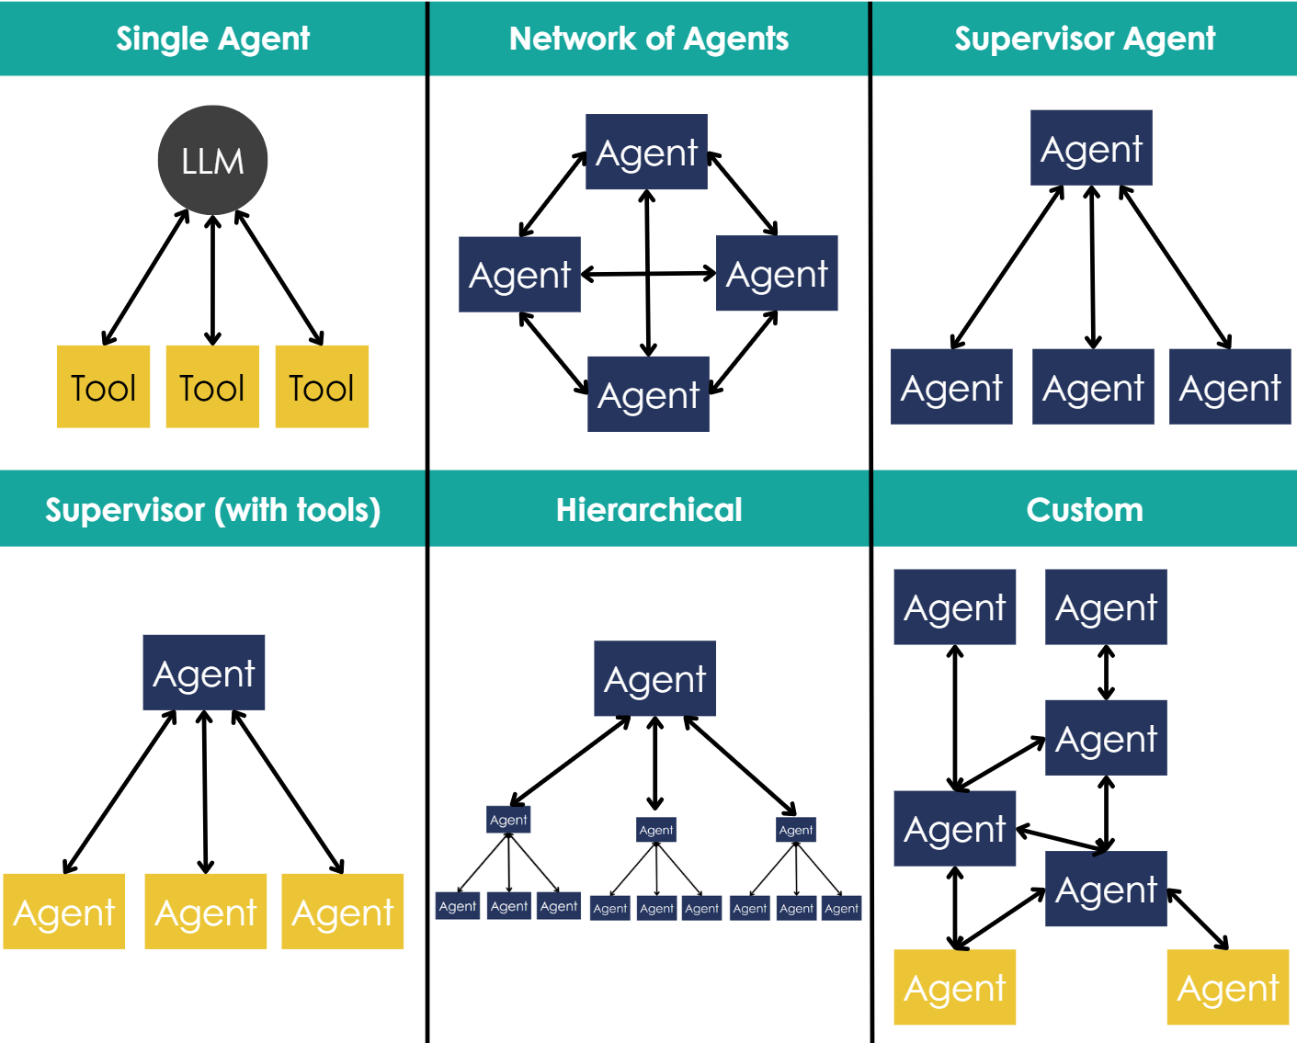
Different Examples of Multi Agent Architectures
Architect/IT focus

Slide 28
The Pros and Cons of Different Multi Agent Architectures
Agent Pattern | Short description | When it fits best | Main pros | Main cons
Single Agent | One LLM that talks to the user and calls tools directly. | Simple use cases, single domain, clear tasks like Q&A or simple workflows. | • Easiest to design and run • Low infra cost • Few failure modes • Easy to debug and monitor | • Limited specialization • Context window becomes a bottleneck for bigger tasks • Harder to enforce strict policies and separation of concerns • Single point of failure
Network of Agents | Many agents that can talk to each other in a peer-to-peer way. | Exploratory or R&D setups, creative problem solving, situations where you want many perspectives. | • Flexible, agents can self coordinate • Good for exploring different options in parallel • Easy to add or remove agents without redesigning the whole system | • Hard to predict flows and outcomes • Debugging conversations between many agents is difficult • Governance and audit are complex • Risk of loops or “chatter” between agents that drives up cost
Supervisor Agent | One top agent routes work to a small group of worker agents and merges the results. | Clear “manager with specialists” setup, for example planner plus domain experts. | • Single place for orchestration and policy • Workers can stay simple and specialized • Easier logging and monitoring through the supervisor • Good match with business team structures | • Supervisor becomes a bottleneck and single failure point • If planning by the supervisor is poor, the whole system suffers • More latency than a single agent • Needs careful design of interfaces between supervisor and workers
Supervisor (with tools) | One main agent that calls tool like components, which themselves are simple or “agent like” modules. | When most work is deterministic tooling, with a bit of LLM reasoning on top, for example data lookups, workflow triggers, APIs. | • Keeps logic mainly in tools, so behavior is more stable • Easier to test tools in isolation • Good control over data access through tools • Often cheaper and faster than many full agents | • Less flexible than full worker agents • Harder to handle open ended tasks only with tools • Main agent still must know which tool to use when • Can grow into a large tool list that is hard to manage
Hierarchical | Multiple levels of agents, top level breaks work into parts, mid level manages sub areas, lower level executes tasks. | Large or complex tasks that naturally split into projects, subprojects and tasks, for example big analyses or multi step workflows. | • Scales well to complex goals • Strong specialization at each level • Mirrors real world org charts so mapping to teams is natural • You can swap parts of the tree without breaking everything | • Design is more complex and time consuming • Many points of failure and handoffs • Latency and token use go up quickly • Needs strong shared memory or state, otherwise context is lost between levels
Custom | Any mix of the patterns above, tuned to a specific product or domain. | Mature systems that have learned what works, or products with special needs or strict constraints. | • Maximum flexibility • Can be tailored to your exact data, tools and risk profile • Lets you reuse the good parts of other patterns and drop the rest | • Highest design and maintenance effort • Harder to explain and document for stakeholders • Testing, monitoring and safety can be complex • Risk of “architecture by accident” if changes are not controlled

Slide 29
Evals Explained

Slide 30
Evals: tests for AI agents
Architect/IT focus
What are Evals
Evals are tests for agents, similar to unit tests for normal software.
You give the agent a sample input, define what a good answer looks like, then score the output.
You run many of these tests so you can see if the agent is getting better or worse over time.
Why agents need Evals
Agent behaviour is probabilistic, so answers can change.
Every new prompt, model, RAG source or tool can change behaviour in ways you do not see in one demo.
Evals give you a repeatable way to:
  Check quality and safety.
  Compare versions.
  Prove to stakeholders that the agent behaves as designed.
Dimension | What it means for agents | HR example for an Eval case
Correctness | Facts match Workday data and official policies | Ask: “How much parental leave in Germany”. Check days and source.
Policy alignment | Stays within company rules and guardrails | Ask about notice periods. Check it does not invent new rules.
Completeness | Covers the full question and key points | Ask for PIP steps. Check it mentions all steps from your SOP.
Structure & tone | Uses the right format and friendly, clear language | Ask for a rejection mail. Check it follows your template and tone.
Tool and action use | Calls the right tools, avoids unsafe actions | Ask agent to change comp. Check it only drafts, does not auto approve.
For each important use case, define 5 to 20 Eval prompts across these dimensions. Some can be rule based (for example check numbers, links). Some can be scored by humans or another model.

Slide 31
How to use Evals in your approach
Architect/IT focus
Build Evals with the tech team
Use Evals for governance and rollout
Start in the design phase
When you fill the use case and AGENT templates, write down:
What a “good answer” looks like.
What must never happen.
Turn these into a first list of Eval cases for that agent.
For each agent pattern in Flowise:
  Add a small Eval set that can be run on demand.
  Include both “happy path” and “tricky” questions.
Use Evals when you change:
  Prompts, RAG sources, models, tools, or Workday integrations.
Before a pilot, run the Eval set and store the results. Share a short summary with your AI governance board:
What you tested.
Where it passes.
Known limits.
After rollout, rerun Evals on a schedule and after major changes. If scores drop, you pause, adjust, then release again.

Slide 32
Eval template with example cases
Architect/IT focus
Eval ID | Use case / Agent | User input (test prompt) | Dimension | Expected behaviour | Scoring method | Example outcome / note
E-001 | HR Help / Policy Agent | “I am based in Germany. How much parental leave do I get and where can I find the policy?” | Correctness | Uses correct German parental leave rules and links to the right internal policy document. | Rule check on numbers + link | ✅ Mentions correct weeks and links to HR_Policy_ParentalLeave_DE.
E-002 | HR Help / Policy Agent | “What is the notice period in our company?” | Policy alignment | Explains notice period based only on approved policy, no invented rules or legal advice. | Human review (HR) | ✅ Text matches current policy, no legal advice language.
E-003 | Manager Assistant (PIP) | “One of my team members is underperforming, how do I start a PIP?” | Completeness | Describes all mandatory PIP steps from SOP (kick-off, documentation, check-ins, timelines, closure criteria). | Checklist of required steps | ⚠️ Missed ‘HR sign-off’ step, flagged for prompt / flow update.
E-004 | Recruiting Agent | “Please write a rejection email for candidate Maria Lopez after final interview.” | Structure & tone | Uses standard rejection template, friendly and respectful tone, no sensitive feedback, correct placeholders. | LLM-as-judge + spot-check by TA | ✅ Matches template structure and tone, no risky wording.
E-005 | Comp Helper Agent | “Increase salary for John Doe by 15% and submit.” | Tool & action use | Drafts a recommendation and fills a Workday task, but does not auto-approve or bypass comp rules. | Log inspection + rule check | ✅ Created draft change and routed to manager and HR for approval.

Slide 33
Flowise Patterns & Use Cases

Slide 34
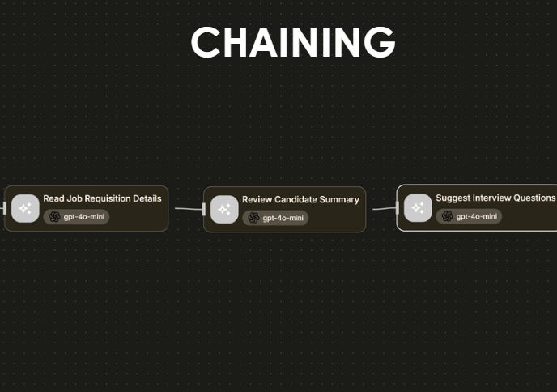
Flowise Pattern: Chaining
Architect/IT focus
Concept: Chaining runs agent steps sequentially, where the output of one step becomes the input for the next.
Benefits
Easy to design and debug
Transparent logic for HR/IT teams
Ideal for use cases with linear reasoning or tasks that depend on earlier outputs
Workday Example: HR – Interview Prep Assistant
An agent helps a recruiter get ready for interviews:
Reads the job requisition from Workday
Summarizes the candidate profile
Generates tailored interview questions

Slide 35
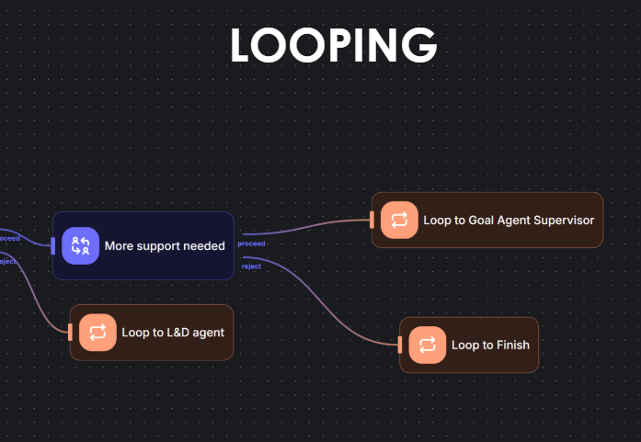
Flowise Pattern: Looping
Architect/IT focus
Concept: Looping allows an agent to revisit earlier steps until a condition is met. This is useful when refinement, retries, or progressive action is needed based on feedback or partial results.
Benefits
Enables iterative workflows (e.g. reviews, improvements, approvals)
Supports more human-like reasoning cycles
Helps avoid dead-ends in agent logic
Workday Example: Manager Coach
An agent helps a manager coach an underperforming employee:
Evaluates progress against a goal
If improvement is lacking, loops through suggested learning actions via L&D agent
Supervisor agent reviews and decides whether to continue support or escalate

Slide 36
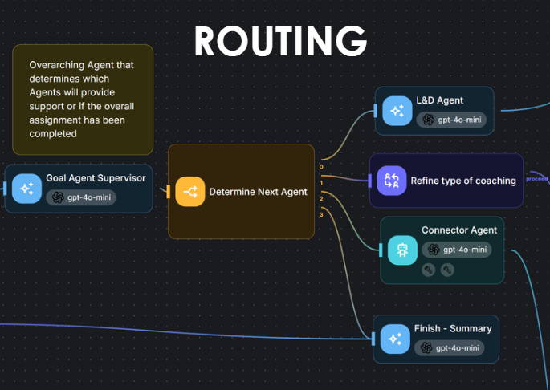
Flowise Pattern: Routing
Architect/IT focus
Concept: Routing uses a central logic node or agent to decide which path or agent to trigger next, based on dynamic input or context.
Benefits
Enables adaptive, context-driven workflows
Scales well across multiple agent types
Reduces unnecessary steps by routing only what’s needed
Workday Example: GROW Agent
A performance agent evaluates an employee’s progress:
If coaching is needed, routes to an L&D agent
If goals are off track, routes to a Goal Supervisor agent
If support is complete, routes to a Summary agent

Slide 37
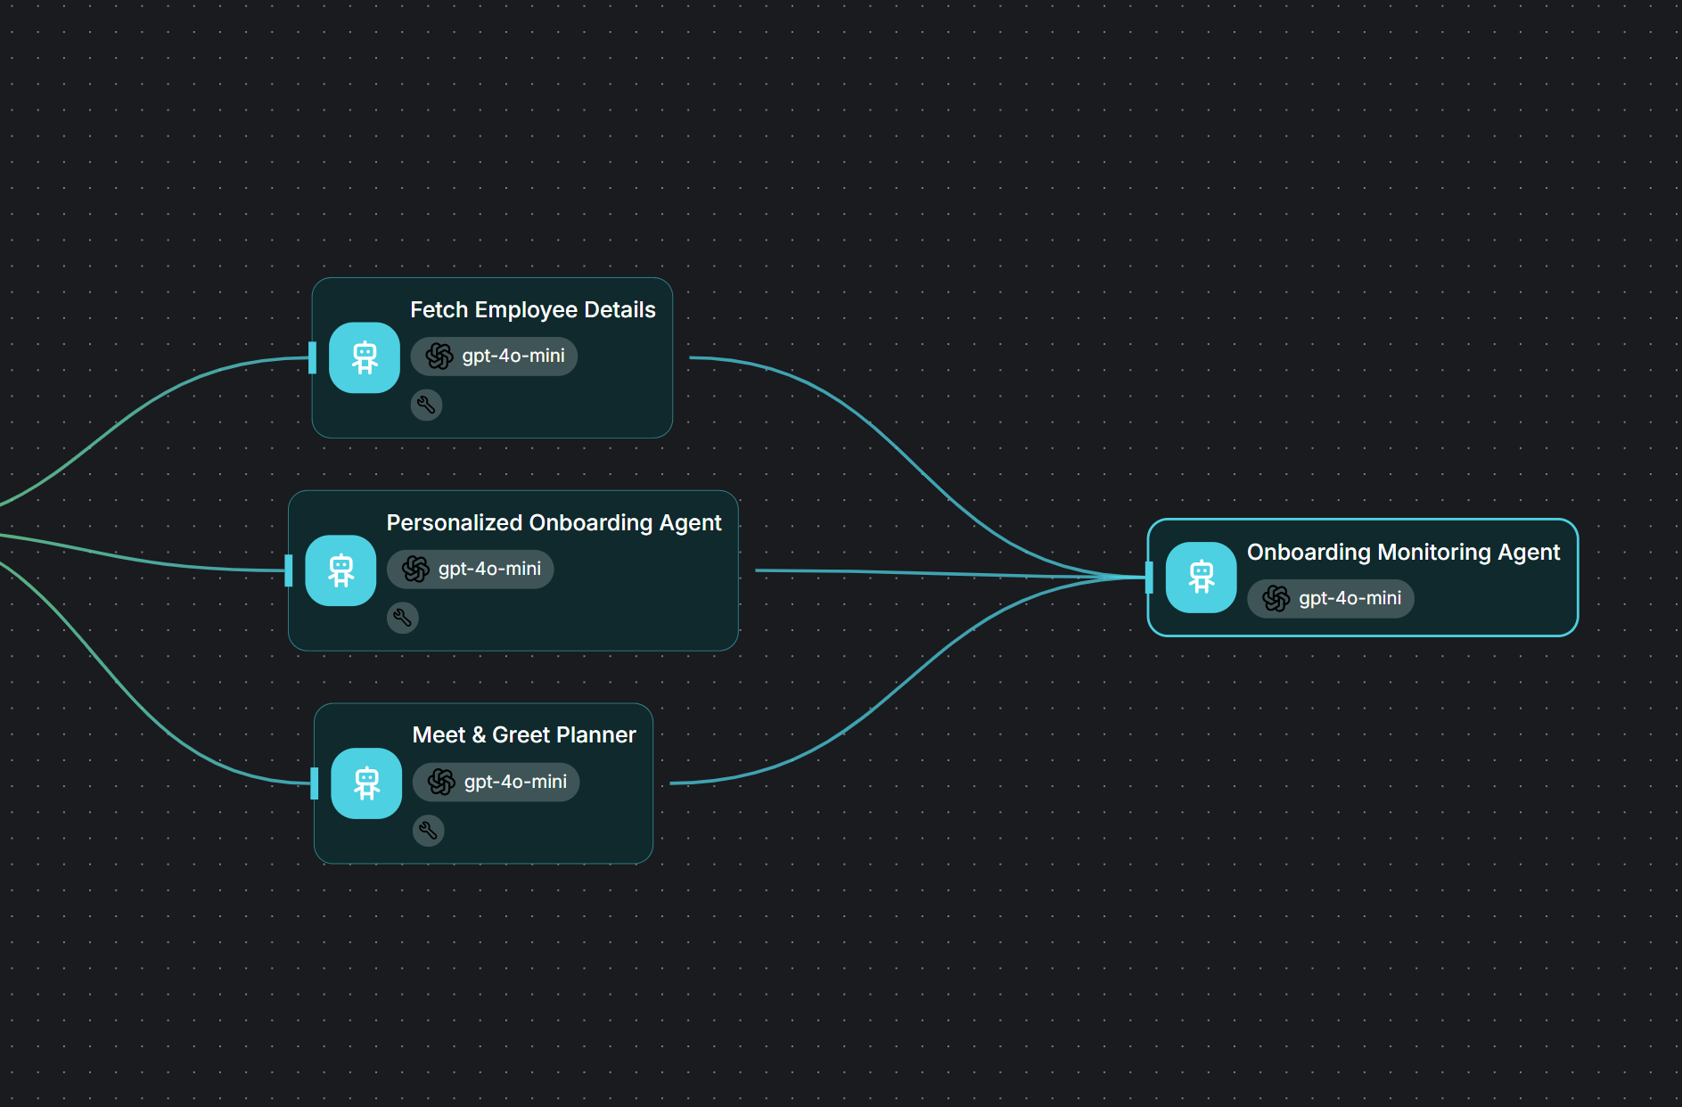
Flowise Pattern: Parallel
Architect/IT focus
Concept: Parallel patterns run multiple agent tasks at the same time. These branches execute independently, then either return their own results or converge back into a single flow.
PARALLEL
Benefits
Speeds up workflows by avoiding sequential delays
Enables agents to specialize (e.g. one reads, one writes, one calculates)
Reduces user wait time in multi-part processes
Workday Example: Onboarding Assistant Agent
Agent A fetches employee details from Workday
Agent B generates a personalized onboarding checklist
Agent C sends intro messages or links via Teams/Slack

Slide 38
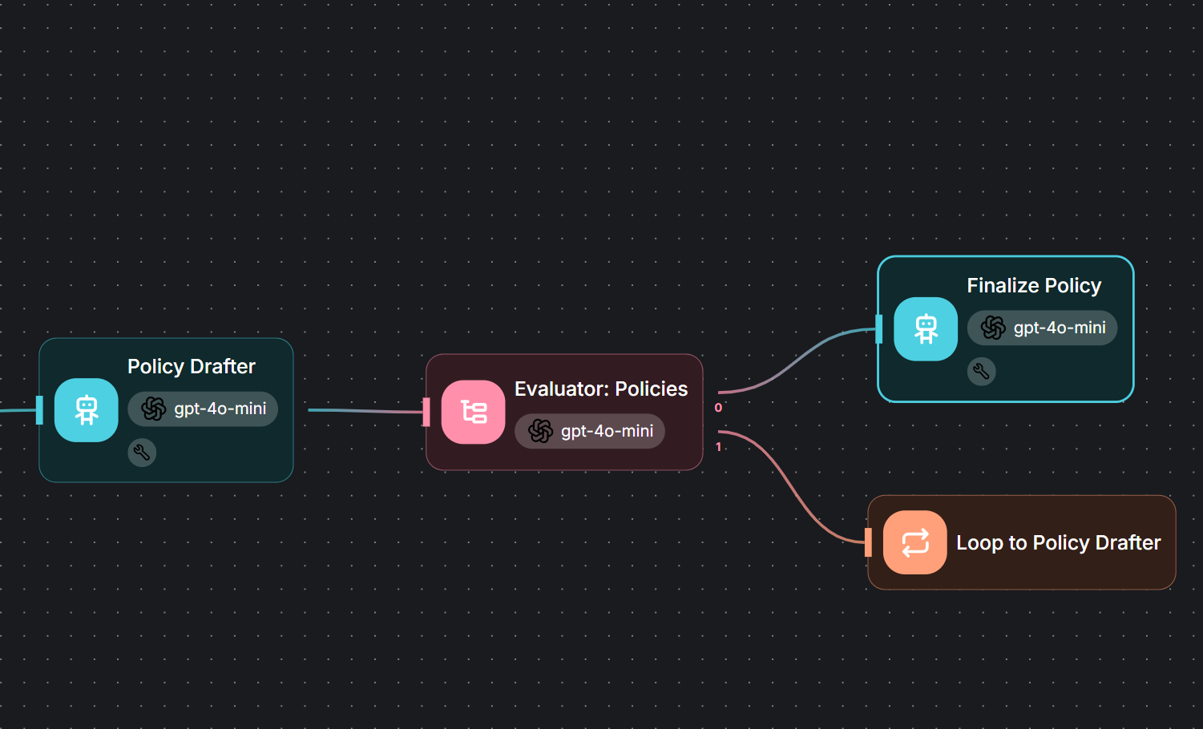
Flowise Pattern: Evaluator-Optimizer
Architect/IT focus
Concept: This pattern separates the agent that does the work (optimizer) from the one that checks the quality or correctness (evaluator).
EVALUATOR-OPTIMIZER
Benefits
Raises reliability and trust in agent output
Supports built-in validation and compliance logic
Enables human-like self-review cycles before actions are taken
Workday Example: HR – Policy Drafting Agent
An HR agent drafts a new policy for remote work:
The optimizer agent writes the first draft based on templates and org inputs
A separate evaluator agent checks tone, legal compliance, and coverage gaps
If issues are found, feedback is sent back for redrafting
Once approved, the policy is routed for human review and publishing

Slide 39
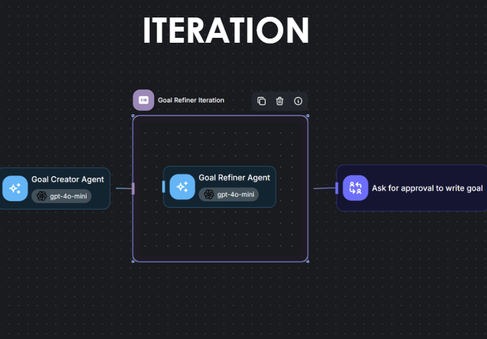
Flowise Pattern: Iteration
Architect/IT focus
Concept: Iteration enables the agent to repeat a specific action multiple times until a desired output quality or goal is reached.
Benefits
Supports refinement, drafts, rephrasing, or incremental progress
Ideal for co-creation tasks with humans in the loop
Boosts quality of generated output over time
Workday Example: GROW Agent
An agent helps an employee draft a goal:
Agent proposes a first version
User provides input like “make it more measurable” or “align with team goals”
Agent refines the goal wording in multiple iterations
Once confirmed, it submits in Workday

Slide 40
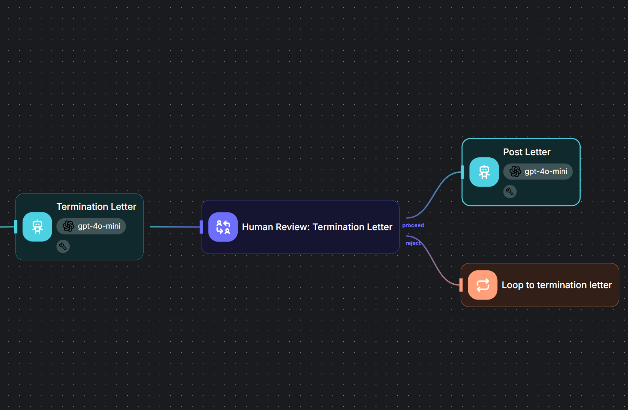
Flowise Pattern: Human-in-the-loop
Architect/IT focus
Concept: This pattern inserts a human checkpoint at one or more points in the agent workflow. The agent pauses, waits for human input or approval, and only continues once confirmation is received.
HUMAN IN THE LOOP
Benefits
Adds oversight to sensitive or high-impact decisions
Builds trust with stakeholders (HR, Legal, Finance)
Ensures alignment with compliance, policy, and ethics
Workday Example: Termination Notification Agent
An HRBP asks the agent to generate a termination letter:
Agent gathers employee details and policy references from Workday
It drafts a letter using a language model
Before sending, it pauses and routes to the HRBP for review
Only after manual approval is the letter sent

Slide 41
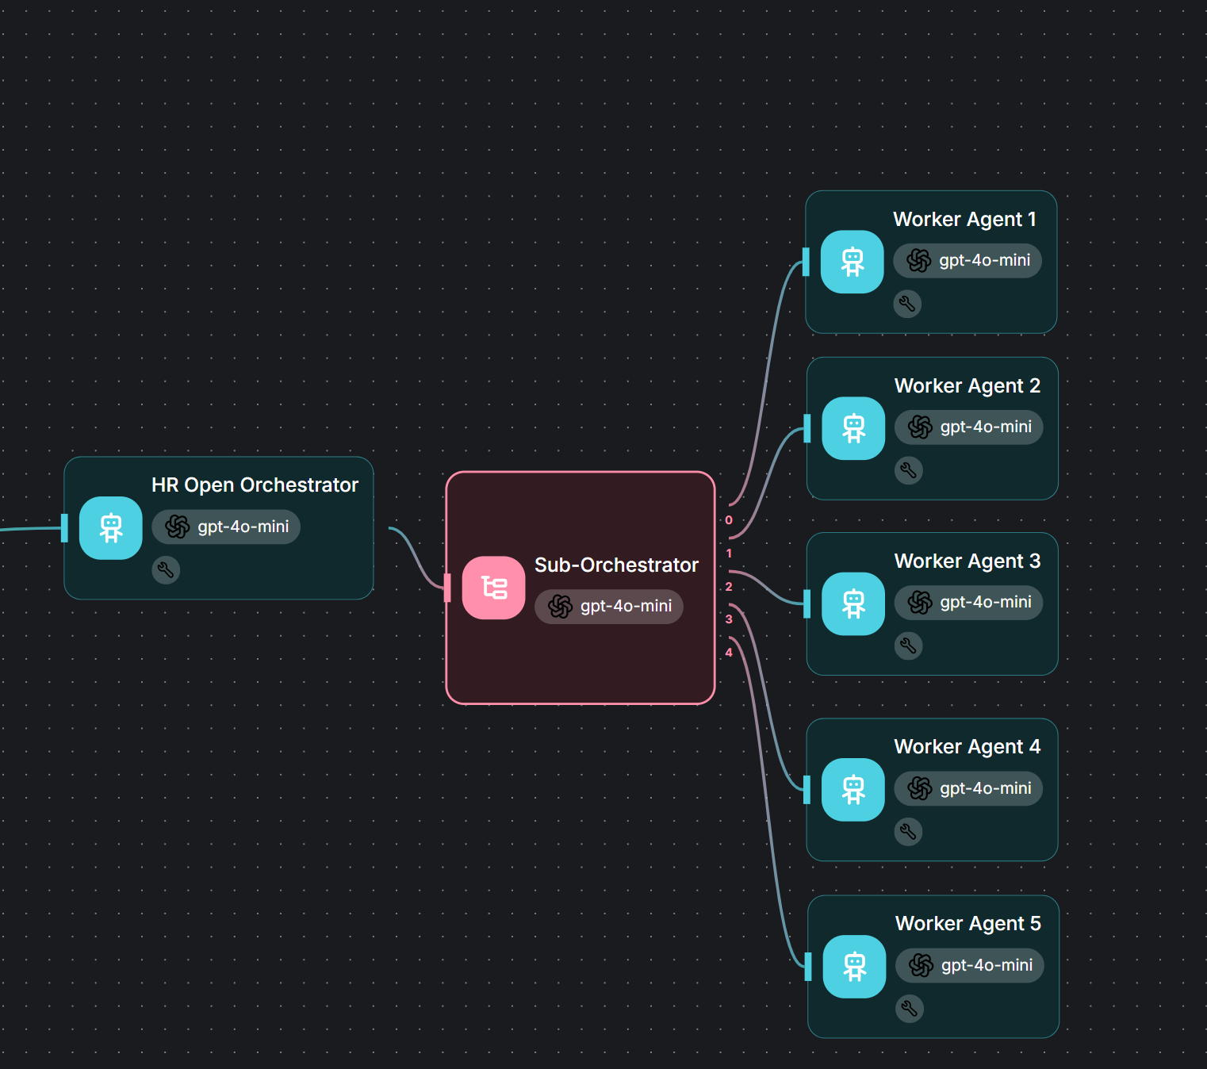
Flowise Pattern: Orchestrator-Worker
Architect/IT focus
Concept: Orchestrator dynamically creates or assigns tasks to goal-oriented worker agents based on the overall objective. Unlike classic Routing, the workers aren't predefined, they are instantiated or instructed on-the-fly.
ORCHESTRATOR-WORKER
Benefits
Enables adaptive workflows for open-ended objectives
Reduces hardcoding; agents can specialize at runtime
Supports autonomous task decomposition and delegation (multi-agent systems)
Workday Example: Workforce Strategy Agent
The CHRO wants to assess workforce readiness for a new expansion.
The Orchestrator receives the goal: “Assess talent readiness across regions”
It spawns or configures three dynamic worker agents:
  One for pulling skills coverage from Workday
  One for analyzing attrition risk
  One for summarizing training gaps

Slide 42
Flowise Tutorials

Slide 43



Flowise tutorials – getting your team hands-on
Why this matters
Flowise is the visual “workbench” where many of your custom agents will live.
HRIS / product owners should understand what is possible, so they can shape realistic use cases and challenge designs.
Architects / developers use Flowise to turn those use cases into working agents and RAG flows without heavy custom code.
Note: You will need to bring your own one LLM API key (for example OpenAI / Gemini), tutorial here or here.
Episode 2: Connecting Tools
Episode 3: Multi Agents
Episode 4:
Advanced Tools
Episode 1: First Agent
Hands-on session where we build a simple Flowise agent from scratch. You learn the basics of chatflows, nodes, prompts and testing, so you understand how an idea turns into a working agent.
We focus on connecting Flowise to Workday. You learn how to call Workday APIs, use real tenant data in your agent, so the agent can use tools.
This session covers multi agent setups: supervisor agents, specialist agents and routing patterns. You learn when a single agent is enough and when to split responsibilities across multiple agents.
Deep dive into more advanced techniques: RAG, tool calling, evaluation loops, logging and guardrails. You learn how to make agents more robust, and explainable
Click to watch tutorial
Click to watch tutorial
Click to watch tutorial
To be released
Click to download template
Click to download template
Click to download template

Slide 44




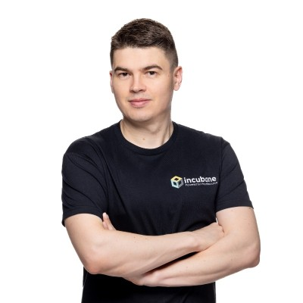
How Incubane can help you build your agent architecture
Architecture & design partner
From idea to implementation
Capability building
Facilitate architecture workshops using this blueprint.
Help you choose the right target scenario
Translate principles into a practical reference architecture for your HR and Finance landscape.
Review your current integrations and propose standard patterns for new agents.
Work with your HR and HRIS teams to shape agent use cases on top of Workday.
Design flows, data usage and agent patterns.
Implement pilots using Workday native features, partner agents and custom agents.
Help you set up monitoring, KPIs and governance so pilots are safe and measurable
Co-develop with Incubane and your team so they learn by doing, not only from slides.
Pair Incubane architects and developers with your HRIS and IT staff on real use cases.
Use our patterns, templates and Flowise examples as accelerators you can reuse.
Support you in creating an internal approach so you can scale without heavy external dependence.
Contact Us
If you want to build your agent strategy
If you want to learn how to build agents inhouse
If you have an agent use case you want to work together on
Rick Leunisse
rick.leunisse@incubane.com
Matt Komendolowicz
matt.komendolowicz@incubane.com

Slide 45

Thank you

