Slide 1

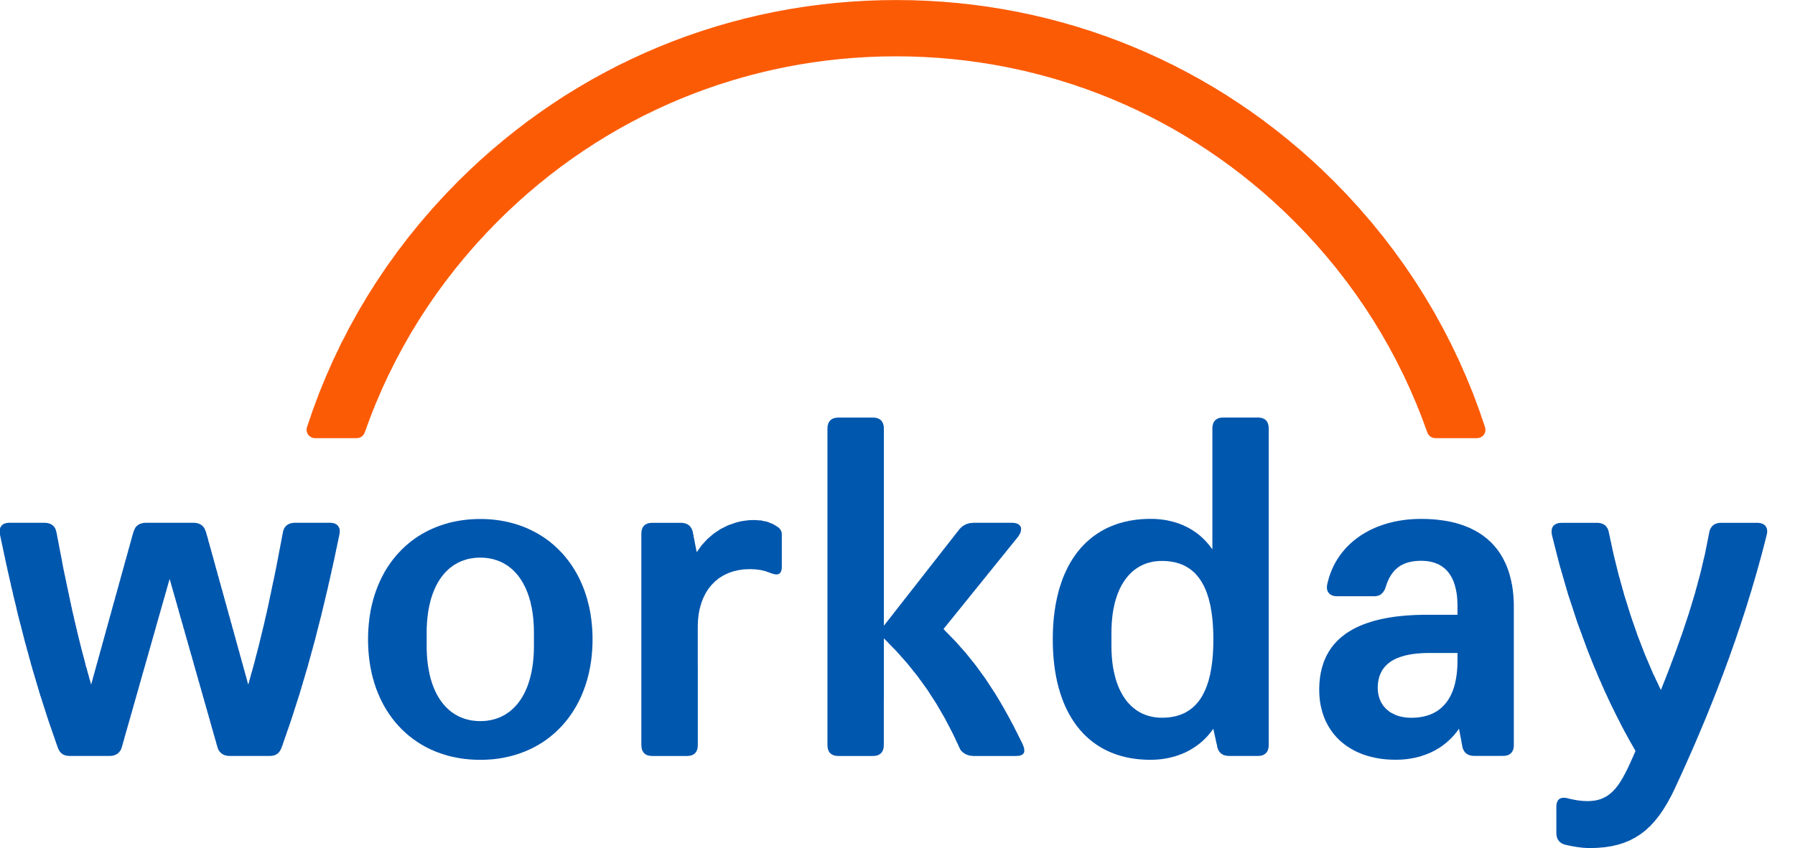
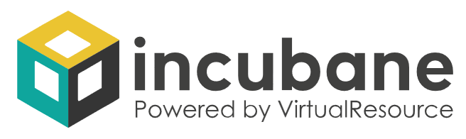

HRIS Agent Strategy Blueprint
Strategy & Vision

Slide 2




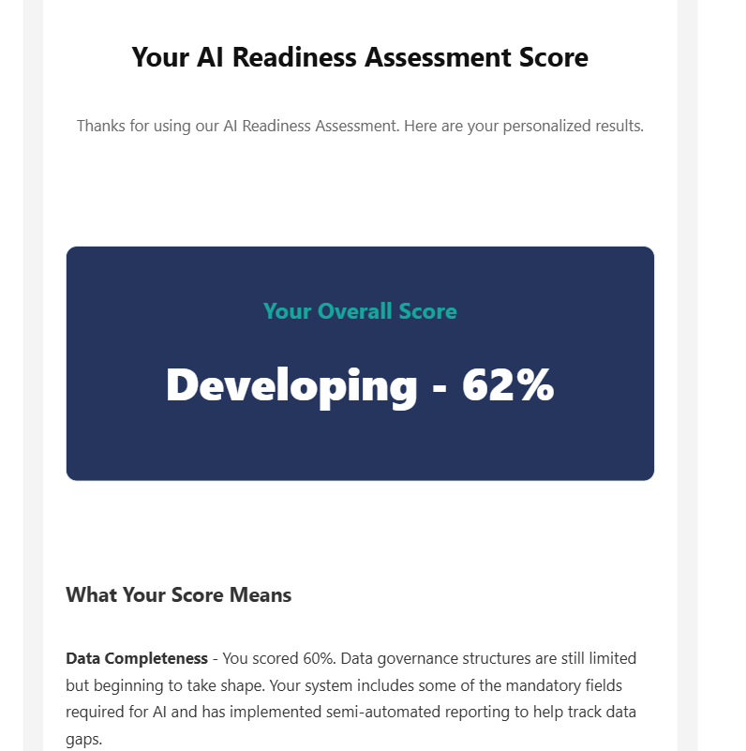
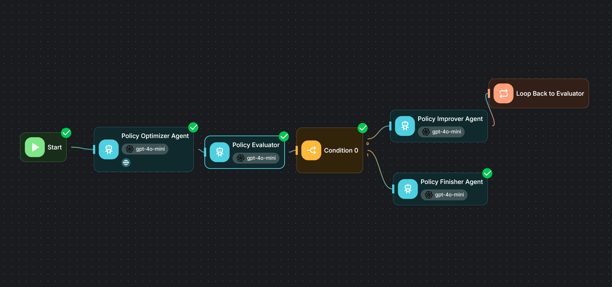
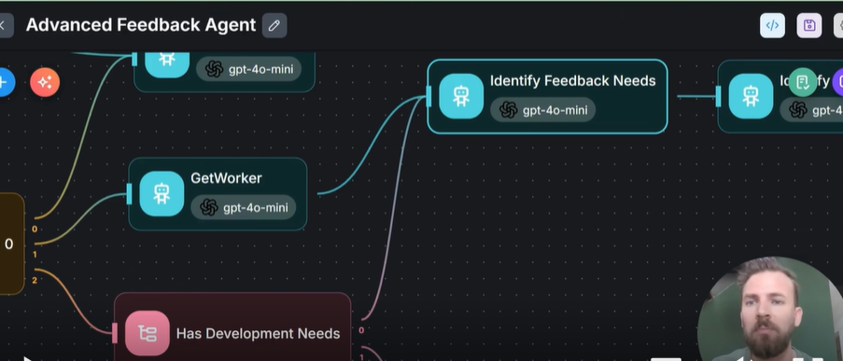
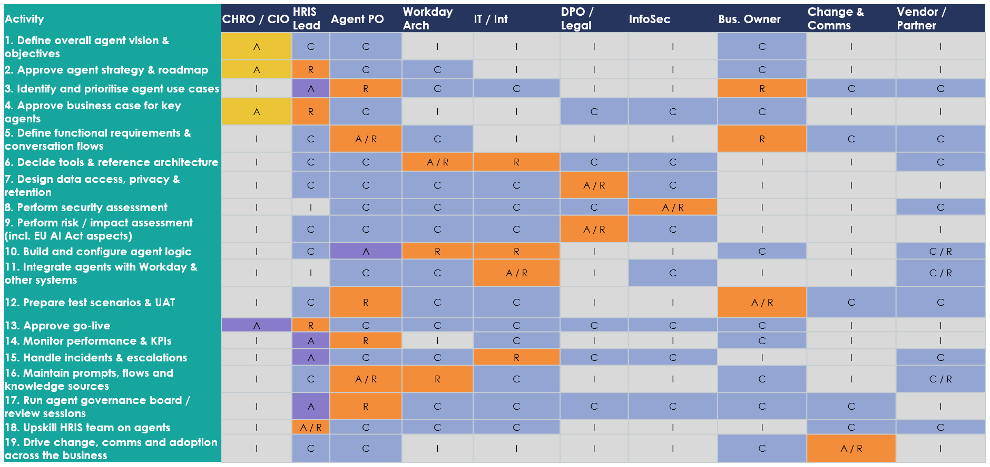
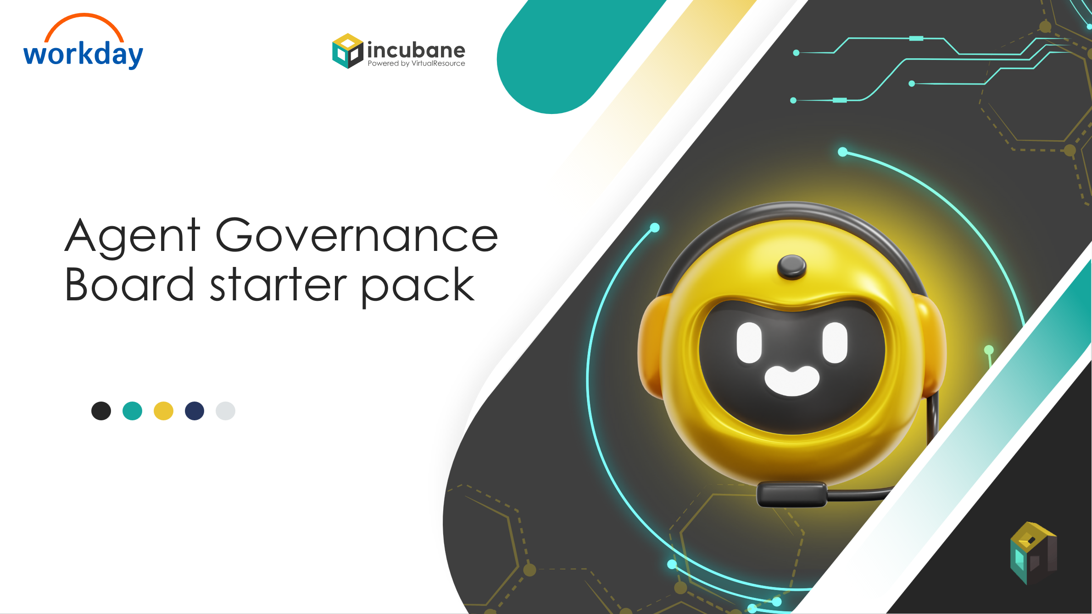
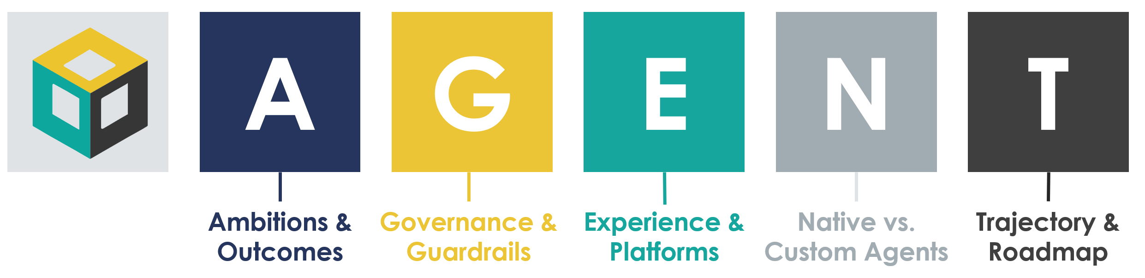
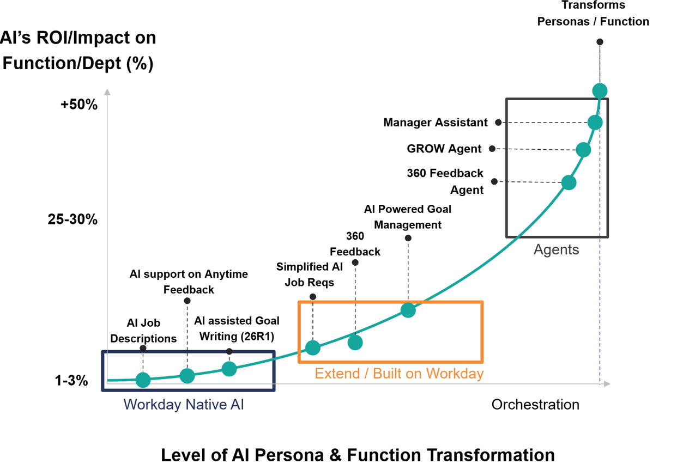
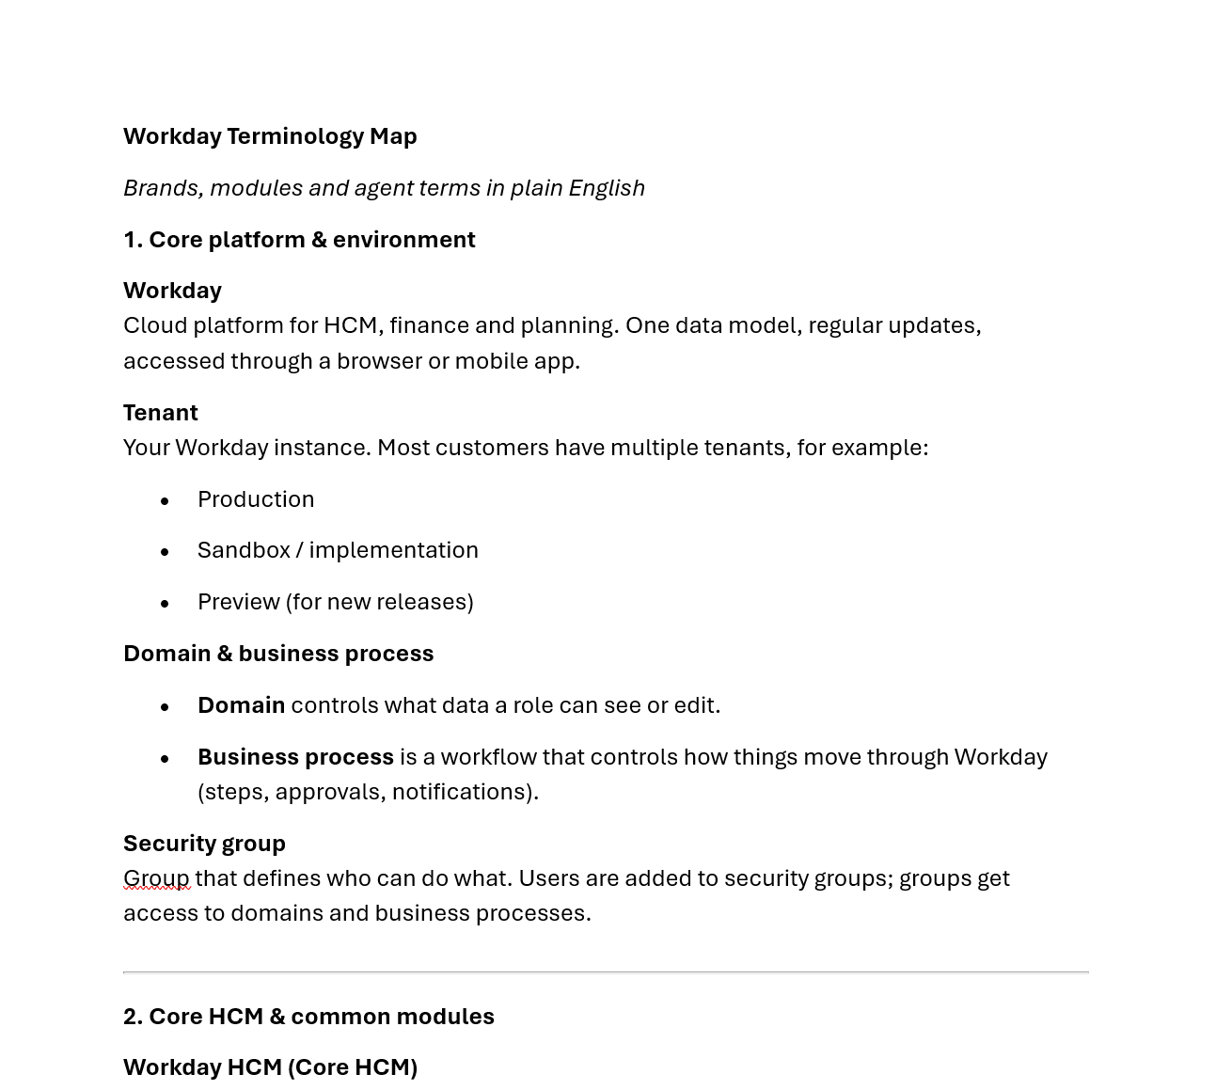
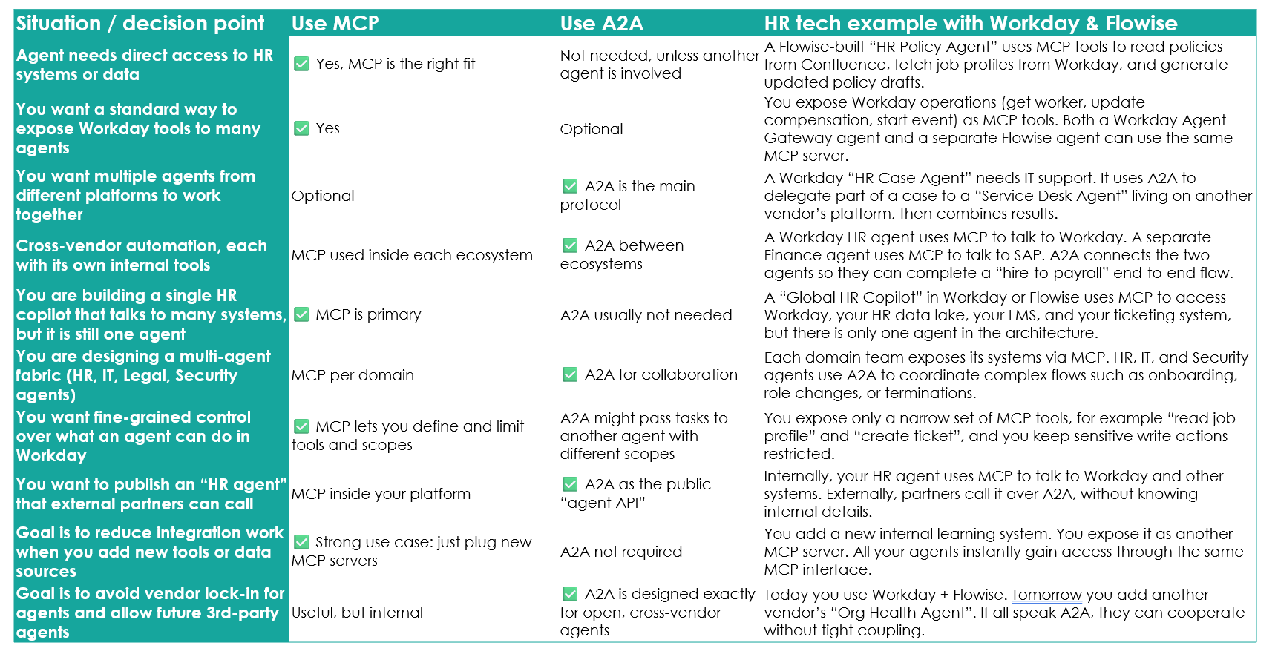
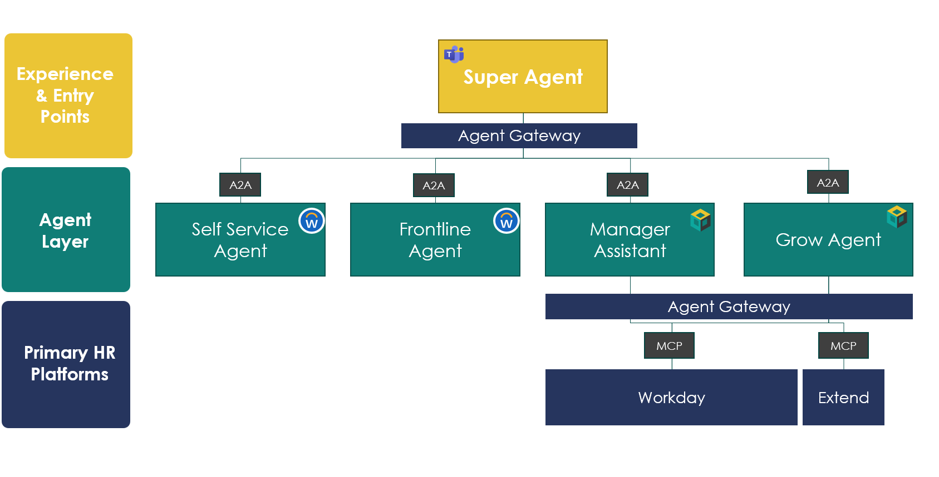
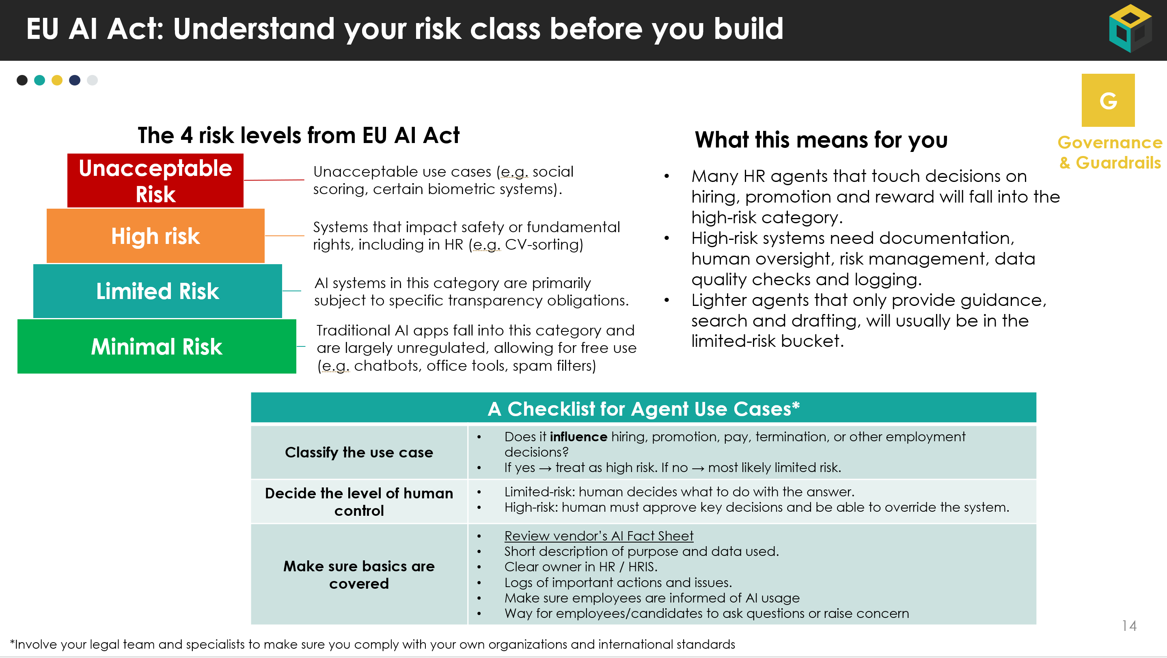
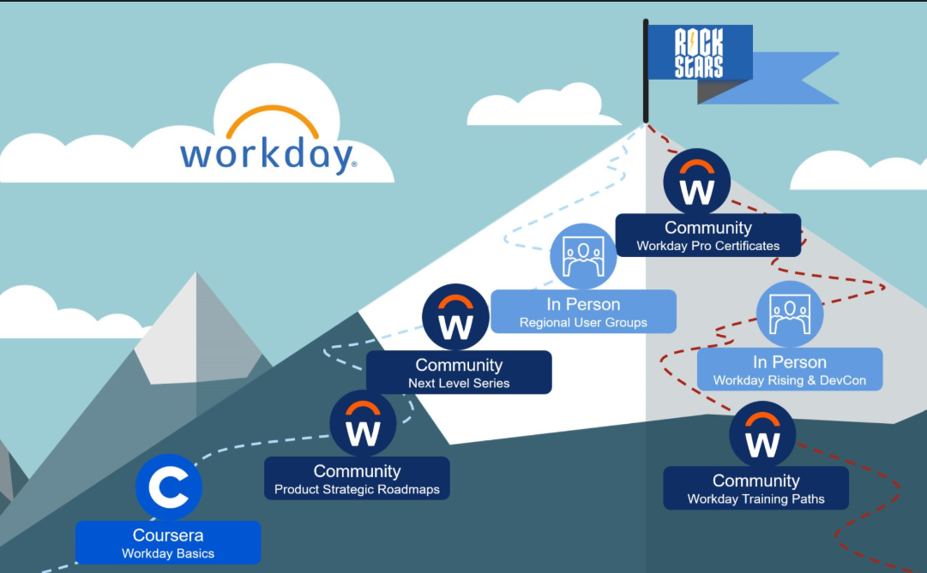
The HRIS Agent Strategy Blueprint
In line with our core value of Sharing Knowledge, we have built the HRIS Agent Strategy Blueprint. It will be released in three parts, and is aimed to give you all necessary tools and templates to start your Agent Journey.
Release Date
5th of Jan
Release Date
12th of Jan
Strategy & Vision
Architecture & Build
Governance & People
Help HR tech lead define the vision and get buy in.
Show how to design and wire agents with Workday and Flowise.
Make it safe, compliant, and make sure people can run it.
Strategy & Vision
Strategy & Vision
Strategy & Vision
AGENT Framework & Templates
Agent Use Case Library for Workday
Business Case & Token Calculator Template
AI Readiness Assessment
Executive Pitch Deck template
On demand webinars
Workday & AI Glossary for HRIS Teams
Agent FAQ
Guiding Principles for Agent Architecture
Agent Reference Architecture & MCP / A2A Explained and Decision Table
Multi-Agent Architecture Templates
Service request types & agent patterns
Flowise Patterns, Templates and Use Cases
Early access to Flowise tutorials
EU AI Act Explained
Risk & Controls Checklist
Example RACI for Agents
Agent Governance Starter Pack for AI Board
HRIS Agent Upskilling Plan (Functional & Technical Track)

Slide 3
Table of Contents – Strategy & Vision
Title | Description | Page
How to use this document | Brief explanation of who this document is for and how to apply it in your Workday agent journey. | 4
A.G.E.N.T. Strategy Framework | Overview of the A.G.E.N.T. strategy lens for agents (Ambitions, Governance, Experience, Native vs custom, Trajectory). | 5
AI Readiness Assessment | Link and guidance for running an AI readiness scan across data, Workday architecture, process and AI maturity. | 9
Workday Agents Catalogue | Overview of Workday native agents and space to document your own agent use cases on Workday. | 11
Business Case Template & Token Cost Estimator | Excel-based template to estimate costs, benefits, token spend and ROI for each agent use case. | 13
Executive Pitch Deck Template | Short executive-ready pitch you can tailor to secure sponsorship from CHRO / CIO and IT leadership. | 15
Workday Ecosystem & AI Glossary | Key Workday platform & AI terms (Extend, Build, Flowise, Agent Gateway, ASoR, etc.) explained for HRIS teams. | 22
Agent FAQ | Frequently asked questions from Incubane’s recent agent and Flowise webinars, with concise answers you can reuse. | 26

Slide 4




How to Use the Strategy & Vision Blueprint
Who this document is for | HRIS leads and HR tech product owners. Product owners and architects for Workday and adjacent HR / Finance tools. HR / IT leaders who sponsor AI and agent initiatives.
When to use it | When you want to define an overall agent strategy on top of Workday. When you are building an agent roadmap and portfolio for the next 12–24 months. When you need to prepare a business case and executive pitch for investment in Workday and partner agents.
How to work with it | Use the A.G.E.N.T. Strategy Framework & Template to capture your ambitions, governance choices, experience goals, native vs custom direction and roadmap. Rewatch the webinar Agent Strategy & Business case if you need more context. Complete the AI Readiness Assessment to understand where your Workday landscape and organisation are today. Explore the Workday Agents Catalogue and start adding your own priority use cases. Build your first agent business cases using the Business Case Template and Token Cost Estimator. Review and tailor the Executive Pitch Deck pages to your context and use them with your CHRO / CIO to gain sponsorship. Use the glossaries and FAQ to align stakeholders on terminology and answer common questions.
Incubane’s Agent Webinar Series
Age of Agents
(intro to Flowise)
Link to webinar
Build Your Agent Strategy & Business Case
Link to webinar
Technical Deep Dive into Flowise & Agents
Link to webinar
Link to slides
Link to slides
Link to slides

Slide 5

A.G.E.N.T. Strategy Framework

Slide 6


Agent Strategy Template
A
Ambitions & Outcomes
Field | Description | Your input
Vision statement | One sentence on why you invest in agents
Main personas | 2-3 key personas (e.g. HRBP, Manager, Employee, Finance) | Persona
Top 3 problems to solve | Concrete pains you want to remove | Pain point X Y Z
Business outcomes | e.g. faster cycle times, better decisions, less manual work
Key KPIs | 3-5 KPIs you will track for agents
Governance & Guardrails
Field | Description | Your input
Risk appetite | How much risk you accept for agents, for example conservative, balanced, ambitious | e.g. “Balanced, low for HR core data”
Data boundaries | What data agents can and cannot use, including sensitive data and cross border rules | List key data domains and red lines
Use case risk levels | Simple categories for use cases, for example low / medium / high risk, or EU AI Act categories | Define levels and examples per level
Human in the loop | When a human must review or approve actions before they hit Workday or other systems | List processes where review is required
Approval model | Who approves which type of agent use case or change, and in which forum | e.g. AI board, HRIS CAB, data privacy
Compliance & EU AI Act | How you make sure agents follow local law and EU AI Act rules | Note required checks and documents
Monitoring & audit | How you log agent activity, monitor outcomes, handle incidents and give recourse | Tools, reports and escalation process
Roles & responsibilities | Who owns what in practice, for example HR, HRIS, IT, legal | RACI style list of key roles
Documentation & transparency | What you document for each agent, and how to share with employees and works councils | Decide minimum docs per agent
G

Slide 7


Agent Strategy Template
E
Experience & Platforms
Field | Description | Your input
Target journeys | Key journeys where users will work with agents, e.g. hire, transfer, performance | List 3 to 5 core journeys
Experience goals | How the experience should feel, e.g. fast, trusted, simple, no jargon | 3 to 5 words that describe the experience
Handover to humans | When the agent should hand over to a human | Describe rules for handover
Agent Builder Platform | Main tools and platforms, for example Flowise, LLM provider, integration tool | List your standard platforms
Primary HR Platforms | Where ~ 80 percent of HR activity happens, for example Workday, ticketing, LMS, intranet etc. | List 3 to 5 systems that must be integrated first
Entry points | Where users meet agents, for example WD Assistant, Teams, Slack | Choose main channels
Integration pattern | How agents talk to systems, for example APIs,, MCP, A2A | Describe preferred patterns
Measurement of experience | How you will measure success, for example CSAT, NPS, completion time | 3 to 5 metrics
Native vs. Custom Agents
Field | Description | Your input
Strategic direction | Overall view on native vs. custom, e.g. native first, custom where it adds clear value | Short statement
Primary native agents | Workday delivered or partner agents you plan to use and extend | List core native agents
Primary custom agents | Key custom agents you plan to build yourself or with a partner | List 3 to 5 custom agent ideas
Decision criteria per use case | How you decide native vs. custom, for example speed, control, data needs, UX, cost | Bullet list of criteria
When to prefer native | Typical situations where you choose Workday delivered or marketplace agents first | Describe 3 to 5 patterns
When to prefer custom | Typical situations where you build in Flowise or other platforms | Describe 3 to 5 patterns
Ownership and support model | Who owns native agents vs. custom agents, including support, SLAs and upgrades | Define roles per type
Vendor and lock in considerations | How you manage dependence on Workday delivered vs. external platforms | Short notes on risk and mitigation
N

Slide 8

Agent Strategy Template
T
Trajectory & Roadmap
Field | Description | Your input
Time horizon | Period you plan for, for example next 12–24 months | e.g. “Now – end 2026”
Starting point | Where you are today with AI and agents | Short summary
Team skills & upskilling | Skills you need and how you will upskill HR, HRIS, IT | Training, coaching, hiring
Stakeholders to align | Key people and forums you must bring along | CHRO, CIO, works council, finance, etc.
Governance readiness | Actions to get AI governance, EU AI Act and policies ready | Boards, policies, templates
Data & integration readiness | Work needed on data quality and key integrations before agents can scale | Main gaps and actions
Business case preparation | What you need to build a credible case, for example baselines, volumes, rate cards | Data sources and owners
First experiments / pilots | 1–3 low risk pilots to test approach and learn | List pilot candidates
Communication plan | How you create excitement and manage expectations around agents | Channels and messages
Use case / agent | Main persona | Annual volume (events) | Time saved per event | Other benefits | Agent complexity (L / M / H) | Est. build cost | Est. run cost / year | Rough annual value | Planned wave
Job Req Agent | Hiring managers | 5.000 requisitions | 15 minutes | Better quality reqs, fewer reworks and back and forth | M | €60k | €15k | ≈ €75k (5.000 × 0,25h × €60) | Now
360 Feedback Agent | People managers | 1.000 360 cycles | 30 minutes | Better summaries, more consistent quality conversations | M | €70k | €20k | ≈ €35k (1.000 × 0,5h × €70) | 6–12m
Goal Setting Agent | Employees, managers | 4.000 goal cycles | 20 minutes | Higher goal quality, fewer reminders, better alignment | M–H | €90k | €25k | ≈ €90k (4.000 × 0,33h × €70) | 6–12m

Slide 9

AI Readiness Assessment

Slide 10
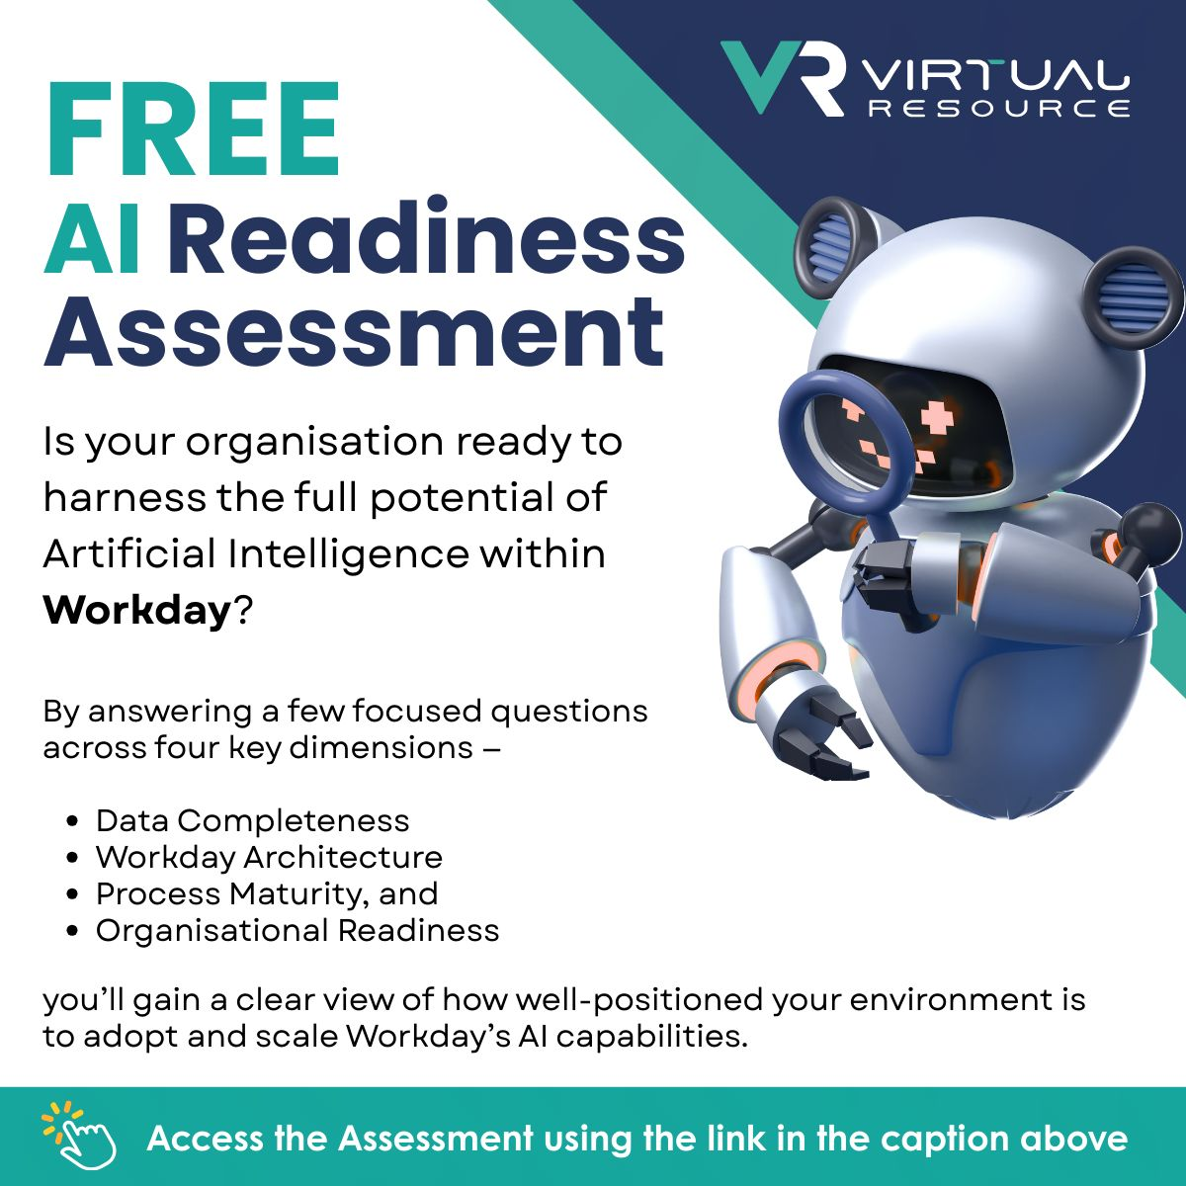
AI Readiness Assessment
Our partner VirtualResource has built an excellent AI readiness assessment. It helps you think through four different dimensions:
Data Completeness
Workday Architecture
Process Maturiy
AI Readiness
Use this link to complete the assessment

Slide 11

Agent Use Library for Workday

Slide 12
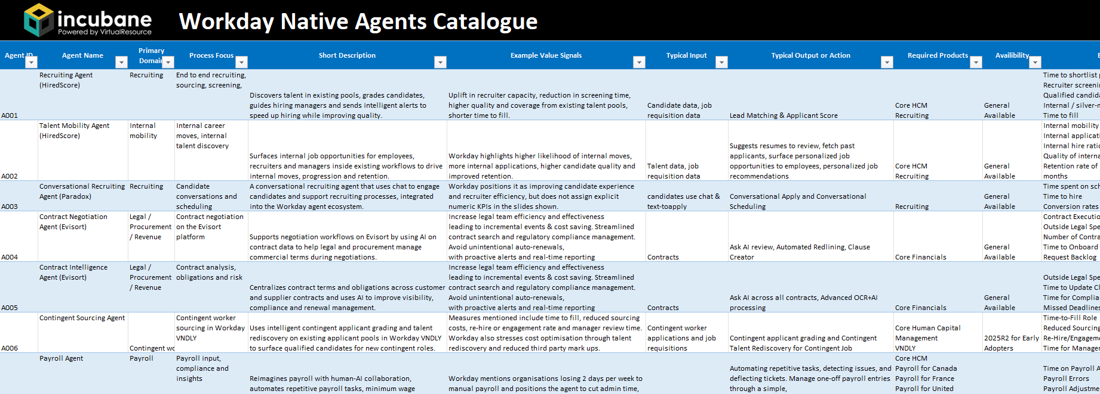

Workday Agents Catalogue
This overview shows both Workday native agents, and gives you space to detail out your own agent use cases.
Click here to
download the Excel

Slide 13

Business Case Template for Agents

Slide 14
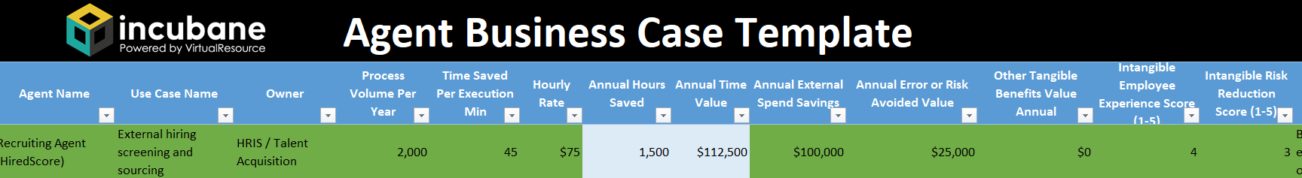
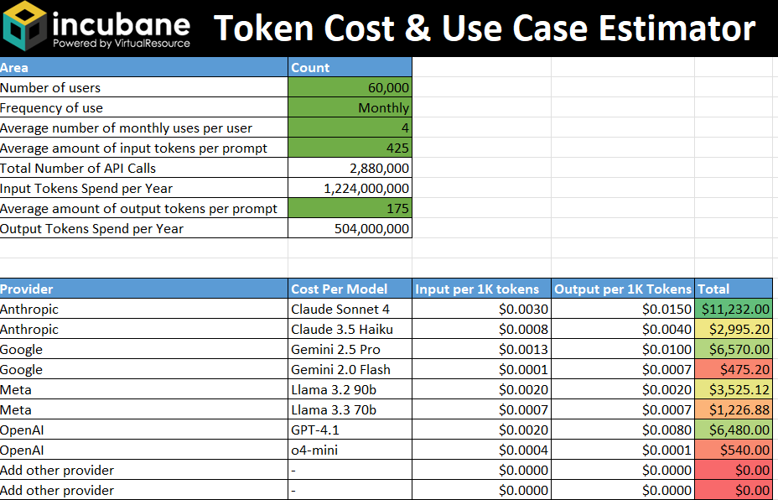
Business Case Template & Token Cost Estimator
Our business case template helps you calculate the total costs, benefits and ROI of different agent use cases. You will have to provide several metrics in order to being able to calculate the ROI. In addition we have a token calculator that can help you estimate run costs of your AI/Agent use case.

Slide 15

Executive Pitch Deck Template

Slide 16




Strategic context: why agents, why now
Our starting point
Why agents, why now
The risk if we do nothing
Our proposal
We already run our core people and finance processes on Workday.
Data, security and approvals are standardised here. Any improvement we make on top of Workday scales across countries and functions. Workday is investing heavily in AI.
The question is not if we use AI, but where we want it to live in this landscape.
AI agents are becoming the next layer of “digital workforce”: they can read data, use tools and complete steps in a process, not just answer questions.
In HR and Finance this means agents that can help with hiring, onboarding, case handling, reconciliations and more. Competitors are starting to use these capabilities to remove low-value work and speed up decisions.
If we do not set a clear direction, teams will solve problems with their own chatbots and point solutions.
That leads to fragmented data, extra integrations, inconsistent employee experience and higher risk. We also underuse AI capabilities already included in our Workday investment.
Use Workday and approved partner agents as our default platform for people and finance use cases.
This lets us reuse Workday data, security and governance, and plug agents directly into existing processes.
We start with a small portfolio of high-value pilots; if they hit agreed KPIs, we scale them as a formal program.

Slide 17
Options: why Workday / partner agents vs point solutions
Option A – Point solutions per use case
Each team buys its own chatbot / AI app. Best of breed instead of best of suite Fast to start, but: extra integrations, extra vendors, inconsistent UX, harder governance
Option B – Custom agents from scratch (outside WD)
Maximum freedom Can tie into overarching IT strategy and use IT’s agent building capability But we own security, hosting, compliance and long-term cost. More work on integrating with Workday
Option C – Workday + partner agents
Built on top of our single source of truth (Workday data model). Uses existing security, roles and audit instead of rebuilding. Agents can live inside Workday processes, but also connect to other systems Can also build custom agents for our own organization using Flowise
Our proposed approach is Option X, because of XYZ

Slide 18
Our A.G.E.N.T. decisions at a glance
A
G
E
N
T
Ambitions & Outcomes
Area | Our View
Vision statement | Use agents on top of Workday to remove low-value admin, improve decisions, and get more from Workday
Main personas | Employees, managers, HR, Finance.
Top outcomes | Faster cycle times, less manual work, better data in decisions.
Business outcomes | e.g. faster cycle times, better decisions, less manual work
Key KPIs | Hours saved, process cycle time, error / rework rate, adoption.
Governance & Guardrails
Area | Our View
Risk stance | Balanced, strict for core HR / pay decisions.
Data boundaries | Workday as source of truth; sensitive data only in defined use cases.
Human in the loop | Required for hiring, performance, pay and termination decisions.
Approval model | High-impact use cases go via AI governance board using a standard checklist.
Experience & Platforms
Area | Our View
Key journeys | Recruiting, HR help, performance / goals, core finance ops.
Experience goals | Fast, simple, transparent, “one place to go”.
Entry points | Workday (incl. Assistant), plus selected channels such as M365 / intranet.
Build Platforms | Workday Extend Pro with Flowise and standard integration tools.
Native vs. Custom Agents
Area | Our View
Default | Workday native and marketplace / partner agents first.
Custom When | We need unique UX, special data, or cross-system flow or when the ROI is greater than X
Ownership | Native agents owned by HRIS with vendor; custom agents owned jointly by HRIS and business product owners
Trajectory & Roadmap
Field | Description
Time horizon | Next 12–24 months.
Starting point | 1–2 pilots on Workday (for example Policy Agent that can read knowledge base)
Waves | 90-day pilot wave, 1-year scale wave, then continuous improvement.
Enablers | Upskilling plan for HRIS / IT, data and integration readiness, AI governance in place.

Slide 19


What it means for HR and IT
Business value Where will this help? | Our process focus: Focus on 2–3 high-volume processes Our proposed KPI’s: e.g. hours saved, cycle time, completion rates, fewer errors.
Risk and compliance | Propose to start with Workday native / partner agents, supported by Workday’s Responsible AI program. Use our AI governance board + checklist for any high-impact use case. Human in the loop; ability to switch off or roll back. Build Agent capability with experienced partner support
Architecture | Native Workday agents fully sit within their cloud system Partner and custom agents can connect via Agent Gateway (using A2A to identify other agents and MCP to call Workday tools) No new data lake or security model; we re-use what we have.
People & change | We created an HRIS upskilling plan (functional + technical tracks). Small cross-functional “agent squad” with HR, HRIS, IT, Data. A separate change plan to be created for our first use case

Slide 20
Our Plan on a Page
Area / Phase | Next 90 days – Pilot & learn | Next 12 months – Scale what works | Beyond 12 months – Strategic expansion
Workday native agents | Identify 2–3 high-value native AI features already in our license (for example recruiting, help desk, finance anomalies). Enable 1–2 as controlled pilots with clear KPIs and user feedback. | Roll out successful features to more countries / BUs. Standardise configuration and support. Include native AI usage and KPIs in HR / Finance dashboards. | Systematically review each new Workday release for AI features. Treat Workday AI as a standard lever in process design and optimisation.
Partner agents | Shortlist 1–2 Workday marketplace / partner agents that solve real pain (for example conversational recruiting, knowledge search). Run a limited PoC with strict scope and governance. | Contract and industrialise chosen partners. Integrate into Workday processes and channels (portal, mobile). Build standard patterns for vendor onboarding, security and support. | Move to a curated “agent portfolio” with a small set of strategic partners. Use Agent Gateway / ASoR concepts as they mature to manage partners as a digital workforce.
Custom agents on Workday | Pick one custom agent idea tightly linked to Workday (for example Manager Assistant, GROW agent, 360 Feedback). Do a feasibility spike and simple prototype using existing integration tools (and Flowise if available). | Build and deploy 1–3 custom agents on Workday for priority processes. Reuse components where possible. Document patterns for security, logging and monitoring. | Treat custom agents as a standard option in the solution catalogue. Reuse frameworks across regions; consider exposing some as global assets or templates.
Capability & operating model | Nominate a small “agent squad” (HRIS, HR, IT, Data). Kick off the functional and technical learning paths. Reserve 2–3 hours per week per person. | Formalise roles: product owner, architect, MLOps / integration lead, change lead. Include agent work in job descriptions and performance goals. Train local HR teams to use and explain agents. | Build a sustainable centre of excellence for AI on Workday. Rotate people through it. Use it to support other platforms as well, not only Workday.
Governance & risk | Agree a simple Workday AI checklist with the AI governance board. Classify each pilot use case, confirm human-in-the-loop points and monitoring. | Embed the checklist in standard intake for HR / IT projects. Automate as much as possible (templates, fact sheet library, risk register). Run periodic reviews of live agents. | Align fully with EU AI Act obligations as they go live. Use audit trails and metrics from Workday / agents to support external reporting and internal assurance.
Data, integration & UX | Confirm which Workday data pilots will use and fix obvious data quality issues. Map current integrations that agents will touch. Design simple, low-friction UI entry points (for example Workday homepage, help portal). | Clean up and standardise key datasets that agents rely on (skills, org data, master data). Consolidate overlapping tools and entry points. Ensure agents reuse existing SSO and security. | Move towards a coherent experience where employees and managers see a small number of smart entry points, not many separate bots. Optimise cross-system orchestration using Workday Build / Agent Gateway patterns.

Slide 21

Decisions we ask today and what happens next
Strategic decisions (today)
Budget and resources requested
Execution next
90 days
Review and
scale
Direction: Approve a Workday-first approach for people and finance agents.
Pilot scope: Confirm 1–2 pilot use cases from the agent library.
Governance: Approve use of the AI checklist and board review for all high-impact Workday AI use cases.
People
1 HRIS product owner, ~0.3 FTE for 3 months.
1 technical lead, ~0.3 FTE for 3 months.
1 HR or Finance process owner, ~0.1–0.2 FTE
Budget
Small pilot budget for: Partner or consulting support
Possible incremental Workday / partner fees and AI consumption during pilots.
Proposal: approve a pilot envelope of €X–Y, with spend tracked per use case and reviewed after 90 days.
Finalise pilot design, risk assessment and KPI baseline.
Configure or build agents in Workday and integrate where needed.
Run pilots with agreed populations and track adoption and outcomes.
After 90 days we will report back on:
Impact vs KPIs (time saved, cycle time, quality, experience).
Risk, data and change lessons.
Recommended scale / adjust / stop decision per pilot.
Refined budget and resource ask for the 12-month roadmap.

Slide 22
Workday Ecosystem Glossary

Slide 23
Workday Ecosystem Glossary
Term | What it is | Why it matters for agents / HRIS
Workday Extend | Platform to build custom apps directly on Workday, using Workday data, security and UX. | Many agent use cases will trigger or live inside Extend apps. It is your custom app layer on Workday.
Workday Extend Essentials | The base Extend edition with the core tools to build apps and workflows. | Good entry point if a customer wants custom apps but is not yet deep into AI and complex orchestration.
Workday Extend Professional | The advanced Extend edition with more orchestration and AI options, including access to AI Gateway, Co-Pilot and Flowise. Also includes additional app slots. | Key license if you want to do serious agent work on top of Workday and use Flowise style builders.
Built on Workday | A program where partners can publish Extend apps on the Workday Marketplace. All customers use the same version of the app. No Extend license is needed to use the apps. | You can purchase of the shelf apps that are pushed directly to your tenant. No maintenance required and much quicker to implement.
Workday Build | The overall developer experience that brings together Extend apps, agents, data, integrations and Marketplace into one build platform. | Build is the story that ties it all into one platform. It’s mostly an umbrella branding term.
Term | What it is | Why it matters for agents / HRIS
Flowise | Visual builder for LLM agents and workflows, using a drag and drop canvas. Workday acquired Flowise for its agent tooling. | Very practical tool for your kit. Many clients will design and test agents here, then connect them to Workday.
Pipedream | Integration and automation platform where you can quickly connect SaaS apps, APIs and webhooks with low-code / code steps. Useful as a lightweight iPaaS in your agent architecture, for example to let agents trigger actions in non-Workday systems | This platform will be essential to connect your agents quickly to many different platforms.
Workday Orchestrate | Workday’s orchestration and integration capability for designing workflows that connect Workday and external systems. | Glue between agents, Workday apps and other tools. Many agent actions will run through Orchestrate flows.
Workday Illuminate | Workday’s AI Brand Name | Umbrella term for all AI features on Workday
Workday AI Gateway | Set of AI APIs in Workday that expose things like skills, document insight, Q&A and forecasting to developers. Part of Extend Pro. | Lets agents and Extend apps call Workday AI features without building their own models.

Slide 24
Workday Ecosystem Glossary
Term | What it is | Why it matters for agents / HRIS
Workday Agent Gateway | Entry point for agents that connect to Workday using shared protocols such as MCP and A2A. | This is the “front door” for external and partner agents into Workday’s agent world. Important in your architecture diagrams.
Workday Agent System of Record (ASoR) | Central system to register, govern and monitor agents, just like you do with workers. | This is the “HR system” for agents. Key idea when you talk about governance, lifecycle and KPIs.
Workday Agents | Workday’s own role based agents for HR and Finance tasks, shipped as part of the product. | Helps you explain the difference between built-in Workday agents and custom or partner agents.
Workday Data Cloud | Shared data platform that combines HR and Finance data and makes it ready for analytics and AI. | Important for more advanced agents that need cross domain insights, not just single worker records.
Workday Marketplace | Catalog of Workday and partner apps and agents that customers can install. | When you talk about “build vs buy” for agents, Marketplace is the place to look for ready made solutions.

Slide 25
AI Terminology Glossary
Term | What it is | Why it matters for agents / HRIS
GenAI (Generative AI) | Type of AI that creates new content, for example text, images or code. | Base technology behind most LLMs and agents you will use.
LLM (Large Language Model) | Very large AI model trained on text that can understand and generate language. | Almost every agent will use one or more LLMs. Helpful to separate “model” from “agent”.
Agent | An LLM wrapped in a role with access to tools so it can take actions, not only chat. | Core concept of your kit. This is the step from “chatbot” to “doer”.
Tool / Tool Call | External function the agent can call, such as an API, query or workflow. | Where the real value sits. For Workday teams, tools are often Workday APIs, reports, Extend apps or Orchestrate flows.
RAG (Retrieval-Augmented Generation) | Pattern where the agent first looks up relevant documents, then uses the LLM to answer. | Key for HR policy, knowledge and case deflection agents, without retraining models.
Context Window | How much text the LLM can “see” in one go, including prompts and retrieved data. | Limits how much history, policy and data you can push into one agent call. Important for design.
System Prompt | Hidden instruction that sets the role, tone and rules of the agent. | Where you encode HR rules, style and guardrails for employee facing agents.
Orchestration Layer | Layer that coordinates agents, tools and workflows to complete a task end to end. | In Workday this is often Flowise plus Workday Orchestrate plus the connections via Agent Gateway.
Term | What it is | Why it matters for agents / HRIS
Guardrails / Policies | Rules that limit what the agent can say or do, and when humans must step in. | Needed to keep agents safe, compliant and aligned with HR and legal rules.
Memory (Agent Memory) | Ways for an agent to remember past interactions or facts over time. | Important for coaching, manager assistant and career agents that need continuity.
Model Context Protocol (MCP) | Open protocol that lets models access tools and data sources through a standard interface. | Helps you build tools once and reuse them across different agents and platforms.
Agent2Agent (A2A) | Protocol that lets agents talk to each other in a structured way and pass tasks around. | Key for multi agent setups such as “HR agent + IT agent + Policy agent” working together.
Human in the Loop (HITL) | Pattern where humans review or approve important agent actions or outputs. | Critical for sensitive HR topics, such as performance or pay decisions.

Slide 26
Agent FAQ

Slide 27
FAQ Based on Incubane’s Recent Agent Webinars
Category | Question | Answer
Technology | Does Flowise support A2A and MCP? | Workday is positioning Agent Gateway as the MCP-compliant way to connect agents to Workday and other tools. Flowise Agent Builder is part of this Build toolkit, so the expectation is that agents built in Flowise will be reachable via MCP / Agent Gateway and can talk to other agents and tools (A2A). Exact node types and configs will be documented by Workday.
Security & data | How is customer data protected when we use agents built with Flowise? | When Flowise Agent Builder runs inside Workday, it uses Workday’s existing security model: tenant isolation, RBAC, audit logs and data residency controls. Workday emphasises human-in-the-loop, secure deployment and transparency as part of the Flowise acquisition and Build launch. If you use open-source Flowise outside Workday, then you are responsible for hosting, access control and compliance.
Security & data | Can agents access only data the user is allowed to see? | The target pattern with ASoR and Agent Gateway is that agents respect Workday security policies: the agent runs actions and queries on behalf of a user or service account, and only sees data that identity can access. We still need to see how Workday will achieve this from a technical perspective. You still need to design prompts, tools and RAG stores so that no extra data is cached or exposed outside those rules.
Skills & org readiness | What skills do we need to build agents with Flowise + Workday? | You need a mix of Workday functional knowledge, API / integration skills and basic LLM / prompt engineering skills. Flowise itself is low-code, so non-developers can design flows, but you still need someone who understands Workday security, data structures, and how to test and monitor AI behaviour in production.
Skills & org readiness | Do we need our own custom LLM or training data to start? | No. Most early use cases will use pre-trained LLMs (via Workday’s chosen models or your cloud provider) plus RAG over your data. You typically start with configuration and prompt design, not full model training. Over time you may fine-tune or add specialised models, but it is not required for v1.
Category | Question | Answer
Use cases | Are agents like Org Design Agent, Manager Assistant Agent, 360 Agent “out of the box” or custom? | Some agents will be Workday-delivered or partner-delivered and appear as products on the Workday roadmap. Others, like your Org Design, Manager Assistant, GROW or 360 Feedback agents, are custom patterns that you or a partner build on top of Workday using Flowise. The FAQ and catalogue you are building should help stakeholders see which is which.
Governance | How do we align Flowise / agents with our AI governance and EU AI Act work? | Treat each agent like any other AI system: classify risk (e.g. many HR agents are high-risk under EU AI Act), define human oversight points, review vendor docs and Workday fact sheets, and run your internal risk and controls checklist before go-live. Workday’s Responsible AI program and EU AI Act alignment reduce provider risk, but you still own how agents are used inside your processes.
Practicalities | How can we follow up or get hands-on with Flowise and agents? | Typical next steps: 1) Try open-source Flowise in a sandbox to learn the basics. 2) Work with your Workday AE to understand Build + Extend Pro roadmap for your tenant. 3) Use our Agent Strategy Kit and Business Case template to pick one or two pilot use cases and estimate value and cost.

Slide 28

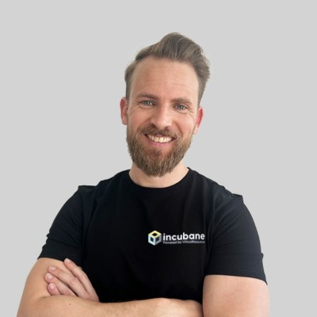

How Incubane can help you with strategy & vision
Clarify your agent vision
Build a realistic roadmap
Support with Exec Stakeholders
Run strategy workshops with HR, HRIS, IT and business leaders using this blueprint.
Help you define a clear agent vision:
  Where agents fit in your HR / IT strategy.
  What “Workday-first for people and finance” means in practice.
  Which principles you want to apply for native, partner and custom agents.
Use your Agent Use Case Library together with our patterns to:
  Prioritise 5–10 high-value use cases.
  Group them into waves (90 days, 1 year, beyond).
Help you size the opportunity with our business case and token cost templates.
Deliver a roadmap slide pack you can use in HR / IT planning and budget cycles.
Tailor the executive pitch deck with your numbers and examples.
Prepare CHRO / CIO and other sponsors for key questions on risk, architecture and value.
Support you in presenting to steering groups or boards, so strategy, architecture and governance all line up.
Stay onboard as a sparring partner while you deliver (or co-deliver) the first agents
Contact Us
If you want to build your agent strategy
If you want to learn how to build agents inhouse
If you have an agent use case you want to work together on
Rick Leunisse
rick.leunisse@incubane.com
Matt Komendolowicz
matt.komendolowicz@incubane.com

Slide 29

Thank you

