Slide 1
Instructions
Each section represent a different chapter from the guidebook
Most slides have been prepopulated with example text, remove them and add your own information
You can copy the slides to your own corporate branding template
You can remove the section slides, they are meant to help you find the right chapters
All examples and numbers are fictitious. Work with your own team or a partner to validate all estimates, benefits etc.

Slide 2
Workday Extend Business Case

Slide 3
Why Workday Extend Is a Strategic Priority Now
The Challenge
Business teams still rely on spreadsheets, emails, or external tools to manage HR and Finance processes. These workarounds create inefficiencies, compliance risks, and a fragmented user experience. Leadership wants agility, control, and innovation, but without adding complexity or introducing new platforms.
The Gap
Core Workday covers ~80% of needs, but lacks flexibility for unique workflows. Business users are solving problems outside the system, creating: Shadow IT risks and disconnected data Manual processes that don't scale Delays in adapting to change Without Extend, organizations are stuck waiting on Workday releases or relying on external vendors.
The Core Ask
To future-proof our Workday investment, we need to: Build in-tenant solutions that meet local and functional needs Consolidate tools and eliminate disconnected processes Enable fast delivery of capabilities, securely and at lower cost Support innovation in areas like GenAI, automation, and advanced user experience
The Solution
Workday Extend allows us to: Rapidly build secure, scalable apps within Workday Leverage existing security, data, and approvals Reduce reliance on spreadsheets, emails, or 3rd party tools Lay the foundation for GenAI use cases and custom automation ROI: Lower total cost of ownership, faster delivery, stronger user experience, and higher data integrity

Slide 4
2. When to Use Extend vs. Built on Workday

Slide 5
Our strategy on Built on Workday vs. Extend
Workday Extend lets you build custom apps directly inside Workday, using your own logic, fields, and workflows, perfect for needs that are unique to your organization. Built on Workday (BoW) apps are pre-built by certified partners and available through the Workday Marketplace, offering fast deployment for common business problems. The key difference: Extend gives full control and flexibility, while BoW gives speed and simplicity with limited customization.
Extend vs. Built on Workday
Assessing our own use cases
 | Workday Extend (Build) | Built on Workday (Buy)
Approach | Build custom app inside Workday | Purchase ready-made app from a partner
Flexibility | Full control, tailor to your needs | Limited config, fixed core logic
Speed | Project-based, depends on scope | Faster if app exists
Ownership | You or partner develops & maintains | Vendor maintains
Cost Type | CapEx (license + dev effort) | OpEx (subscription/license)
Best For | Unique processes, full control needed, many use cases and inhouse capability | Common use cases, fast deployment
Question | Use Case: Mass Hire | Use Case: Optimized Onboarding
Is this need common or unique? | Common | Our requirements are unique
Can we work with a configurable product? | Yes | Maybe, but we do need to connect it to our own inhouse LMS, so unlikely
How many use cases do we see long term? | Multiple use cases
Do we have internal dev capability or will we use a partner? | Not capability yet, but planning to build a team
What’s easier to fund: project (CapEx) or subscription (OpEx)? | CapEx
How quick do you need it to be live? | End of calendar year | No fixed date
Given the number of use cases we have and a few unique needs, we will move forward with Extend

Slide 6
3. Identifying Use Cases for Workday Extend

Slide 7
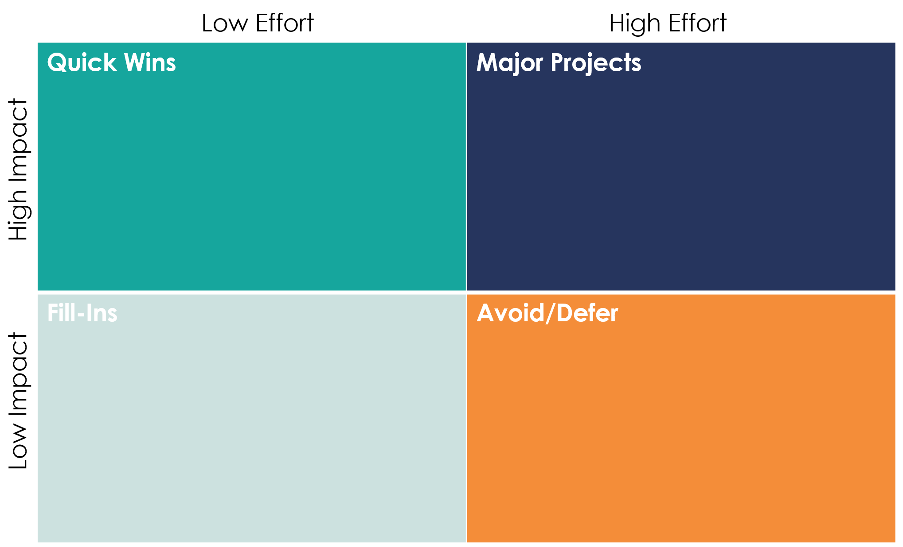
Workday Extend Use Case Brainstorm
Purpose: Workday Extend Use Case Brainstorm
Attendees: HR Operations, HRIS/IT, Payroll, Finance, Business Analysts
Agenda | Time
Quick overview of Workday Extend and why we’re here | 5 min
Go around the room asking: “What do you do in Excel that you wish was in Workday?” “What process do you repeat every month that feels clunky?” “What frustrates end users the most?” | 10 min
Whiteboard / Sticky Note Exercise: Participants write down 2–3 ideas each Group similar ideas Vote on top 3 (e.g., dot voting) | 15 min
Shortlisting & Next Steps: Score top ideas on effort/impact (use matrix on the right) Agree on which one(s) to explore further Assign owner to capture the details | 15 min
Next Step Questions: Is this problem worth solving now? Can Workday Extend actually solve it? Does it replace a vendor, eliminate a spreadsheet, or automate manual work? | 15 min

Slide 8

Use Case Brainstorm Overview
Use Case
Estimated Effort
Estimated Impact
Strategic Fit
Frequency of Use
Pain Level / Urgency
Replaces Tool
Customer / Teams Affect
High
High
Efficiency
Contingent Worker Onboarding
Weekly
Medium
Manual Process
Hiring Managers
Tuition Reimbursement
Low
High
Efficiency
Daily
High
Excel
Employees
Employee Offboarding
Medium
Medium
N/A
Weekly
Medium
Enhances WD Process
Managers
AI Supported Goal Setting
Medium
High
Employee Experience
Annually
High
Enhances WD Process
Employees
Low
High
Compliance
Permanent Education Tracker
Weekly
Medium
Manual Process
Hiring Managers
Technical Competencies
High
High
Compliance
Daily
High
Third Party system
Employees
360 Feedback
Medium
High
Employee Experience
Weekly
Medium
Manual Process
Managers
Advanced AI Check-Ins
Medium
High
Employee Experience
Daily
High
WD + Manual Process
All workers
Employee Relations Manager
Medium
Medium
N/A
Ad-hoc
Low
Email / Docs
HRBP + Legal
Promotion Nominations
Medium
High
Efficiency
Quarterly
High
Manual Process
Hiring Managers
High
Medium
Low
Launch Candidates

Slide 9
4. Building a Business Case for Workday Extend

Slide 10
Use Cases Summary
Analysis | Contingent Worker Onboarding | Tuition Reimbursement | AI Supported Goal Setting
Current Problem | Onboarding for contractors is handled outside of Workday, using Google Forms, emails, and spreadsheets. Data is entered twice, processes are slow, and documents are stored in disconnected locations. | Reimbursement requests are often tracked in spreadsheets or submitted via email. It’s hard to manage policy rules, ensure approvals, and track spending centrally. Delays frustrate employees and burden HR. | Goal setting is inconsistent across teams. Many managers forget to enter goals or write vague ones. There’s little alignment to company OKRs, and HR spends time chasing updates before reviews. No intelligent support exists in Workday today.
Proposed Extend App | An in-tenant “Request a Consultant” app that lets managers initiate onboarding directly in Workday. Includes form submission, automated approvals, document upload, and creation of worker record. | A guided tuition reimbursement request form inside Workday. Built-in policy checks, manager approval routing, and finance integration. Allows uploading receipts, auto-calculates eligible amounts, and tracks YTD balances. | A smart goal-setting assistant inside Workday. Suggests goals using GenAI based on role, manager goals, or company OKRs. Prompts managers with goal-writing tips and nudges them if goals are missing or vague.
Business Impact Areas | Time saved: ~40 hours/month Cost avoided: ~$35,000/year (retiring legacy tool + manual effort) Better audit trail (everything tracked in Workday) Smoother manager experience No need for duplicate data entry | Employee experience: clearer process, fewer errors Compliance: ensures only eligible expenses are reimbursed Time saved for HR and Finance teams: ~ 80 hours/month Visibility into education spend | Better goal quality across the org Time saved for employees in setting goals: 1 hour per employee per year (11.521 hours total) Time saved for managers: 20 min per employee (3.840 hours total) More alignment to company OKRs Easier mid-year and year-end reviews
Extend Fit Criteria | ☑ Unique to our process ☑ No BoW app available ☑ Uses Workday data and objects ☑ Needs custom logic/UI ☑ Known pain point (frequent complaints) | ☑ Unique to our process ☑ No BoW app available ☑ Uses Workday data and attachments ☑ Needs dynamic policy logic | ☑ Needs GenAI logic ☑ Extends existing performance process ☑ No native Workday AI for goal setting ☑ Use of Extend UI and orchestration logic ☑ AI assistance is a differentiator
Estimated Effort | Development effort: 6–8 weeks Partner required? ☑ Yes Internal support readiness: Medium | Development effort: 4–6 weeks Partner required? ☐ No (can be built internally with light support) Internal support readiness: High | Development effort: 6–8 weeks Partner required? ☑ Yes (due to AI logic and user experience design) Internal support readiness: Medium
Comments | Well-scoped pilot use case with clear business value. Strong support from HR Operations and Talent Acquisition. Visible to business leaders, good first win. | Common use case with visible value. Strong employee support and easy to communicate. Could be a fast win with internal resources or junior Extend devs. | Innovative use case with strategic value. High visibility, great for showcasing GenAI in Workday. Strong alignment with performance management and leadership buy-in required.

Slide 11
Business Case Overview
Analysis | Recurring Costs | Development Cost (One-time) | Time Saved (hours per year) | $ saved based on FTE (~ blended $50/hour) | Tool Replaced (Annual License Cost + Maintenance Saved)
Contingent Worker Onboarding | $ 5.000 (internal support) | $ 45.000 (estimated inhouse development cost) | 480 | $ 24.000 | $ 35.000 (retiring legacy tool)
Tuition Reimbursement | $ 5.000 (internal support) | $ 25.000 (estimated inhouse development cost) | 960 | $ 48.000 | $ 55.000 (not investing in new point solution)
AI Supported Goal Setting | $ 15.000 (internal support + cost of tokens) | $ 45.000 (estimated inhouse development cost) | 15.361 | $ 768.050 | N/A
Other | $ 50.000 (annual cost for Extend Essentials SKU) | $ 45.000 (change & training & external ad-hoc partner support)
Total | $ 75.000 | $ 150.000 | 16.801 | $ 840.050 | $ 90.000
*Note: all numbers on these slides are fictatious and should be replaced with validated numbers.

Slide 12
Cost & ROI Overview by Use Case
ROI
42%
Contingent Worker Onboarding
172%
Tuition Reimbursement
299%
AI-Supported Goal Setting
123%
Overall Extend ROI
Notes:
Calculations example
Tuition Reimbursement
One-Time Development: $25,000
Annual Support: $5,000
Annual Benefit: $48,000
Annual Net Benefit = $48,000 − $5,000 = $43,000
ROI = ($43,000 / $25,000) × 100 = 172.0%

Slide 13
5. Securing Internal Buy-In

Slide 14
Winning Stakeholder Support: Who to Engage & How
Stakeholder Engagement Plan
Stakeholder | Interest | Key Message | Engagement Strategy
CFO | ROI, total cost of ownership | “This will save €XX and pay back in under 18 months.” | Share business case early, 1:1 review pre-steerco
CHRO | Talent experience, adoption, digital HR | “This supports better onboarding, retention, and performance.” | Highlight user experience wins, demo a use case
CIO / IT Director | Security, architecture, integration load | “No new platforms – all within Workday’s existing cloud + controls.” | Include in design reviews, flag low maintenance model
HR/Finance Managers | Operational workload, usability | “You’ll spend less time chasing data or rekeying requests.” | Involve in workshops, validate pain points
End Users (e.g. HRBPs) | Fear of change, added steps, unfamiliarity | “You’ll have fewer spreadsheets and a faster experience in Workday.” | Engage early with mockups, training, and UAT involvement
Internal Workday Team | Configuration fit, ongoing support | “We’ll align with your current tenant structure and security model.” | Collaborate during design, handover support expectations
Influence – Interest Grid
Low Interest
High Interest
Meet their needs | Manage closely
Monitor | Keep informed
CFO
CHRO
High Influence
CIO
HR / Finance Managers
Internal Workday team
Low Influence
End Users

Slide 15
6. Maintenance & Support

Slide 16




Support & Sustainment Plan Summary
Enhancement & Releases
Support Model
Extend apps tested in preview tenant during each release cycle. Sanity checklist owned by support team. Quarterly review with stakeholders. Minor changes handled in-house. Major upgrades via partner SOW.
Hybrid – Internal team handles Level 1 issues and enhancements. Partner provides expert support & release testing.
Training & Readiness
Support Owner(s)
Internal: Workday Platform Manager
External: Partner X (via annual support contract)
Support team completed Extend training. Practice app built internally for skill building. Initial app will be co developed with Partner X
Issue Management
Budget Allocation
Tickets logged via internal helpdesk, escalated to Partner X when needed. SLA-based triage in place.
Year 1: €25K support agreement + €15K internal capacity Years 2–3: €15K/year estimated

Slide 17
7. Partner Selection

Slide 18
Partner Selection – Comparison Summary
Criteria | Partner A | Partner B | Partner C
Extend Experience | 10+ Extend apps delivered, including onboarding, workflows, and manager tools. | 3 Extend projects, mostly for compliance tracking. | Limited Extend experience; more BoW-focused.
Team Profile | Dedicated Extend team with named senior architect and 2 certified developers. | Team of mid-level consultants with Extend training. | Offshore devs, no confirmed Extend architect.
Delivery Approach | Agile delivery, co-design workshops, knowledge transfer embedded. | Waterfall approach, limited iteration during build. | One-time delivery model with fixed scope.
Reusables / Accelerators | Has templates for document upload, approvals, and dashboards. | Custom from scratch each time. | No reusable assets available.
Support & Handover | Includes documentation, training, and 30-day hypercare. | Offers bug fix period only; no enablement. | Post-go-live support optional, billed hourly.
Cultural Fit | Strong engagement, fast response, flexible to stakeholder needs. | More formal/structured; slower turnaround. | Less consultative; required heavy follow-up.
Reference Feedback | Positive feedback on quality, communication, and post-launch support. | Mixed – one reference noted delivery delays. | One reference, no Extend-specific projects.
Pricing Estimate (App 1) | $55K – includes 2-week discovery, full build, and 1-month support. | $48K – build only, discovery not included. | $42K – lowest cost but excludes training/support.
Optional Pilot Sprint | Offered a discovery sprint with stakeholder interviews and mockups. | No pilot offered. | Discovery phase not part of engagement model.
Support Model | Hybrid: internal L1 support + partner for updates & biannual testing. | Partner-only support for 6 months, no internal training. | No defined support model, support billed hourly.
Recommendation
Based on Extend experience, delivery quality, and overall value, Partner A is the strongest fit. They balance deep technical knowledge with collaboration and long-term maintainability.

Slide 19





Connect with Incubane for more support on your Extend needs
Matt Komendołowicz
Managing Partner
matt.komendolowicz@incubane.com
Rick Leunisse
Managing Partner
rick.leunisse@incubane.com

