Slide 1
Instructions
Each section represent a different chapter from the guidebook
Most slides have been prepopulated with example text, remove them and add your own information
You can copy the slides to your own corporate branding template

Slide 2
The Workday HR Tech Strategy Playbook

Slide 3
Understand the Current Workday Experience

Slide 4
Workday Current State Assessment – Key Findings
Executive Summary
Performance management usage is low – only 40% of managers set goals in Workday.
Workday reports lack visibility – HR leadership missing key workforce insights.
Finance experiencing payroll sync errors, delaying compensation cycles.
Employees rarely use self-service – 55% still rely on HR for tasks they could complete in Workday.
Manual HR processes consume ~2,500 hours annually, which could be reduced with automation.
Pain Points & Gaps
Underutilized Workday Features
Category | Issue | Impact on Business | Recommendation
HR Processes | Only 40% of managers set goals in Workday | Inconsistent performance tracking | Automate goal-setting reminders & training
HR Service Delivery | HR spends 5+ hours per week responding to routine HR queries | Wasted HR capacity & employee frustration | Implement Workday Help for automated case management
IT & Security | Role-based security setup incomplete | Unauthorized access risks | Conduct a Workday security audit
Finance | Payroll data misalignment with ERP | Monthly pay runs require manual fixes | Improve Workday-finance integration
Finance | Expense approvals require manual oversight | Delayed reimbursements & compliance risk | Automate approvals using Workday Business Processes
Employee Experience | 55% of employees still rely on HR for transactions | Wasted HR team capacity | Launch training for self-service adoption
Majority of employees are unaware of the Workday mobile app
70%
Hours are spent on creating total rewards statements by HR. With Extend we could automate this and reduce this with 1.100 hours.
1.400
80% of offboarding steps handled manually via email. Develop offboarding Extend app → Reduce processing time by 60%
80%

Slide 5
Align with HR Leadership & Business Goals

Slide 6
Workday HR Tech Strategy – Enabling [Your Company Name]’s Growth & Efficiency
Our HR Tech Vision Statement
Leverage Workday as the backbone of our HR transformation—creating a unified, scalable, and data-driven platform that accelerates growth, improves workforce planning, and enhances employee experience.
Our 4 Strategic Pillars
Process Automation & Efficiency
Data-Driven Decisions
Scalable Growth Enablement
Employee Experience & Retention
Reduce manual HR tasks by 40% through automation.
Enable real-time analytics via Workday Prism & Adaptive Planning.
Support global expansion and M&A with configurable HR processes and streamlined Extend process.
Improve career growth & learning via Workday Learning & Journeys.

Slide 7
Mobilizing Your HRIS Team to Assess Modules

Slide 8





Executive Summary
Current Workday Utilization
Majority of modules is well utilized. Core HCM & Payroll are well adopted, while Talent & Extend are underutilized.
Key Pain Points
Low adoption
Too may processes are manual outside WD
Data quality in APAC is very low
Quick wins for immediate impact
Configure reminders for outstanding tasks
Provide QRC’s and help text for key processes
Reduce number of approvals in hire process
Long Term Strategic Enhancements
Optimize and streamline E2E process with Extend
Implement succession planning
Fully automated payroll integrations in APAC

Slide 9
Workday Module Assessment Summary
Workday Module | Utilization Score (1-5) | Top Pain Points | Quick Wins | Long-Term Enhancements
Core HCM | 4/5 | Manual data entry errors | Automate data validations | AI-driven HR data audits
Talent & Performance | 3/5 | Low goal adoption, managers lack insights | Enable Skills Cloud, set up notifications | Implement Succession Planning
Payroll | 2/5 | Frequent integration issues | Fix payroll-to-ERP data sync | Overhaul payroll approval workflows
Workday Extend | 1/5 | No custom HR apps developed yet | Identify manual HR processes to automate | Develop contract automation & onboarding workflow apps
Prism Analytics | 3/5 | Manual reporting efforts still high | Train HR team on dashboard creation | Develop executive workforce analytics dashboard

Slide 10




Pain Points & Recurring Issues
Compliance & Security Risks
Data & Reporting Challenges
To get access to data the security framework has seen many ad-hoc changes. The incoming organization changes will also require a security redesign.
Data quality in certain regions is very low and trust in data is low. HR spends excessive time generating workforce reports manually or manually adjusting Workday reports.
Onboarding Process
Manual Workarounds
Workday’s onboarding module is underutilized, leading to a manual onboarding process involving spreadsheets and email-based tracking.
Many processes take place outside of Workday, still in Excel and emails. Payroll team manually adjusting integrations every cycle. Talent team is doing succession planning in Excel etc.
High Volume of HR Support Tickets
User Adoption Gaps
Employees and managers lack awareness or training on Workday self-service, leading to an over-reliance on HR teams for simple tasks like updating personal info, requesting time off, or checking payslips.
Managers not using goal-setting tools consistently. Often managers ask HR to complete processes on their behalf. Feedback is that the system has too many clicks and fields.

Slide 11
Quick Wins (Immediate Fixes, <3 months)
Automate performance review reminders
Enable Workday Email Reminders
Provide QRCs & Help Text on Key Processes
Reduce Number of Approvals in Hire
Expected impact: 15% increase in completion rates.
Expected impact: Reduce HR queries by 20%.
Expected impact: Reduce HR queries by 10%.
Expected impact: Reduce time to hire by 2 days

Slide 12




Long-Term Workday Enhancements (6-24 months)
AI Driven HR Data Audits
Payroll APAC Integrations
We think big picture and not just system implementors, focusing on the end-to-end design ensuring technology enables the process and not the other way round
We operate as part of the client team and as such are not your typical consultancy. We strive to understand your business needs and aim for quality not quantity.
Automate repetitive HR processes with Extend
We have several tools that will accelerate transformation programs. We also focus on setting clients up for success from day 1 including tools to help you determine your implementation scope and a related SoW, RACI and plan to ensure tasks don’t fall through the GAPs and ultimately affect your program budget and timelines. We guarantee we will save you money in the long run.
Implement Succession Planning
Whether it’s the latest craze in AI or machine learning, we understand HR and what are the best technologies out there to drive the best people experience and service.
We also thrive on making strategy practical. No pie in the sky stuff, we bake the pie, and you get to eat it .

Slide 13
Run a One-Day Strategy Workshop

Slide 14
Workshop Objectives & Agenda
Topic | Time
Present Current State Findings | 9:00 – 10:00
Brainstorm Improvements | 10:00 – 12:00
Prioritize & Develop a Roadmap | 13:00 – 14:30
Draft the Workday Technology Roadmap | 14:30 – 16:00
Review & Assign Action Items | 16:00 – 17:00
Objectives
Align Workday initiatives with business and HR strategy.
Prioritize improvements based on impact and effort.
Develop a roadmap for execution.

Slide 15
Icebreaker
Choose one of the following icebreakers:
1. Rock-Paper-Scissors Tournament
Everyone pairs up and plays rock-paper-scissors.
Winners move on to the next round until there’s a final champion!
Great for quick energy and friendly competition.
2. Human Knot
Everyone stands in a circle and grabs two random hands (not from the same person).
The group must untangle themselves without letting go to form a circle again.
Creates teamwork and lots of laughs!
3. Group Juggle
Start with one soft object (like a stress ball) and toss it around in a pattern while saying names.
Add more objects one by one, making it increasingly chaotic and fun!
The goal is to keep everything in motion without dropping anything

Slide 16
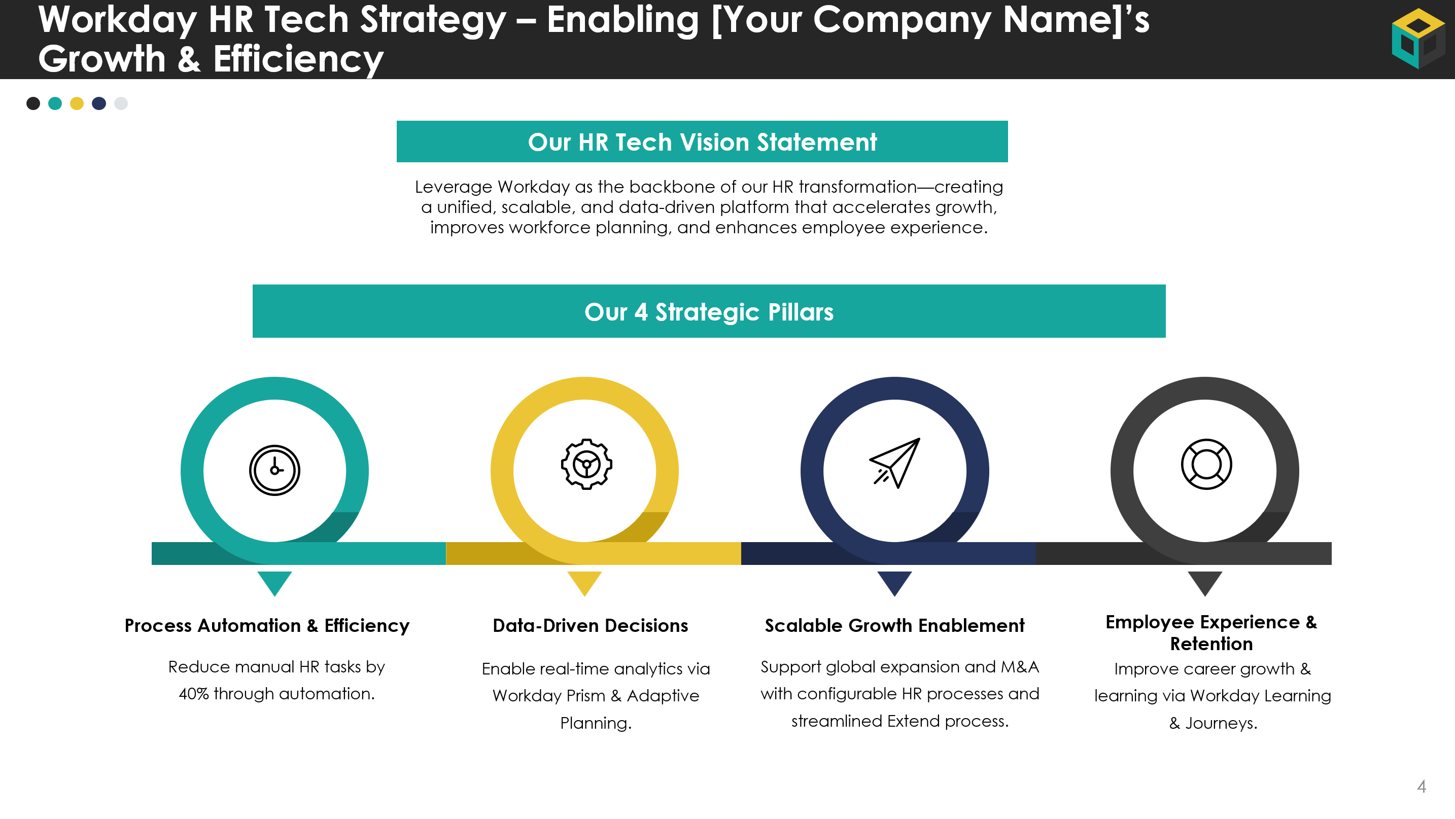
Your HR Tech Strategy Vision
Discuss the draft vision. Are there any refinements you want to apply?

Slide 17
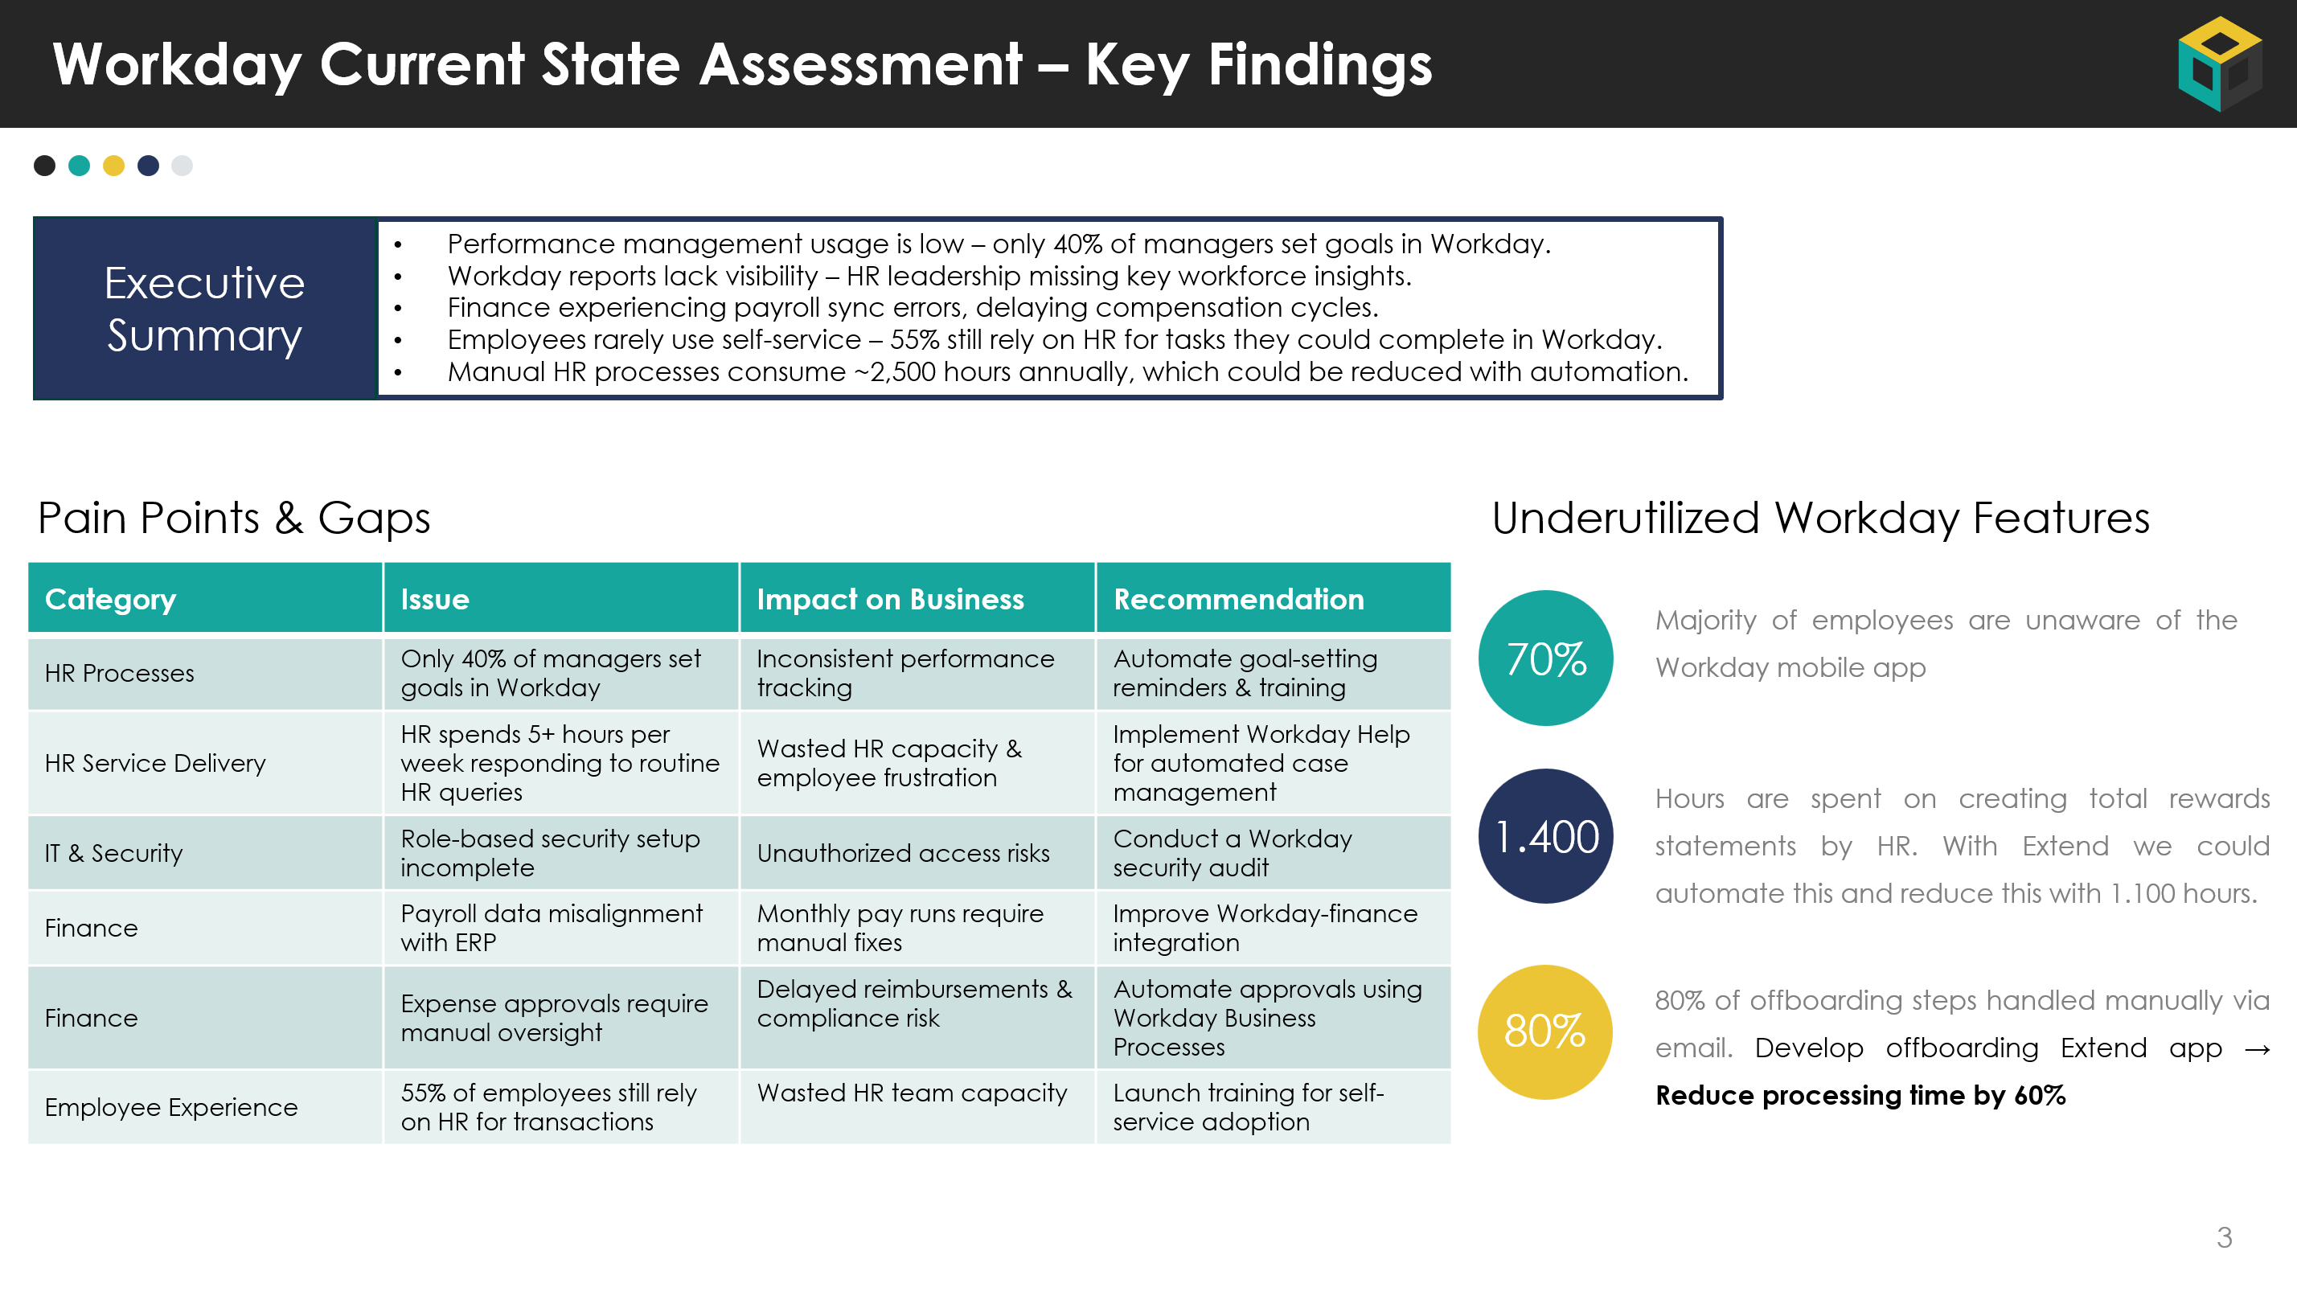
Current State – Workday Strengths & Challenges
Discuss Outcomes of Initial Analysis
Use Whiteboard or Mural to Expand
What’s Working in Workday? | What’s Challenging in Workday?
Example: Payroll processing is smooth | Example: Performance reviews are inconsistent

Slide 18
Brainstorm Workday Improvement Ideas
Process Fixes
Technology Enhancements
User Adoption & Training
Reporting & Data
Other

Slide 19
Prioritization – Impact vs. Effort Matrix
Low Effort
High Effort
Quick Wins | Major Projects
Fill-Ins | Avoid/Defer
High Impact
Low Impact

Slide 20
Our Workday Roadmap for the Next Three Years
Today
Q1 Review
Date
Q2 Review
Date
 | April | May | Jun | Q3 | Q4 | 2026 | 2027
Quick Wins
Long Term Enhancements
Long Term Fixes
HR Leadership
QRCs & Help Text
Milestone
Enable Reminders
Optimize hire process
Workday Extend Process Optimization
AI Driven HR Data Audits
Implement Succession Planning
Payroll APAC Integrations
AI Driven HR Data Audits
Go Live
Redesign Onboarding Process
Q1 Leadership Meeting
Q2 Leadership Meeting
Update HR on Quick Wins

Slide 21
Next Steps
Based on the workshop list all action items
Define who owns what after the workshop
Discuss how you will monitor, track and keep each other accountable
Action Item | Owner | Due Date

Slide 22
Building the Workday HR Technology Roadmap

Slide 23
Our Workday Roadmap for the Next Three Years
Today
Q1 Review
Date
Q2 Review
Date
 | April | May | Jun | Q3 | Q4 | 2026 | 2027
Quick Wins
Long Term Enhancements
Long Term Fixes
HR Leadership
QRCs & Help Text
Milestone
Enable Reminders
Optimize hire process
Workday Extend Process Optimization
AI Driven HR Data Audits
Implement Succession Planning
Payroll APAC Integrations
AI Driven HR Data Audits
Go Live
Redesign Onboarding Process
Q1 Leadership Meeting
Q2 Leadership Meeting
Update HR on Quick Wins

Slide 24
Keeping Leadership & Teams Updated on Workday Progress

Slide 25
Agenda for Quarterly Workday Review
Topic | Current Items
Review Roadmap Progress | Example: Update on Workday Learning implementation
Address New Business Priorities | Example: A new compliance law may require prioritizing Workday security enhancements.
Resolve Issues & Risks | Example: “Project X is delayed due to HRIS resource constraints – should we adjust scope or bring in external help?”
Plan for the Next Quarter | Example: “We need Finance approval for Workday Adaptive Planning rollout next quarter.”
Leadership Involvement | Example: “Update from CHRO on Workday Rising executive discussions outcomes”

Slide 26
HR Tech Metrics Scorecard
Metric | Current Status | Baseline (2024) | Q1 2025 | Q2 2025 | Target (Q4 2025)
% Employees logging into Workday monthly | ● | 70% | 75% | 78% | 90%
Performance Reviews Completed on Time | ● | 60% | - | 75% | 90%
Avg. HR Ticket Resolution Time (days) | ● | 5 | 4.2 | 4 | 3
Manual HR Transactions per Quarter | ● | 200 | 150 | 80 | 0 (fully automated)
Workday Roadmap Initiatives Completed | ● | N/A | 3 of 3 | 5 of 6 | All Phase 1 by Q2 2026

Slide 27





Connect with Incubane for more support on your Workday roadmap
Matt Komendołowicz
Managing Partner
matt.komendolowicz@incubane.com
Rick Leunisse
Managing Partner
rick.leunisse@incubane.com

