Slide 1

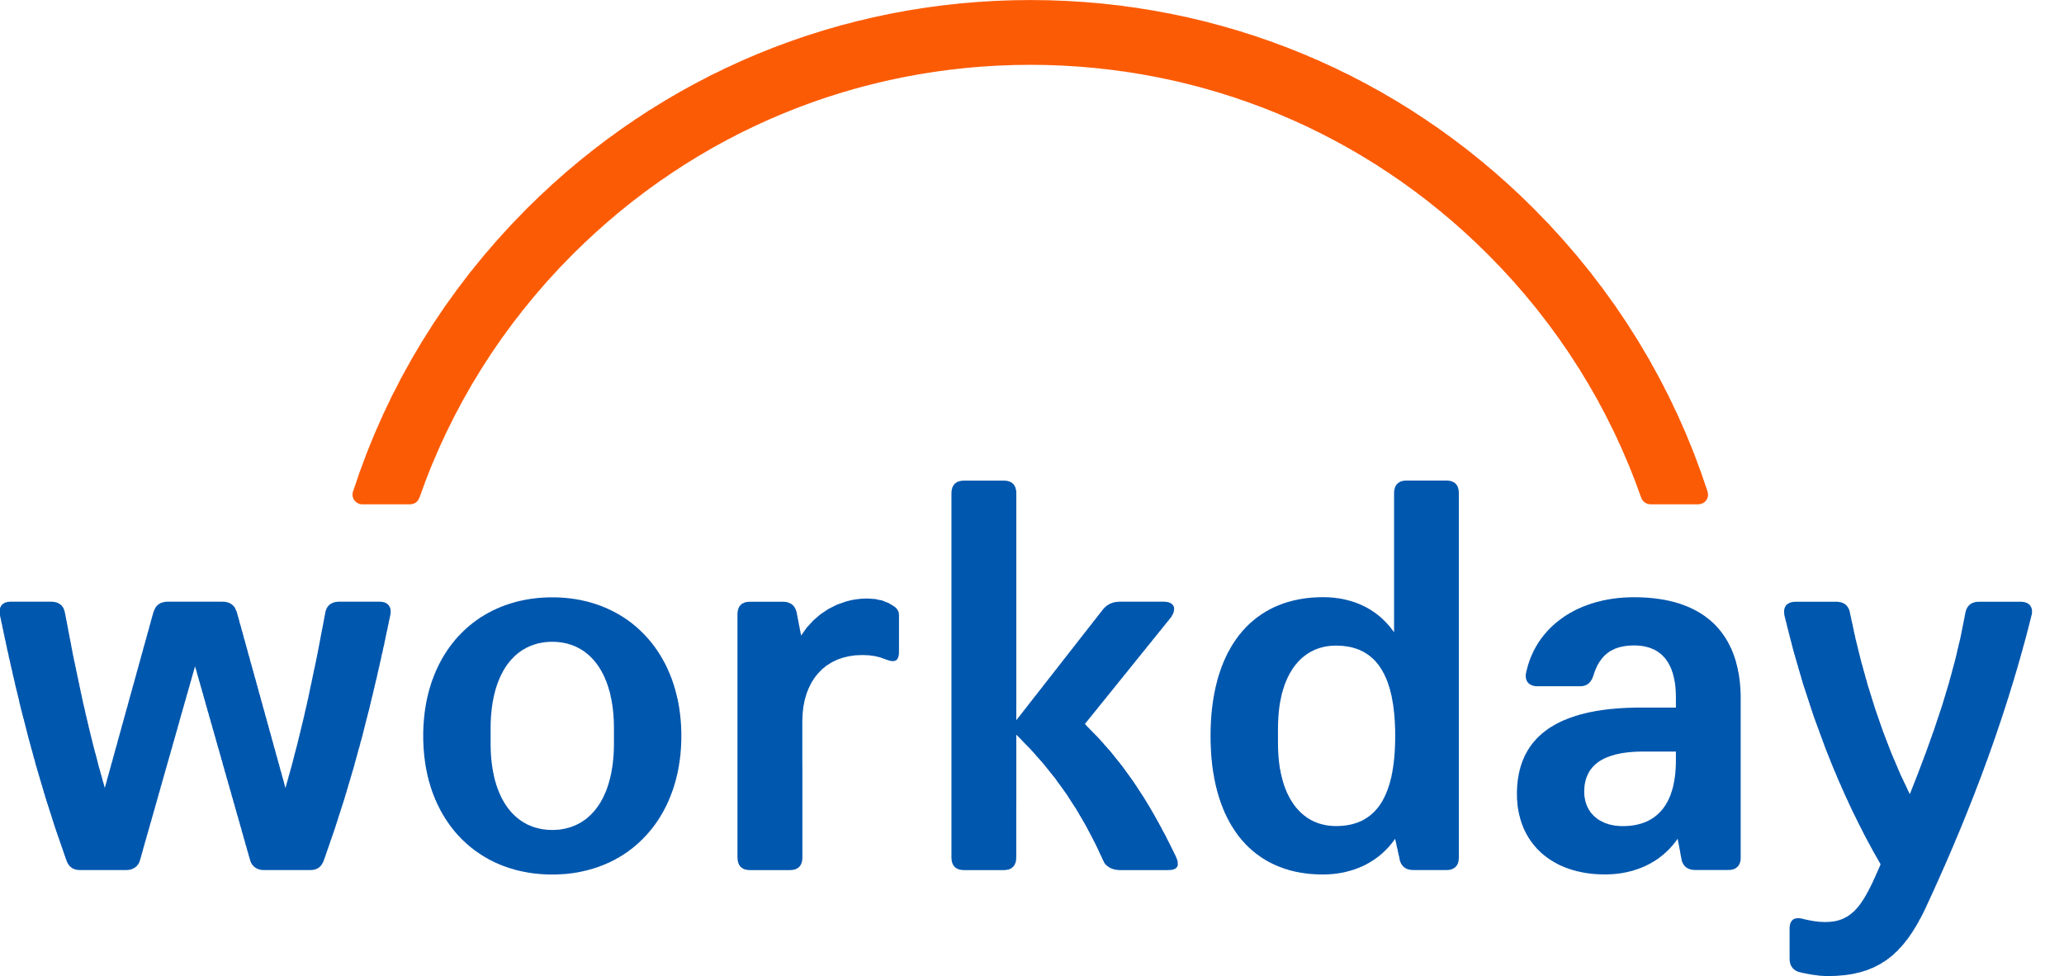
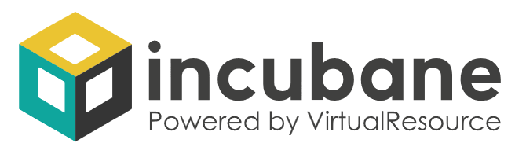

HRIS Agent Strategy Blueprint
Governance & People

Slide 2



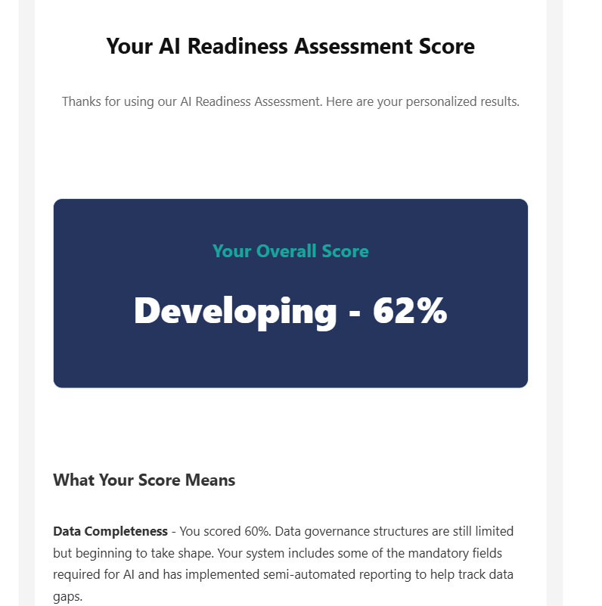
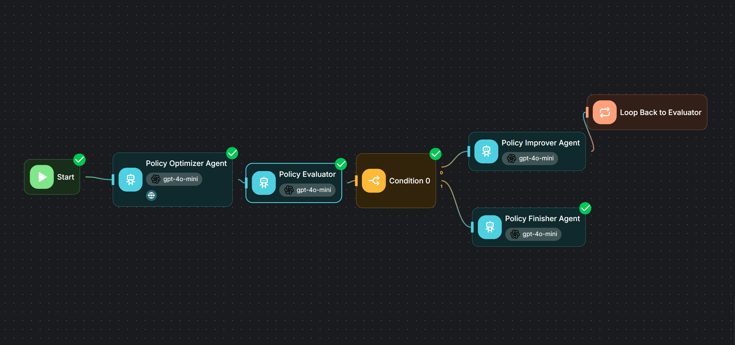
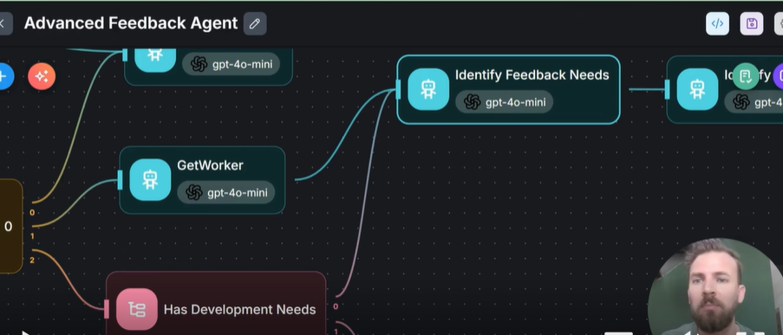
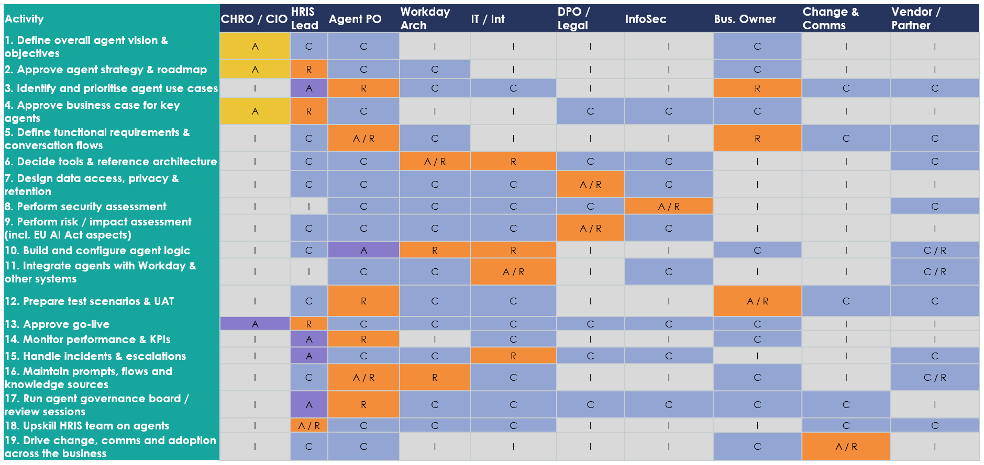
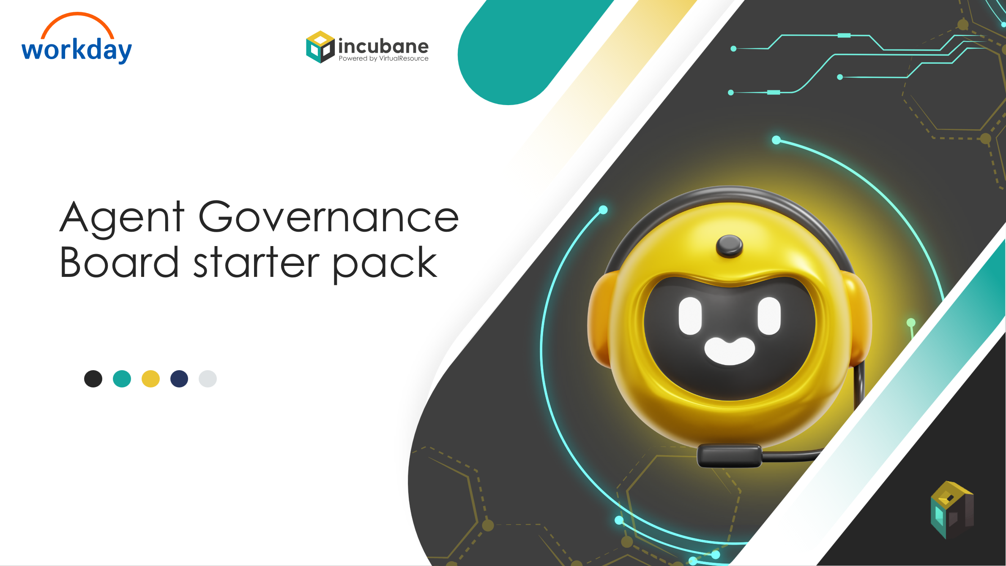
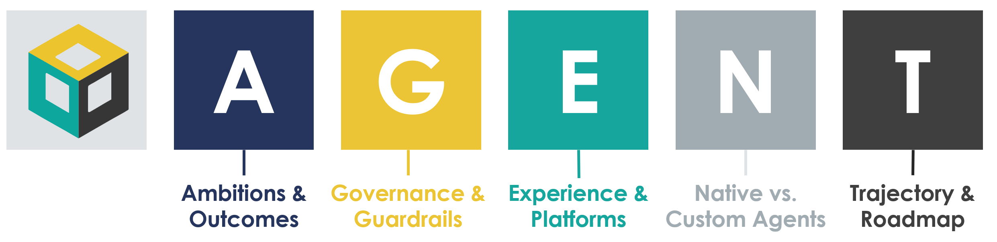
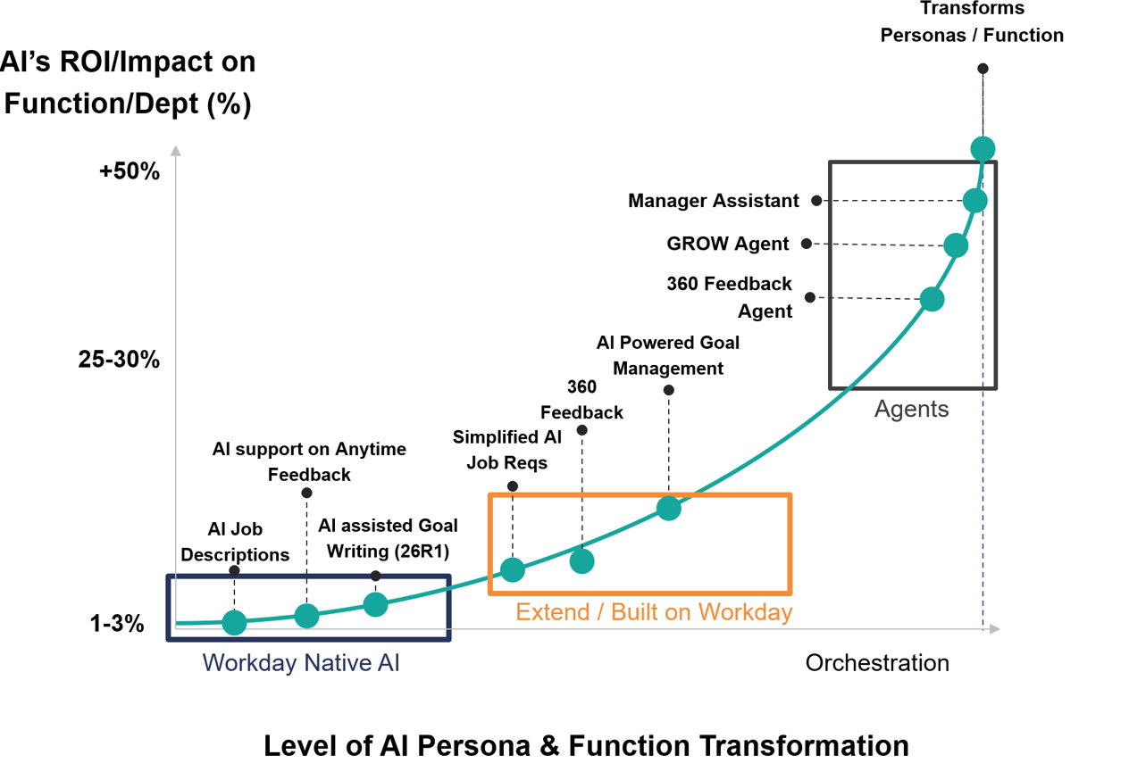
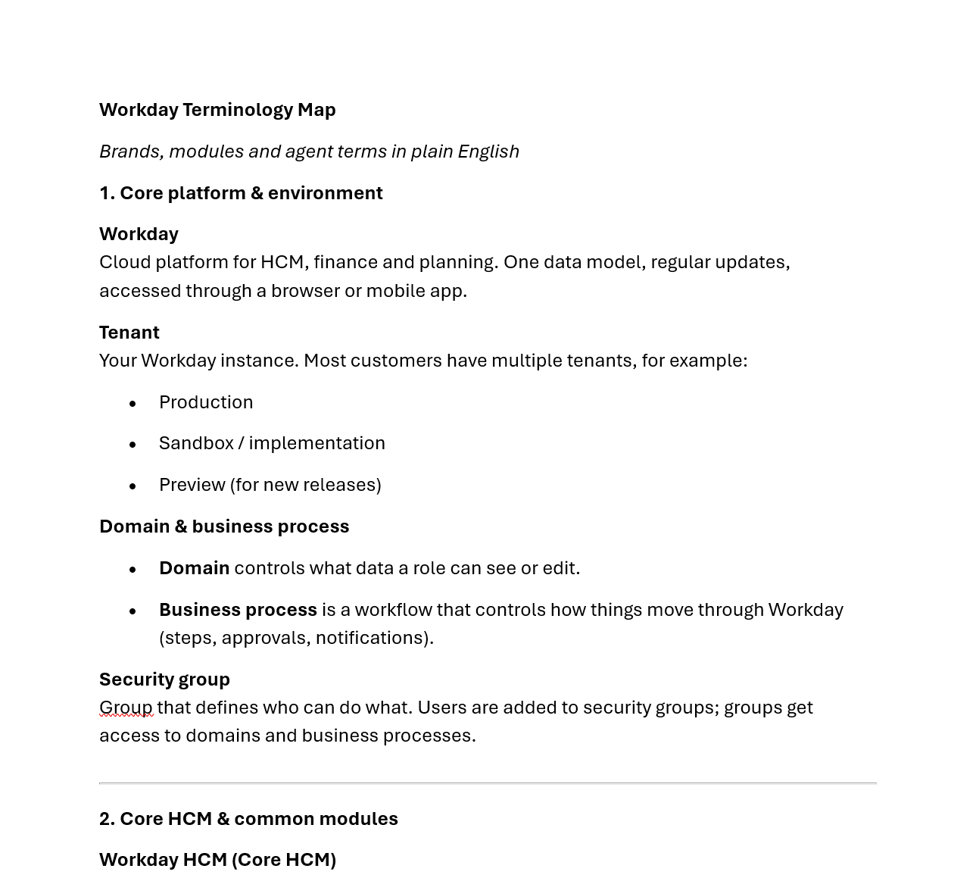
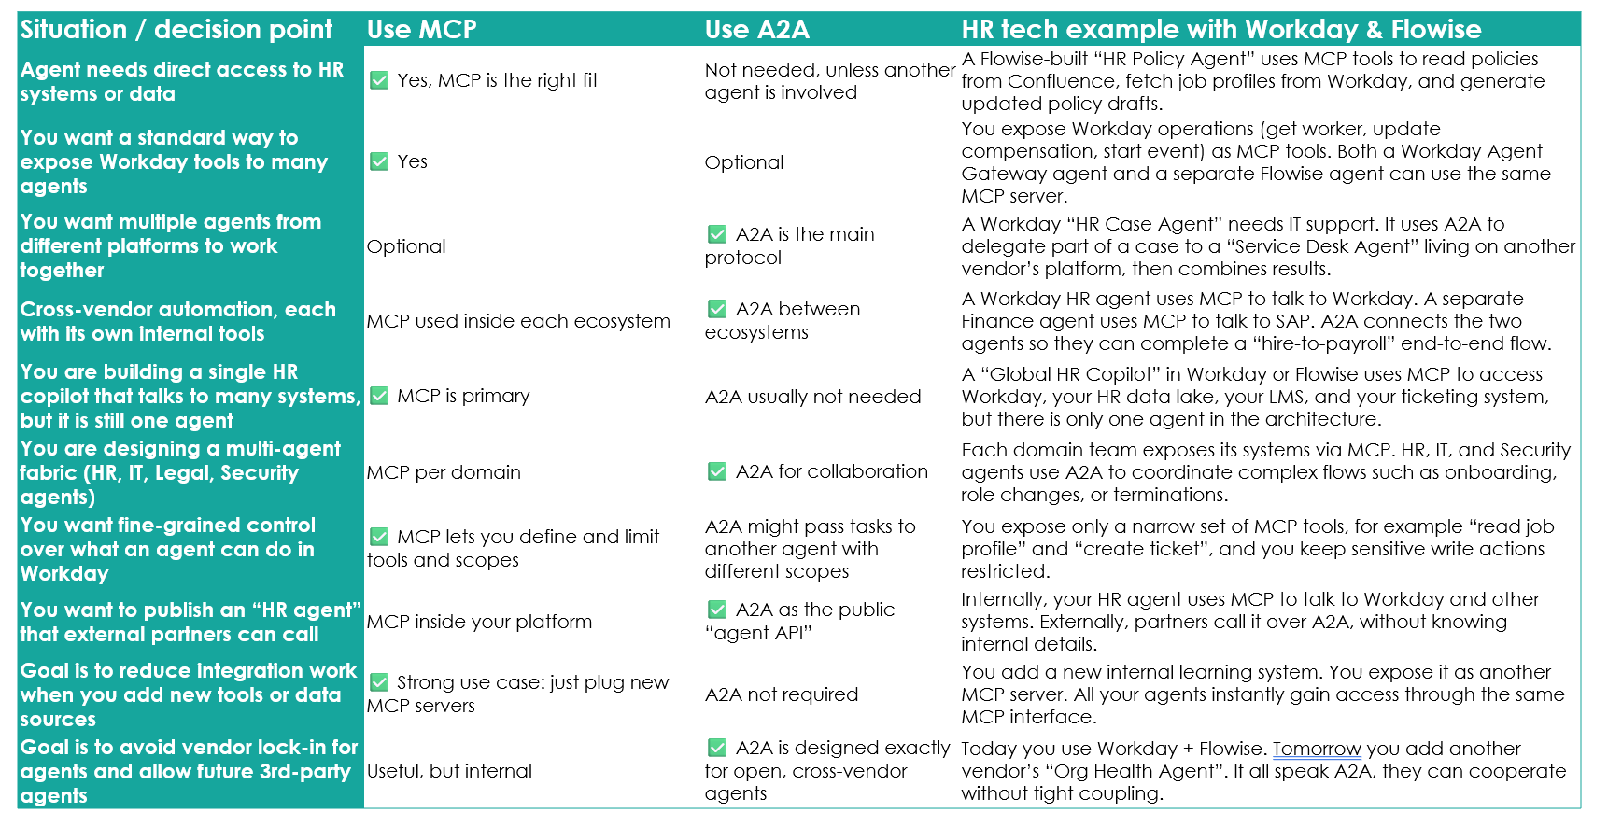
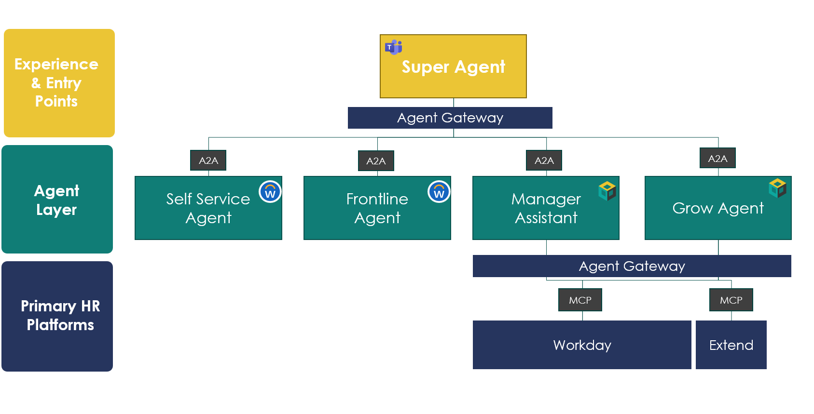
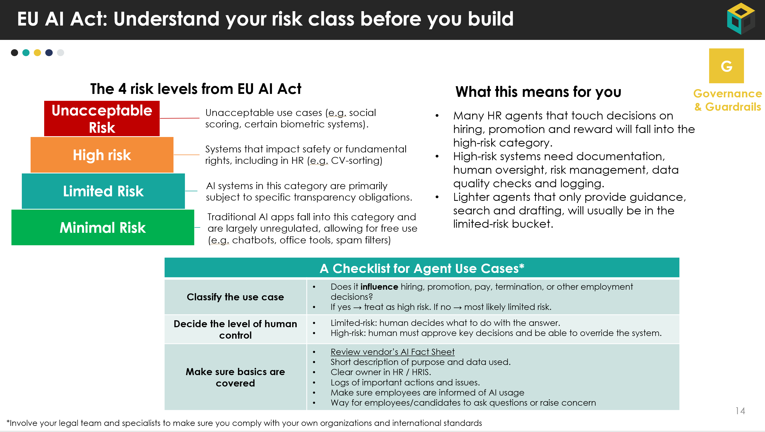
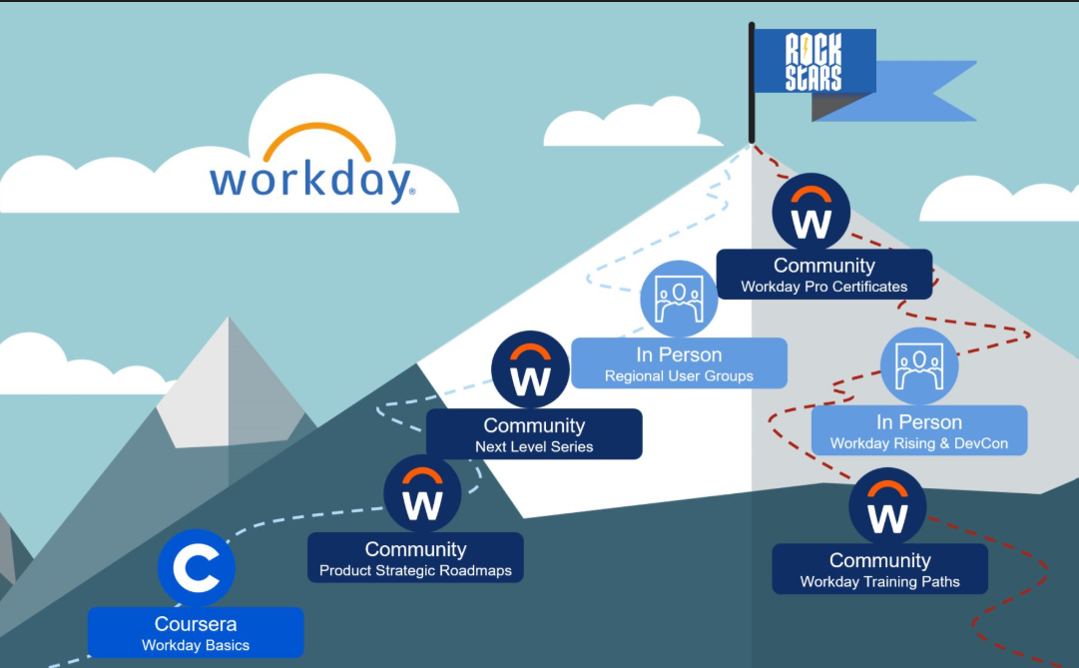
The HRIS Agent Strategy Blueprint
In line with our core value of Sharing Knowledge, we have built the HRIS Agent Strategy Blueprint. It will be released in three parts and is aimed to give you all necessary tools and templates to start your Agent Journey.
Click here to download PPT
Click here to download PPT
Strategy & Vision
Architecture & Build
Governance & People
Help HR tech lead define the vision and get buy in.
Show how to design and wire agents with Workday and Flowise.
Make it safe, compliant, and make sure people can run it.
Strategy & Vision
Strategy & Vision
Strategy & Vision
AGENT Framework & Templates
Agent Use Case Library for Workday
Business Case & Token Calculator Template
AI Readiness Assessment
Executive Pitch Deck template
On demand webinars
Workday & AI Glossary for HRIS Teams
Agent FAQ
Complex concepts simplified: Deterministic vs. Probabilistic, using RAG, Evals and more.
Guiding Principles for Agent Architecture
Agent Reference Architecture & MCP / A2A Explained and Decision Table
Multi-Agent Architecture Templates
Service request types & agent patterns
Flowise Patterns, Templates and Tutorials
EU AI Act Explained
Risk & Controls Checklist
Example RACI for Agents
Agent Governance Starter Pack for AI Board
HRIS Agent Upskilling Plan (Functional & Technical Track)

Slide 3
Table of Contents – Governance & People
Title | Description | Page
How to use this document | Brief explanation of who this document is for an how to use it | 4
EU AI Act explained for HRIS managers | Simple overview of the EU AI Act risk classes and what they mean for HR and Workday AI use cases. | 5
Risk & Controls checklist | Practical checklist of key risk and control questions to review any Workday AI feature or agent. | 13
Example RACI for agents | Suggested split of responsibilities across HR, HRIS, Legal, Risk, Security, business and vendors. | 15
Agent governance starter pack for your AI board | Short slide flow you can use to brief the AI governance board and get decisions on concrete use cases. | 17
Change Management Approach | A starting point for your Change Management approach using the ADKAR framework | 23
HRIS agent upskilling guide | Functional and technical learning paths with concrete resources to build your team’s agent skills. | 26

Slide 4



How to Use the Governance & People Blueprint
Who this document is for | HRIS leads and HR tech product owners. Legal, Privacy, Risk and InfoSec partners involved in AI decisions for Workday. Members of your AI governance or HR governance board.
When to use it | When you consider enabling a new Workday AI feature or agent. When you design a custom or partner agent and need risk and role clarity. When you prepare a governance board discussion on a specific AI use case.
How to work with it | Start with the EU AI Act overview to understand the basic concept, align on language and risk levels. Use the Risk & Controls checklist as a starting point to assess each AI use case. Review and modify the RACI to agree who does what across HR, HRIS, Legal, IT, business and partners. Use the AI Governance board starter kit slides to inform your board on Workday & AI and bring a potential case to your board Use the Upskilling guide to build the skills you need in HRIS and your wider team so this becomes a repeatable process.

Slide 5

EU AI Act Explained

Slide 6
EU AI Act: what HRIS managers need to know
The EU AI Act is the new EU law that regulates how AI is developed and used, based on the level of risk it can create for people
It does not ban AI in HR, but it sets stricter rules for AI that can affect people’s rights, for example hiring or promotion decisions
The Act uses risk categories (prohibited risk, high risk, transparency risk, general purpose AI) and attaches requirements to each.
Many HR and Finance use cases in Workday will fall in high risk or transparency risk, so we need clear governance, documentation and human oversight
Our goal as HRIS is: use the Act as a guardrail and checklist, not to become lawyers. We work with Legal, Risk and Privacy on the detailed interpretation.
Information only, not legal advice. Always confirm with your legal and privacy teams.

Slide 7
Workday’s role under the EU AI Act
The Act talks about three main roles for AI:
Provider – builds and sells AI systems.
Deployer – uses AI systems in its own operations.
Downstream provider – adds third party AI, for example GPT models, into its products.
Workday is:
A provider when it delivers native AI features and models inside Workday.
A deployer when Workday uses AI internally for its own processes.
A downstream provider when it plugs general purpose AI (GPAI) into Workday features.
Workday has had a formal Responsible AI program since 2019 and is updating its risk evaluation and documentation to match the EU AI Act categories and duties. For Workday native AI, Workday handles most provider obligations, including model testing, documentation and risk controls.
As a customer, we are mostly in the deployer role, so we focus on:
Deciding which AI features to use.
Using them in a way that fits our policies and local law.
Monitoring outcomes and raising issues if we see risks.
Information only, not legal advice. Always confirm with your legal and privacy teams.

Slide 8
EU AI Act: Understand your risk class before you build
The 4 risk levels from EU AI Act
What this means for you
Unacceptable Risk
Unacceptable use cases (e.g. social scoring, certain biometric systems).
Many HR agents that touch decisions on hiring, promotion and reward will fall into the high-risk category.
High-risk systems need documentation, human oversight, risk management, data quality checks and logging.
Lighter agents that only provide guidance, search and drafting, will usually be in the limited-risk bucket.
High risk
Systems that impact safety or fundamental rights, including in HR (e.g. CV-sorting)
Limited Risk
AI systems in this category are primarily subject to specific transparency obligations.
Minimal Risk
Traditional AI apps fall into this category and are largely unregulated, allowing for free use (e.g. chatbots, office tools, spam filters)
A Checklist for Agent Use Cases*
Classify the use case | Does it influence hiring, promotion, pay, termination, or other employment decisions? If yes → treat as high risk. If no → most likely limited risk.
Decide the level of human control | Limited-risk: human decides what to do with the answer. High-risk: human must approve key decisions and be able to override the system.
Make sure basics are covered | Review vendor’s AI Fact Sheet Short description of purpose and data used. Clear owner in HR / HRIS. Logs of important actions and issues. Make sure employees are informed of AI usage Way for employees/candidates to ask questions or raise concern
Information only, not legal advice. Always confirm with your legal and privacy teams.

Slide 9
What Workday already does and what we control
Workday responsibilities (high level)
Uses a risk based development process. Every new AI use case is assessed early, assigned a risk level, and given extra controls if needed. Aligns its Responsible AI program with frameworks like NIST and the EU AI Act risk model, including testing and documentation even for many lower risk features. Invests in transparency: AI fact sheets for generally available AI features. Clear information on model inputs, outputs, training approach and limitations. Runs internal programs to improve explainability, AI literacy, and AI policies
Customer controls inside Workday
Feature enablement – we decide which AI features and agents to switch on, and for which groups. Data contribution control – we can control if our tenant data is used to improve Workday models. Access and security – we can create security groups and AI governance groups that decide who can configure and use AI features. Transparency to employees – we can use Workday resources and our own comms to explain where AI is used and how people can ask questions or opt out where required.
As HRIS, our job is to combine Workday’s controls with our own policies and governance and involve Legal and Risk whenever we plan a new higher risk AI use case.
Information only, not legal advice. Always confirm with your legal and privacy teams.

Slide 10
Major AI-Related Legislation Impacting HRIS (Global Overview)
This overview highlights some of the most visible AI-related laws that can impact how you use AI in HR and HRIS, next to the EU AI Act. It is not exhaustive, but a starting point to spot where you may be in scope and to trigger a deeper conversation with your internal legal and compliance teams.
Legislation | Geography | Description | In Effect? | Specific Impact on HRIS/HR Tech
EU Artificial Intelligence Act (AI Act) | European Union (EU) | Comprehensive EU-wide framework regulating AI based on risk levels (bans unacceptable AI, strict rules for high-risk AI). Employment-related AI is deemed “high-risk”, triggering heavy compliance obligations. Also prohibits certain uses (e.g. emotion recognition in workplaces). | No (adopted, enforcement expected by 2026–27) | HRIS Impact: HR tools (hiring, monitoring, etc.) will require rigorous risk assessments, transparency measures, human oversight and bias mitigation. HR AI systems must be documented and audited to meet the Act’s standards. Some AI functionalities (like emotion analysis on employees) are outright banned, requiring HRIS providers to disable or avoid those features.
General Data Protection Regulation (GDPR) | EU (global reach) | Landmark data protection law governing personal data processing and privacy. Requires lawful basis, transparency to data subjects, and strong safeguards for personal data. It also restricts purely automated decisions that have significant effects on individuals. | Yes (in force since 2018) | HRIS Impact: HR systems handling EU residents’ data must ensure data transparency, access/correction rights, and data minimization. If an HRIS automates decisions (hiring, promotion, etc.) without human involvement, individuals have the right to be informed and to demand human review. Non-compliance can lead to fines, so HR tech must include privacy controls (e.g. consent prompts, opt-outs, explainability features).
Canada Artificial Intelligence and Data Act (AIDA) | Canada (federal) | Proposed federal AI law similar to the EU AI Act, aimed at regulating “high-impact” AI systems. Would impose requirements for transparency, fairness, and privacy in AI used by organizations operating in Canada. The law targets tools like automated decision engines, screening and biometric systems. | No (pending – expected 2025 enforcement) | HRIS Impact: HR AI solutions classified as “high-impact” (e.g. hiring algorithms, employee monitoring AI) will need to meet privacy, transparency, and bias mitigation standards. Employers using AI in HR will likely have to conduct assessments and ensure measures to prevent discrimination, akin to EU requirements. HRIS vendors may need to provide documentation and compliance support for Canadian clients.
China Internet Information Service Algorithmic Recommendation Regulations | China | Nationwide regulations (effective 2022) that mandate transparency and oversight of algorithmic recommendation services. Companies must disclose algorithm details to authorities, allow users to opt-out of personalized recommendations, and conduct regular audits for fairness. | Yes (since March 2022) | HRIS Impact: HR platforms operating in China that use recommendation or ranking algorithms (e.g. resume ranking, training recommendations) must register and publicly disclose key aspects of those algorithms. Systems must include user controls (e.g. ability to turn off AI recommendations) and undergo audits. Employers need to vet HR tech vendors for compliance with these transparency and reporting requirements to avoid regulatory penalties.
Information only, not legal advice. Always confirm with your legal and privacy teams.

Slide 11
Major AI-Related Legislation Impacting HRIS (Global Overview)
Legislation | Geography | Description | In Effect? | Specific Impact on HRIS/HR Tech
NYC Local Law 144 (Automated Employment Decision Tools) | New York City, USA | Pioneering local law prohibiting use of automated employment decision tools (AEDTs) for hiring or promotions unless the tool undergoes an annual bias audit by an independent auditor and results are published. Employers must also give candidates notice that AI will be used in assessment. | Yes (in force; effective July 2023) | HRIS Impact: Any HR software using AI/ML for recruiting (résumé screening, video interview scoring, etc.) in NYC must be audited yearly for bias, with a summary of the audit publicly posted. HRIS vendors need to furnish bias audit reports or tools cannot be used by NYC employers. Additionally, HR must inform candidates about the AI tool’s role and what characteristics it evaluates, ensuring transparency in AI-driven hiring decisions.
Colorado SB 24-205 (Colorado AI Act) | Colorado, USA | Comprehensive state law designating AI use in employment decisions (hiring, promotion, etc.) as high-risk. Requires employers (50+ employees) to implement AI risk management policies and conduct impact assessments for all AI systems. Employers must also publish a plain-language disclosure about their AI system’s use and data collection. Provides rights to individuals to correct AI-driven data and appeal significant automated decisions. | No (takes effect Feb 1, 2026) | HRIS Impact: Organizations using AI in HR processes must establish ongoing risk assessments and mitigation plans for those tools. HRIS software deployed in Colorado will need features for data correction and an appeals process for employees/candidates affected by automated decisions. Employers and HRIS providers share responsibility to prevent “algorithmic discrimination”, meaning HR AI tools must be designed and configured to avoid adverse impact on protected classes or face legal liability.
Illinois Artificial Intelligence Video Interview Act | Illinois, USA | First-of-its-kind state law regulating AI in hiring interviews. Requires companies to notify applicants and obtain consent before using AI to analyze video interviews. Employers must explain how the AI works and what characteristics it evaluates. Recorded interview videos can only be shared with persons necessary to evaluate the candidate, and applicants can request deletion of their video and AI analysis within 30 days. | Yes (in force since Jan 2020) | HRIS Impact: HR hiring systems with video interview analytics must include informed consent workflows and clear explanations for candidates. HRIS or video interview platforms need functionality to delete interview recordings/analysis on request. These requirements promote data transparency and give candidates control, so HR departments may avoid or heavily vet AI video interview tools to remain compliant (Illinois also mandates annual reporting of demographic data if AI-only video screening is used).
Information only, not legal advice. Always confirm with your legal and privacy teams.

Slide 12
Major AI-Related Legislation Impacting HRIS (Global Overview)
Legislation | Geography | Description | In Effect? | Specific Impact on HRIS/HR Tech
Illinois Human Rights Act – AI Amendment (HB 3773) | Illinois, USA | Recent amendment to Illinois’ anti-discrimination law (IHRA) explicitly banning the use of AI (including generative AI) in ways that discriminate against protected classes (even unintentionally). Requires employers to notify employees and applicants whenever AI is used to “influence or facilitate” any employment decision (hiring, promotion, discipline, etc.). Enforcement by the state human rights department with civil penalties and remedies for violations. | Yes (effective Jan 1, 2026) | HRIS Impact: Employers must transparently disclose any HRIS features or tools that use AI in employment decisions. HRIS platforms will need to provide information to employers about where AI is embedded (e.g. in screening, performance analytics) to enable these notices. The law’s broad ban on AI-driven bias means HR tech used in Illinois must be carefully tested and monitored for disparate impact – using AI that results in biased outcomes can lead to discrimination claims. Compliance may involve documentation of AI logic and regular bias audits (even though Illinois does not mandate audits, proof of fairness will be critical).
California FEHC Automated-Decision Systems Regulations | California, USA | New regulations (2025) by California’s Civil Rights Council extending the Fair Employment and Housing Act (FEHA) to cover automated decision systems in employment. Unlawful to use AI or algorithms that result in discrimination against applicants or employees. Requires human oversight of AI-driven decisions (no fully autonomous hiring decisions), and mandates employers retain records of AI criteria and outputs for 4 years. The rules broadly define covered AI tools (e.g. resume screeners, video interview analyzers, candidate matching algorithms). | Yes (effective Oct 1, 2025) | HRIS Impact: HR systems using automated decision-making in California must be deployed with built-in human review processes – employers cannot rely solely on AI for final employment decisions. HRIS vendors need to ensure their tools allow for human intervention and produce audit records of how decisions are made, since employers must keep AI-related records for at least four years. AI-driven assessments that disproportionately screen out protected groups could directly violate California law, so HR tech providers and users must rigorously test for bias and make accommodations for people with disabilities or other protected traits (aligning AI tool use with traditional FEHA non-discrimination mandates).
California Consumer Privacy Act – Automated Decision Rules | California, USA | Recent amendments to California’s privacy laws (CCPA/CPRA) to address AI: From 2027, covered employers using automated decision-making technology in employment must notify applicants and employees about its use. Individuals must be given the right to opt out of automated decisions (or alternatively, a right to appeal to a human decision-maker). Employers will also be required to conduct impact assessments of these AI tools and answer employees’ requests with plain-language explanations of how the AI works. | No (effective Jan 1, 2027) | HRIS Impact: HR technology used in California will need to support transparency and choice for employees. This means HRIS software should be able to generate user-friendly explanations of any algorithms used in hiring or HR decisions, and provide mechanisms to handle opt-out requests (e.g. offer a manual process if someone opts out of AI). Employers will need to perform algorithmic bias and privacy impact assessments on HRIS tools, so vendors may be expected to supply assessment documentation. These requirements elevate employees’ rights around automated decisions (similar to GDPR).

Slide 13
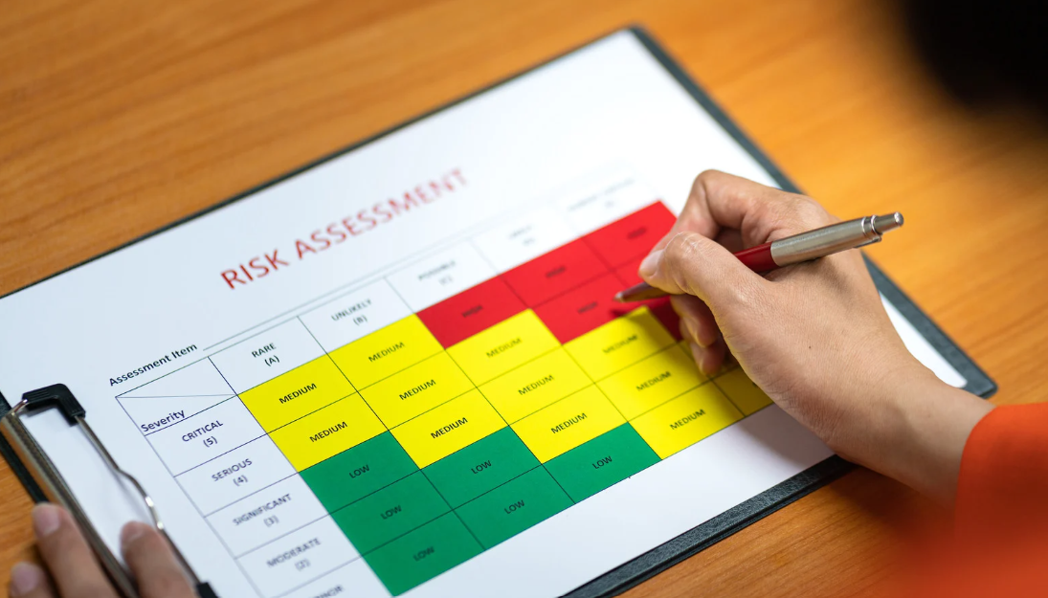
Risk & Controls - Checklist

Slide 14
Risk & Controls Checklist
Area | Risk / control question for this use case | Example control(s) to consider | Suggested owner | In place? (Y/N) | Notes / actions
Purpose & risk level | Does the use case influence hiring, promotion, pay, termination, access to benefits, or other fundamental rights? | Classify as high-risk if yes; document intended purpose and what decisions it supports; confirm with Legal if it falls under EU AI Act high-risk. | HRIS + Legal
Roles & responsibilities | Have we clearly defined who is provider, deployer and any downstream provider for this AI? | Document whether it is native Workday, partner, or custom; record vendor responsibilities vs our responsibilities; capture contact points. | HRIS + Vendor Mgmt
Data sources & quality | Which data fields does the AI rely on, and is that data accurate and up to date? | List all key data sources; check for missing or conflicting values; schedule regular data quality checks or run a Data Quality Agent. | HRIS / Data owner
Lawful basis & privacy | Is the use of personal data for this AI covered by our existing legal basis and privacy notices? | Validate with Privacy / DPO; ensure records of processing are updated; consider DPIA if high-risk; minimise data where possible. | Privacy / Legal
Fairness & bias | Could the AI output create unfair outcomes for protected groups? | Review vendor fact sheet or documentation; check if model was tested for bias; plan periodic fairness checks on our own data. | HRIS + People Analytics
Human oversight | Where and how can humans review, override or stop the AI? | Define mandatory human review points; ensure UI clearly allows override; document when human approval is required before actions are taken. | Process owner
User transparency | Do affected employees/managers know AI is being used and how to raise concerns? | Include AI in policy / FAQs; show clear indicators in the UI; provide a contact or form to ask questions or challenge outcomes. | HR / Comms
Security & access | Who can configure, run and see the outputs of this AI? | Use Workday security groups; restrict access to sensitive outputs; apply least-privilege; review access regularly. | HRIS / Security
Vendor assurance | For native or partner AI, have we reviewed the vendor’s AI documentation? | Collect Workday AI Fact Sheet or partner equivalent; check risk classification, limitations, and recommended controls; keep in a central repo. | HRIS + Procurement
Monitoring & logging | How will we monitor performance, errors and misuse over time? | Enable logging; define KPIs (accuracy, time saved, complaint rate); set schedule to review metrics and incidents; plan rollback option. | HRIS + Risk
EU AI Act alignment | Have we mapped this use case to an EU AI Act category and checked key obligations? | Use simple mapping: prohibited / high / transparency / minimal; ensure high-risk use cases have extra documentation, testing and oversight. | Legal / Risk
Information only, not legal advice. Always confirm with your legal and privacy teams.

Slide 15

Example RACI for Agents

Slide 16
Example RACI for agents
Activity | CHRO / CIO | HRIS Lead | Agent PO | Workday Arch | IT / Int | DPO / Legal | InfoSec | Bus. Owner | Change & Comms | Vendor / Partner
1. Define overall agent vision & objectives | A | C | C | I | I | I | I | C | I | I
2. Approve agent strategy & roadmap | A | R | C | C | I | I | I | C | I | I
3. Identify and prioritise agent use cases | I | A | R | C | C | I | I | R | C | C
4. Approve business case for key agents | A | R | C | I | I | C | C | C | I | I
5. Define functional requirements & conversation flows | I | C | A / R | C | I | I | I | R | C | C
6. Decide tools & reference architecture | I | C | C | A / R | R | C | C | I | I | C
7. Design data access, privacy & retention | I | C | C | C | C | A / R | C | I | I | I
8. Perform security assessment | I | I | C | C | C | C | A / R | I | I | C
9. Perform risk / impact assessment (incl. EU AI Act aspects) | I | C | C | C | C | A / R | C | I | I | I
10. Build and configure agent logic | I | C | A | R | R | I | I | C | I | C / R
11. Integrate agents with Workday & other systems | I | I | C | C | A / R | I | C | I | I | C / R
12. Prepare test scenarios & UAT | I | C | R | C | C | I | I | A / R | C | C
13. Approve go-live | A | R | C | C | C | C | C | C | I | I
14. Monitor performance & KPIs | I | A | R | I | C | I | I | C | I | I
15. Handle incidents & escalations | I | A | C | C | R | C | C | I | I | C
16. Maintain prompts, flows and knowledge sources | I | C | A / R | R | C | I | I | C | I | C / R
17. Run agent governance board / review sessions | I | A | R | C | C | C | C | C | C | I
18. Upskill HRIS team on agents | I | A / R | C | C | C | I | I | I | C | C
19. Drive change, comms and adoption across the business | I | C | C | I | I | I | I | C | A / R | I

Slide 17
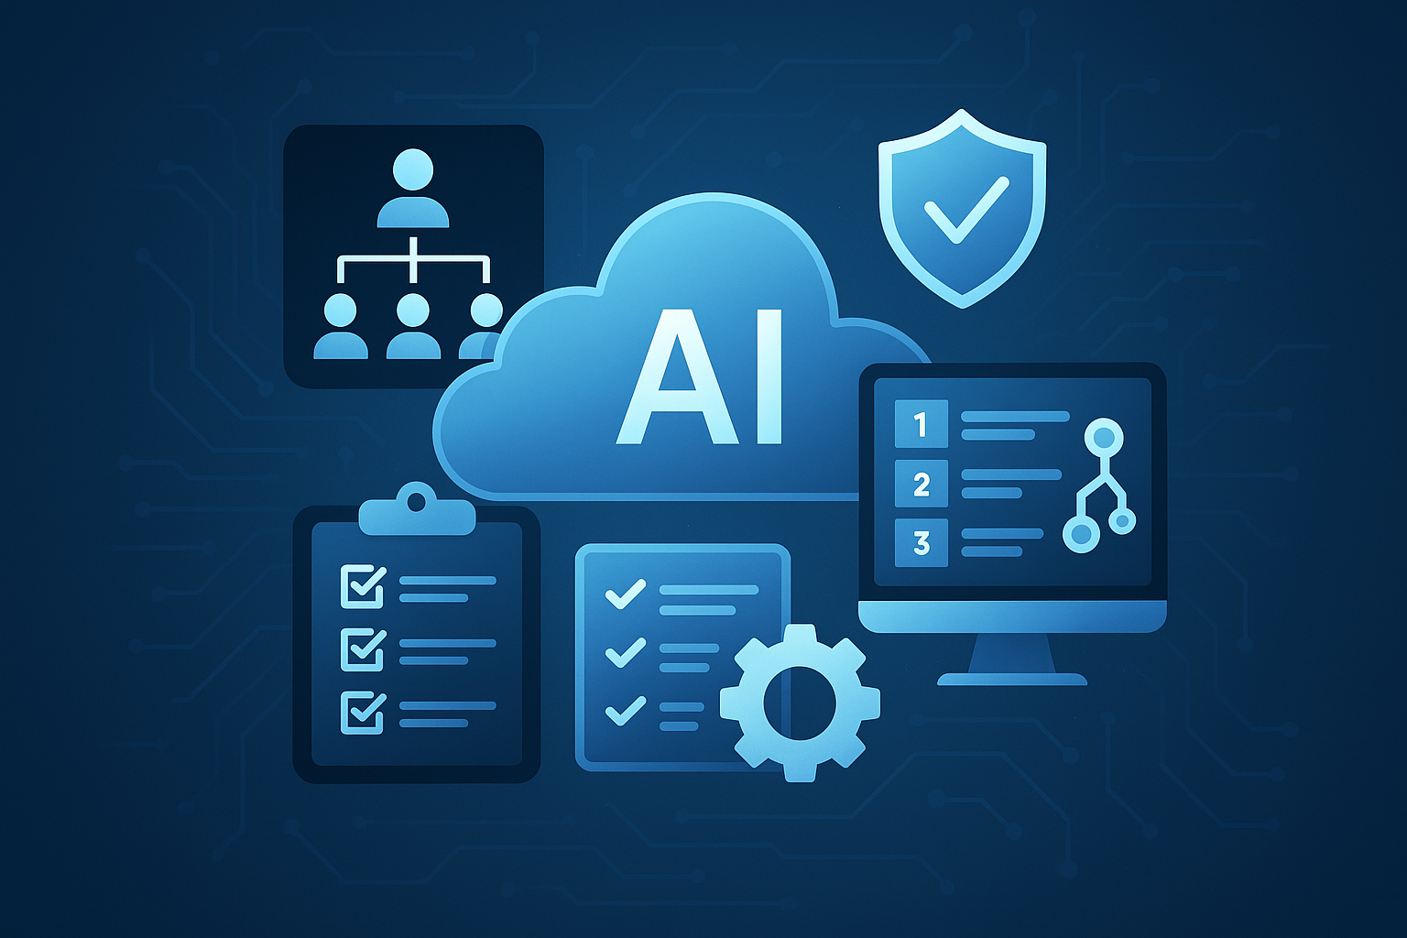
Agent Governance Starter Pack

Slide 18
Workday AI, what we are asking from the AI governance board
Why we are here
Workday now ships more AI and agent features in HR and Finance. Some are already in our tenant or our license. As HRIS, we do not want to “just switch them on”. We want a clear, agreed way of deciding which features we use and how. Today is about giving you enough context on Workday AI, and agreeing how we will involve this board for current and future Workday AI decisions.
What is in scope of this deck
In scope are AI capabilities inside Workday This includes: Native Workday AI features (for example recommendations, anomaly detection, assistants). Partner AI that is integrated with Workday (for example marketplace apps or agents). Custom agents or apps we might build on Workday (Extend, Flowise, integrations).
What we need from the board
Agreement on a simple set of guardrails for Workday AI Agreement on a standard checklist and review path for Workday AI use cases. A shared view on who must be involved for Workday AI decisions and when they are involved For the concrete feature or agent we present today, we also ask for a clear decision

Slide 19




How Workday uses AI
Where AI appears in Workday today
Types of AI in Workday
AI is getting more embedded in Workday and will likely appear in all areas. Currently we predominantly see it:
HR: recruiting, skills and profiles, learning, performance, help / case deflection.
Finance: anomaly detection, forecasting, account reconciliations, contracts.
Classic ML: predictions, recommendations, anomaly detection.
GenAI: summarisation, content suggestions, conversational assistants.
Agents: AI that can use tools, call APIs and perform actions in processes.
Transparency Tools
Types of solutions we will bring
For native and some partner AI, Workday provides AI Fact Sheets with purpose, inputs, outputs, limitations. We will use these as standard input for your reviews.
Native Workday AI features (designed and governed by Workday).
Partner AI integrated into Workday (for example through marketplace).
Custom agents we or a partner build on Workday (Extend, Flowise, integrations).

Slide 20
Governance, roles and EU AI Act view
Workday
Acts as provider of native AI and some partner / platform components. Runs a formal Responsible AI program and aligns with EU AI Act risk categories. Provides documentation (fact sheets, model info) and technical controls (security, logging, configuration).
Our organisation
Decides which Workday AI features to enable, for whom, and in which processes and acts as a deployer (potentially working with a partner). Must ensure use is consistent with policy, law, and EU AI Act obligations for deployers, especially for HR high-risk use cases (for example hiring, internal mobility, performance). Owns process design, communication to employees, local DPIAs / impact assessments where required.
Practical guardrail for HRIS
Be extremely careful and sensitive when working with people data Treat Workday AI that affects people’s opportunities or salary as high-risk by default. Aim for use cases that fall into the Limited risk category of the EU AI Act. Always involve Legal / Privacy / Risk for these features and for custom or partner agents.
Information only, not legal advice. Always confirm with your legal and privacy teams.

Slide 21
Workday AI use case checklist for the board
For each Workday AI feature or agent we bring to you, we will answer these questions up front (in addition to any other standards you may have):
Topic | Questions
Purpose and outcome | What decision or task does the AI support? Is it advisory only or can it trigger actions / changes in Workday?
Impact and risk level | Does it impact hiring, promotion, pay, termination, or access to benefits? Proposed EU AI Act view (for example likely high-risk vs lower risk / transparency only).
Data and fairness | Which data fields are used? Are there known data quality issues? What has Workday or the partner done on bias / fairness testing?
Human oversight and user experience | Where is human in the loop? Who can override or correct the AI? How will employees and managers be informed that AI is used?
Controls, monitoring and exit | Which controls we will apply in Workday (security groups, configuration, access limits). How we will monitor usage and outcomes, and when we would pause or roll back the feature. What happens to our data if we stop using the feature.

Slide 22
Example use case and decision we ask today
In case there is no existing template for your governance board you can use the one below
Topic | Answer
Feature / Agent Name | For example: “Workday Recruiting AI feature X” or “Custom Manager Assistant Agent”.
Process and personas | Process: which HR / Finance process it supports. Personas: employees, managers, HR, finance, etc.
Value Summary | What value will the use of this application drive?
Business Case | Use the business case template to calculate the ROI
Solution type | Native Workday / Partner integrated / Custom built on Workday.
Type of AI | GenAI/Machine Learning/Agent/
Risk and controls summary | Short summary for each checklist area: Purpose and impact. Proposed risk view (for example likely high-risk). Key data used. Human oversight points. Proposed controls and monitoring.
AI Fact Sheet | Link
Ask to the board | Decision: enable / enable as pilot / not enable yet. Any conditions (for example extra monitoring, limited population, time-boxed pilot). Named owner and review date.

Slide 23

Change Management Approach

Slide 24

Why change management for agents
Agents touch daily work for employees, managers and HR. If people do not trust it, they will not use it, no matter how smart it is. We use the ADKAR model to guide the people side of agent adoption.
Awareness
Desire
Knowledge
Ability
Reinforcement
Awareness
Desire
Knowledge
Ability
Reinforcement
People understand why we introduce agents on top of Workday.
Key groups see “what is in it for me” and want to try it.
Users know how the agent works, what it can and cannot do.
People can use it in real tasks and know where to go for help.
We keep the new way of working alive with follow up, feedback and KPIs.

Slide 25
ADKAR Action Plan
Phase | Managers & Employees | HR, IT & HRIS
Awareness | Simple story: why we use agents, how Workday stays the source of truth. Use short videos, demos, manager briefings. | Joint sessions on agent strategy and risk, link to overall HRIS roadmap.
Desire | Show concrete benefits: fewer clicks, faster answers, better guidance. Use early adopter stories from real teams. | Show how agents reduce manual tickets and free time for real HR work.
Knowledge | Quick guides: “3 things this agent can do for you today.” In-app tips, FAQ based on real questions. | Training paths from the blueprint: functional and technical tracks. Explain deterministic vs probabilistic, RAG, governance basics.
Ability | Start with pilots and small groups, offer support channels. Ask users to try specific tasks with the agent. | Co-build first agents with Incubane or internal experts. Give HR / HRIS clear roles in testing, Evals and fact sheets.
Reinforcement | Share usage numbers and small wins. Recognise teams that use the agent well and give feedback. | Add agent adoption KPIs to HRIS scorecard. Use regular retros to adjust prompts, flows and training.
Desire
Knowledge
Ability

Slide 26
HRIS Agent Upskilling Guide

Slide 27







How to Use this Agent Upskilling Path as an HRIS Team
Agent Upskilling
Program
1. Pick people and tracks
6. Feed into roadmap
Assign each team member to a primary track:
Functional track for HRIS product owners, HR process owners, HRBPs
Technical track for HRIS analysts, integration specialists, developers
All should complete the Flowise sessions
When a use case looks solid, use the Risk and Controls checklist and Business Case tab
Bring these to your AI governance board or similar forum for review
Add approved use cases to your HRIS / Workday roadmap
2. Block real learning time
5. Pair functional and tech
Agree on a simple rule: 2–3 hours per week per person for learning. Put this in the calendar, same slot every week. Treat it like a project meeting, not “nice to have”.
For each promising use case, create a small pair. One functional owner and one technical owner.
Ask them to use the next modules to:
Refine the process design (where to keep deterministic steps, where an agent)
Sketch a simple architecture using Workday and, later, Flowise or other tools
3. Learn in small sprints
4. Connect learning to real use cases
Take the tables module by module, in order. For each module:
Everyone watches / reads the resource for their track
They write 3 bullets: “what I learned” and “what this could mean for Workday”
They bring those bullets to a short discussions in your team meeting
After every 2–3 modules, run a 30–45 minute team sessionAsk functional track:
“Which HR processes could benefit from this, in our tenant
”Ask technical track: “How would we roughly implement this, with Workday tools we know”
Capture outputs in your Agent Use Case Library and Business Case tabs. Force yourself to end each session with one concrete idea added or updated

Slide 28
Functional Upskilling Track
Topic / Module | Resource (Link) | Format | Description / Key Learning
AI Agents 101 – Foundations | Introduction to AI Agents (DataCamp Course) | Online Course | Fundamental concepts of AI agents. Explains what agents are and how they differ from chatbots or basic automation, covering key components (like memory, tool use, orchestration) and the Thought-Action-Observation (TAO) loop – all without coding. Provides a beginner-friendly foundation for understanding “agentic” AI systems in business.
Agents vs. Chatbots – What’s the Difference? | AI Agents in HR: 10 Practical Use Cases (Teamflect Blog) | Article | Clarifies the capabilities of AI agents in contrast to standard chatbots. Emphasizes that chatbots answer questions, while AI agents take action to get things done, automating tasks and making recommendations. Through 10 HR-specific use cases (from automating job postings to analyzing engagement surveys), readers see how agents can save HR teams hours by handling recruiting, onboarding, policy Q&A, performance reviews, etc.. This builds understanding of where agents fit into HR workflows.
Flowise Tutorials | Flowise Tutorials on Youtube | Video Series | In our own Incubane Flowise tutorials we show you the basics from Flowise. You will understand some of the core concepts, which will give you a good starting point if your organization decides to move forward with Flowise.
Super Agents | From Assistants to Super Agents: Where AI is Going Next | Podcast | In this podcast Josh Bersin discusses the evolution of AI in the enterprise and how we shift from a focus on individual productivity to a focus on multi-functional Superagents. In HR the idea of Superagents lets us rethink our HR practices from the ground up and vastly simplify the way our company works. And Superagents bring autonomy to business.
HR Case Study – Recruiting with AI | Ace Hardware’s AI Hiring “Aha Moment” (Paradox Blog Interview) | Article (Interview) | Case study of agent implementation in recruiting. An interview with Ace Hardware’s TA Director on using a conversational AI agent (via Paradox) integrated with Workday Recruiting. It details how AI handled interview scheduling and candidate communications, resulting in an 86% candidate conversion rate and thousands of hours saved. Offers functional teams a concrete example of improving hiring speed and freeing HR staff for higher-value work.
Responsible AI & AI Governance | Workday’s AI Masterclass | Video series | Learn to responsibly build, deploy, and govern AI for business. Workday AI Masterclass features expert insights for creating a brighter work day. Visit each module to access all lessons and resources.
Designing Agentic Workflows | Agentic AI: Workflows vs. agents | Video | In this video, Aja and Jason discuss agentic workflows, how agents are different from workflows, and when to use an agentic workflow.
AI Agents in Production | AI Agents in Production: Lessons from Rippling and LangChain | Video | How does a company deploy AI agents across HR, payroll, IT, and finance products used by thousands of companies? Ankur Bhatt, Head of AI at Rippling, shares insights on building production-ready agents with Harrison Chase, CEO of LangChain.
Workday Agents | Workday's Talent Mobility Agent | Workday Learning (free course) | This video highlights how HiredScore AI for Talent Mobility integrates with Workday Talent Optimization. We also cover how the Talent Mobility agent benefits employees, recruiters, managers, and talent leaders.
Workday Agents | Contract Negotiation Agent | Workday Learning (free course) | This video explores the Contract Negotiation Agent, a built-in document editor that provides a seamless experience for editing, reviewing, and redlining your workflow documents. You will also review some AI drafting tools.
Workday Agents | Contract Intelligence Agent | Workday Learning (free course) | This video provides instructions for using Ask AI in Evisort to obtain answers to questions about contracts.

Slide 29
Technical Upskilling Track
Topic / Module | Resource (Link) | Format | Description / Key Learning
AI Agent Integration with Workday | OpenAI Cookbook: GPT Actions for Workday (OpenAI Guide) | Documentation | Guide to integrating ChatGPT (GPT-4) with Workday via APIs. Demonstrates how to use OpenAI’s function-calling (Custom Actions) to have ChatGPT perform Workday tasks (like submitting PTO requests or retrieving employee info) autonomously. Covers Workday OAuth setup and example API calls (e.g. Request_Time_Off, Get_Workers) to show how an AI agent can safely act within Workday. This teaches technical users how an LLM-based agent can interface with a live HRIS. For inspiration only, not production grade.
Flowise Tutorials | Flowise Tutorials on Youtube | Video Series | In our own Incubane Flowise tutorials we show you the basics from Flowise. You will understand some of the core concepts, which will give you a good starting point if your organization decides to move forward with Flowise.
Low-Code Agent Development (Workday) | Flowise AI – Visual Agent Builder | Tool (Docs) | Intro to Flowise, the low-code platform now part of Workday. Flowise allows visually building AI agents and workflows with drag-and-drop nodes. The documentation outlines key features: a visual builder, support for tools/LLMs, memory, human-in-the-loop, and easy deployment options.
Workday AI Platform & Agents | Workday Build and AI Agents (Blog) | Article (News/Blog) | Overview of Workday’s AI developer tools and agent offerings. The first blog introduces Workday Build – a unified developer platform with the new Workday Flowise Agent Builder for creating custom AI agents within Workday.
Workday AI Gateway | Getting Started with AI Gateway | Workday Learning (free course) | In this course, you will learn how to modify an app that scans a resume, and shows condensed information about the applicant, as well as their skills that are relevant to the target job. Additionally, you will learn how to work with the Workday Machine Learning APIs, modify and deploy an Extend application, and discover how to find and use the output from a Machine Learning API in your application’s logs.
MCP | Building Agents with Model Context Protocol | Video (long) | The Model Context Protocol is a universal, open standard for connecting AI systems with data sources, replacing fragmented integrations with a single protocol. This workshop from Anthropic -- the creators of MCP -- talks about the philosophy behind MCP, its impact on the broader ecosystem since launch, and how developers can use it to build context-rich AI apps and agentic experiences.
Multi Agent Archictures | Multi-agent Systems Architectur Design Patterns | Video | In this video, they explore the fundamental architectures of multi-agent AI systems. As your AI applications grow in complexity with more tools and requirements, agents can become confused about tool selection. Understanding your underlying architecture is key to building effective systems.

Slide 30


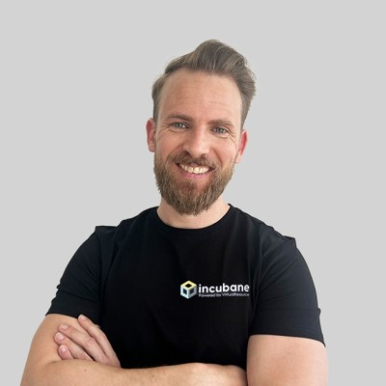

How Incubane can help you with governance & people
Design your AI governance model
Working with AI risk and compliance
Build the operating model and skills
Run working sessions with HR, HRIS, Legal, Risk and IT using this blueprint.
Help you define a practical AI governance model around Workday
Turn the Risk & Controls checklist into a living tool, not a one-off slide.
Translate EU AI Act and internal policies into simple guardrails for HR and HRIS.
Support you in documenting use cases, risk classification and controls in a way auditors and regulators understand.
Help you build lightweight fact sheet packs per agent / feature so HR, works councils and employees know what is in use.
Help you define a target operating model for agents.
Who owns which agent, who monitors performance, who handles incidents.
Use our upskilling paths to train HRIS, HR product owners and IT on agents, governance and basic AI literacy.
Co-facilitate pilot reviews and retros so your governance board gains confidence and speed
Contact Us
If you want to build your agent strategy
If you want to learn how to build agents inhouse
If you have an agent use case you want to work together on
Rick Leunisse
rick.leunisse@incubane.com
Matt Komendolowicz
matt.komendolowicz@incubane.com

Slide 31

Thank you

