Slide 1

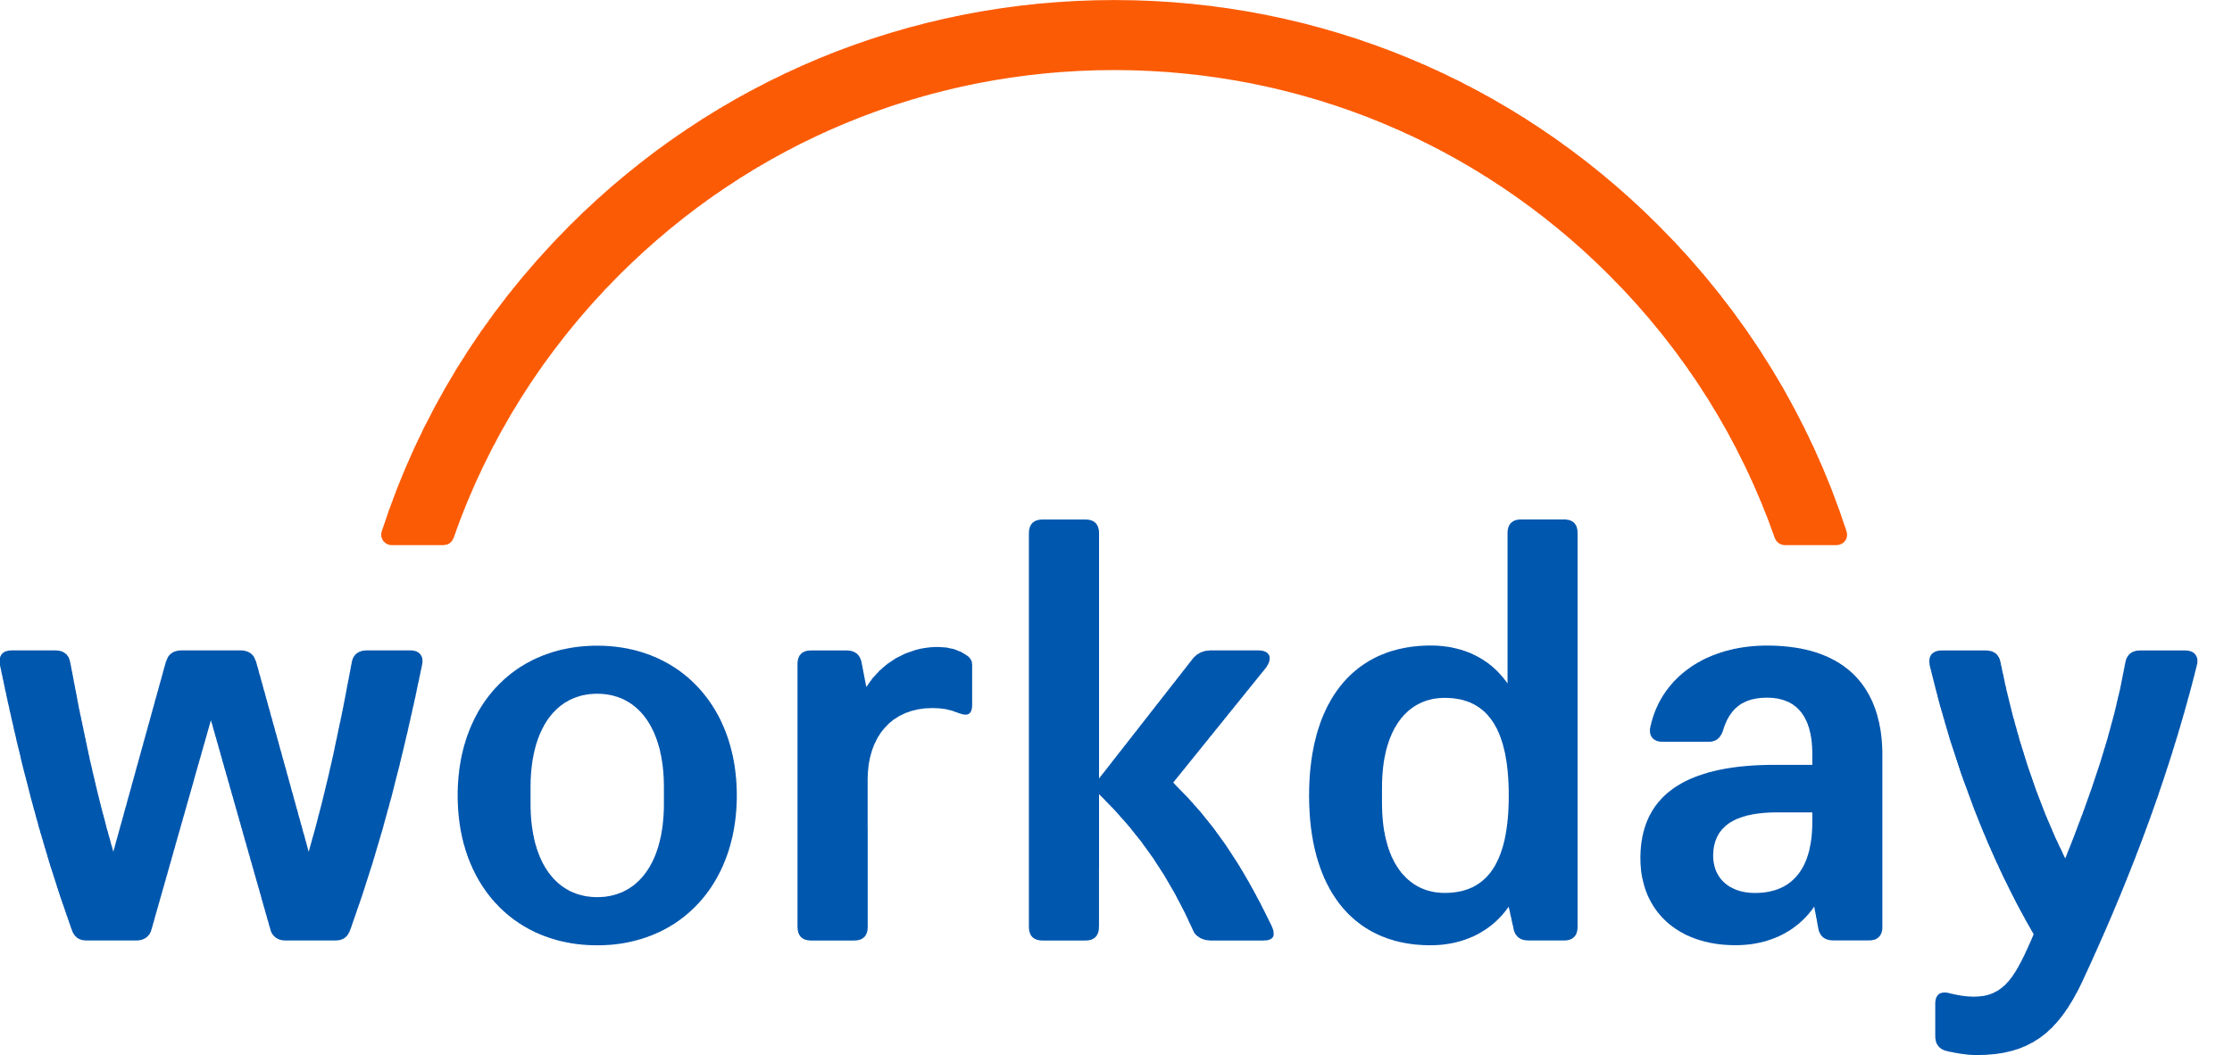


Incubane’s A.G.E.N.T. Strategy Framework

Slide 2
Agent Strategy Framework

Slide 3


Agent Strategy Template
A
Ambitions & Outcomes
Field | Description | Your input
Vision statement | One sentence on why you invest in agents
Main personas | 2-3 key personas (e.g. HRBP, Manager, Employee, Finance) | Persona
Top 3 problems to solve | Concrete pains you want to remove | Pain point X Y Z
Business outcomes | e.g. faster cycle times, better decisions, less manual work
Key KPIs | 3-5 KPIs you will track for agents
Governance & Guardrails
Field | Description | Your input
Risk appetite | How much risk you accept for agents, for example conservative, balanced, ambitious | e.g. “Balanced, low for HR core data”
Data boundaries | What data agents can and cannot use, including sensitive data and cross border rules | List key data domains and red lines
Use case risk levels | Simple categories for use cases, for example low / medium / high risk, or EU AI Act categories | Define levels and examples per level
Human in the loop | When a human must review or approve actions before they hit Workday or other systems | List processes where review is required
Approval model | Who approves which type of agent use case or change, and in which forum | e.g. AI board, HRIS CAB, data privacy
Compliance & EU AI Act | How you make sure agents follow local law and EU AI Act rules | Note required checks and documents
Monitoring & audit | How you log agent activity, monitor outcomes, handle incidents and give recourse | Tools, reports and escalation process
Roles & responsibilities | Who owns what in practice, for example HR, HRIS, IT, legal | RACI style list of key roles
Documentation & transparency | What you document for each agent, and how to share with employees and works councils | Decide minimum docs per agent
G

Slide 4


Agent Strategy Template
E
Experience & Platforms
Field | Description | Your input
Target journeys | Key journeys where users will work with agents, e.g. hire, transfer, performance | List 3 to 5 core journeys
Experience goals | How the experience should feel, e.g. fast, trusted, simple, no jargon | 3 to 5 words that describe the experience
Handover to humans | When the agent should hand over to a human | Describe rules for handover
Agent Builder Platform | Main tools and platforms, for example Flowise, LLM provider, integration tool | List your standard platforms
Primary HR Platforms | Where ~ 80 percent of HR activity happens, for example Workday, ticketing, LMS, intranet etc. | List 3 to 5 systems that must be integrated first
Entry points | Where users meet agents, for example WD Assistant, Teams, Slack | Choose main channels
Integration pattern | How agents talk to systems, for example APIs,, MCP, A2A | Describe preferred patterns
Measurement of experience | How you will measure success, for example CSAT, NPS, completion time | 3 to 5 metrics
Native vs. Custom Agents
Field | Description | Your input
Strategic direction | Overall view on native vs. custom, e.g. native first, custom where it adds clear value | Short statement
Primary native agents | Workday delivered or partner agents you plan to use and extend | List core native agents
Primary custom agents | Key custom agents you plan to build yourself or with a partner | List 3 to 5 custom agent ideas
Decision criteria per use case | How you decide native vs. custom, for example speed, control, data needs, UX, cost | Bullet list of criteria
When to prefer native | Typical situations where you choose Workday delivered or marketplace agents first | Describe 3 to 5 patterns
When to prefer custom | Typical situations where you build in Flowise or other platforms | Describe 3 to 5 patterns
Ownership and support model | Who owns native agents vs. custom agents, including support, SLAs and upgrades | Define roles per type
Vendor and lock in considerations | How you manage dependence on Workday delivered vs. external platforms | Short notes on risk and mitigation
N

Slide 5

Agent Strategy Template
T
Trajectory & Roadmap
Field | Description | Your input
Time horizon | Period you plan for, for example next 12–24 months | e.g. “Now – end 2026”
Starting point | Where you are today with AI and agents | Short summary
Team skills & upskilling | Skills you need and how you will upskill HR, HRIS, IT | Training, coaching, hiring
Stakeholders to align | Key people and forums you must bring along | CHRO, CIO, works council, finance, etc.
Governance readiness | Actions to get AI governance, EU AI Act and policies ready | Boards, policies, templates
Data & integration readiness | Work needed on data quality and key integrations before agents can scale | Main gaps and actions
Business case preparation | What you need to build a credible case, for example baselines, volumes, rate cards | Data sources and owners
First experiments / pilots | 1–3 low risk pilots to test approach and learn | List pilot candidates
Communication plan | How you create excitement and manage expectations around agents | Channels and messages
Use case / agent | Main persona | Annual volume (events) | Time saved per event | Other benefits | Agent complexity (L / M / H) | Est. build cost | Est. run cost / year | Rough annual value | Planned wave
Job Req Agent | Hiring managers | 5.000 requisitions | 15 minutes | Better quality reqs, fewer reworks and back and forth | M | €60k | €15k | ≈ €75k (5.000 × 0,25h × €60) | Now
360 Feedback Agent | People managers | 1.000 360 cycles | 30 minutes | Better summaries, more consistent quality conversations | M | €70k | €20k | ≈ €35k (1.000 × 0,5h × €70) | 6–12m
Goal Setting Agent | Employees, managers | 4.000 goal cycles | 20 minutes | Higher goal quality, fewer reminders, better alignment | M–H | €90k | €25k | ≈ €90k (4.000 × 0,33h × €70) | 6–12m

Slide 6
Ambitions & Outcomes

Slide 7




Personas and pains: where should agents help first
A
Start from people and problems, not from technology.
Ambition & Outcomes
Main Personas | Typical Pain points | Outcomes You Want | KPI Examples
 | Confusing processes, slow answers | Simpler self service and quicker answers | 25% faster self-service tasks, 30% fewer “how do I” tickets
 | Unclear where to start, not getting value out of people processes | Fewer questions and faster completion | 30% fewer tickets, 20% faster task completion
 | Rework, data quality issues, high workload | Less rework and better data quality | 50% fewer corrections in critical fields
 | Many manual steps, chasing managers for info, rework on job reqs | Less admin and a smoother hiring flow | 20% shorter time to open a req, fewer incomplete or rejected reqs
Employee
Manager
HR Ops
Recruiter

Slide 8
Governance & Guardrails

Slide 9
EU AI Act: Understand your risk class before you build
G
The 4 risk levels from EU AI Act
What this means for you
Governance & Guardrails
Unacceptable Risk
Unacceptable use cases (e.g. social scoring, certain biometric systems).
Many HR agents that touch decisions on hiring, promotion and reward will fall into the high-risk category.
High-risk systems need documentation, human oversight, risk management, data quality checks and logging.
Lighter agents that only provide guidance, search and drafting, will usually be in the limited-risk bucket.
High risk
Systems that impact safety or fundamental rights, including in HR (e.g. CV-sorting)
Limited Risk
AI systems in this category are primarily subject to specific transparency obligations.
Minimal Risk
Traditional AI apps fall into this category and are largely unregulated, allowing for free use (e.g. chatbots, office tools, spam filters)
A Checklist for Agent Use Cases*
Classify the use case | Does it influence hiring, promotion, pay, termination, or other employment decisions? If yes → treat as high risk. If no → most likely limited risk.
Decide the level of human control | Limited-risk: human decides what to do with the answer. High-risk: human must approve key decisions and be able to override the system.
Make sure basics are covered | Review vendor’s AI Fact Sheet Short description of purpose and data used. Clear owner in HR / HRIS. Logs of important actions and issues. Make sure employees are informed of AI usage Way for employees/candidates to ask questions or raise concern
*Involve your legal team and specialists to make sure you comply with your own organizations and international standards

Slide 10
Experience & Platforms

Slide 11















How you will build your agent tech stack
E
Experience & Platforms
Experience & Entry Points
In which channels will people actually use the super agent, day to day?
Agent Platforms
Which platforms will we standardise on to build and run agents?
Vendor Native Agents
Agent & Automation Orchestrators
Large Language Models
Primary HR Platforms
Where does 80 percent of HR activity happen, and which systems must the super agent talk to first?

Slide 12
Native vs. Custom Agents

Slide 13
How you will build your agent tech stack
N
Criteria | Native Workday agent / feature | Partner agent / app | Custom agent (Flowise etc.)
Speed to value | ✓ Very fast, uses what you already have | ✓ Fast if product fits well | ~ Slower, needs design and build
Fit with standard Workday process | ✓ Best fit | ✓ Often good if vendor knows Workday | ~ Good when process is special or crosses systems
Need for unique process / IP | ✖ Low | ~ Medium | ✓ High, you can encode your own way of working
Need for cross system orchestration | ~ Limited, mostly inside Workday | ~ Often focused on one domain | ✓ Strong, can call Workday, ticketing, LMS, other SaaS
UX control (channel, brand, tone) | ~ Within Workday patterns | ~ Depends on vendor | ✓ Full control, you design the super agent experience
Compliance and risk comfort | ✓ High, Workday controls and roadmap | ~ Vendor controls, you need to assess | ~ You must design and prove controls yourself
Internal skills and ownership required | ✓ Lower, mainly configuration and adoption | ~ Vendor plus some internal owner | ✓ Higher, you need product, tech and support capacity
Cost profile over 3–5 years | ✓ Included in Workday cost with Flex Credits, depends on usage | ~ License plus services | ~ Build cost plus run cost, higher but with more flexibility
When it is usually best choice | “Standard” HR flows, simple Q&A, basic manager support | Deep niche (LXP, knowledge, helpdesk, assessments) | Super agents, cross vendor journeys, high value unique use cases
Native vs. Custom Agents
✓ best fit
~ possible, depends
✖ usually not suitable

Slide 14
Trajectory & Roadmap

Slide 15
Get Ready For Agents: Foundations For The Next 12–24 Months
T
A roadmap is not only a list of agents. You first need some foundations in place.
Trajectory & Roadmap
Foundation | Key question | Your status
Skills & capacity | Do we have people who can own and build agents?
Governance & AI policy | Do we have basic AI and EU AI Act rules agreed?
Data & integrations | Is our HR Data Quality and integration experience good enough to start?
Platforms & tools | Have we chosen our core AI platform and orchestrator?
Stakeholders & buy in | Are CHRO, CIO, HRIS, works council on board?
Business case inputs | Do we know volumes, time spent and cost rates?
Pilot candidates | Do we have 2–3 low risk pilots to learn from?

Slide 16
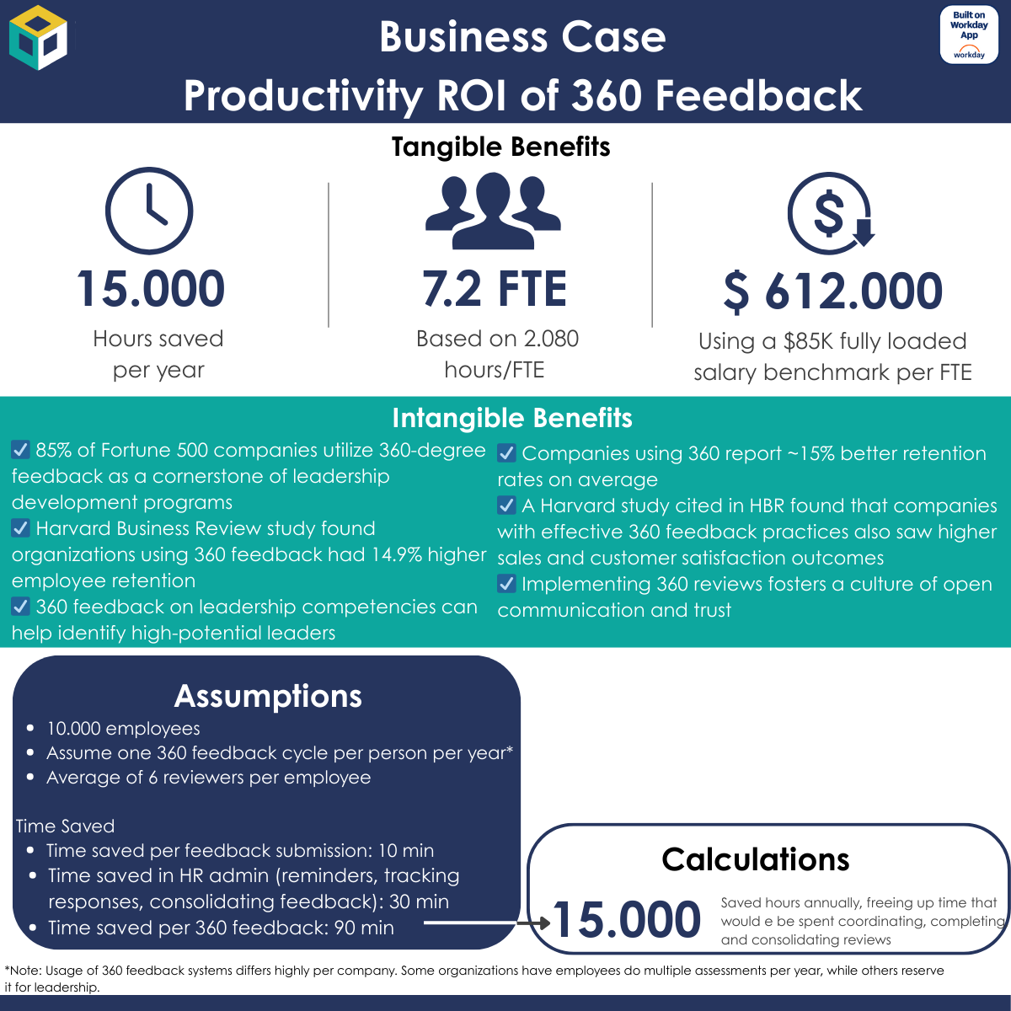
Your Agent Roadmap And Business Case On One Page
T
Trajectory & Roadmap
Use case / agent | Main persona | Annual volume | Time saved per event | Other benefits | Agent complexity (L / M / H) | Rough annual value | Planned wave
Manager Hiring Assistant | Hiring managers | 8.000 reqs 48.000 interviews | 15 min per req 12 min per interview | Better req quality, less rework | Medium | ≈ $736k (8.000 × 0,25h ×$60) + (48.000*0,2h*$60) | Now
360 Feedback Agent | People managers | 10.000 | 90 min | Better summaries, stronger conversations | Medium | ≈ $612k (10.000 × 1,5h × $40) | 6–12m
Grow / Goal Setting Agent | Employees, managers | 25.000 goal cycles, 4 goals on average | 12 min | Higher goal quality, fewer reminders | High | ≈ $800k (100.000 × 0,2h × $40, rounded) | 6–12m

Slide 17
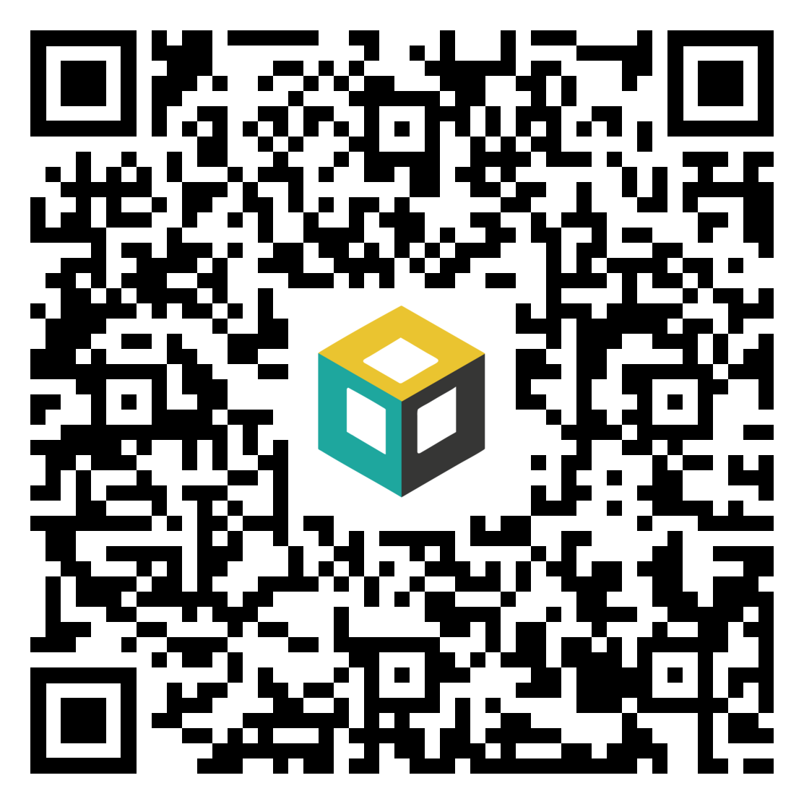
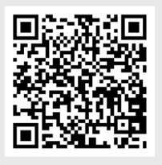
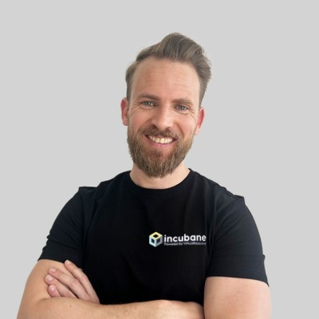
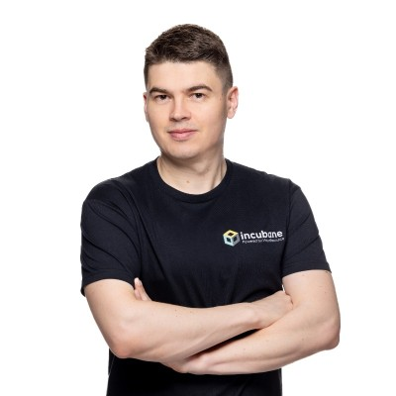
What is your next step in your agent journey?
Learn More on the Technology
of Flowise
Get into Action Mode and Meet
With Us
If you want to get a full understanding of how to build with Flowise, understand the tech, how it fits in your overall landscape and how to build internal capability.
If you want to get started with a strategy, a business case, a pilot or deploy agents within your organization and see actual results.
Why
When
Wednesday Dec 10th at 15:00 CET / 9:00 ET
Book a meeting with us
You will learn:
What are the main capabilities of Flowise
How does it interact with Workday
How does it work with your overall landscape
How do you build internal capability
We can discuss:
Your agent/AI use cases
Your overall strategy and business case
More about Extend Pro, Agent System of Records or other innovation topics
What
How
Scan to register
Scan to book
Contact Us
If you want to build your agent strategy
If you want to learn how to build agents inhouse
If you have an agent use case you want to work together on
Rick Leunisse
rick.leunisse@incubane.com
Matt Komendolowicz
matt.komendolowicz@incubane.com
Notes:
Matt & Rick

