Slide 1
Workday Rising US 2025
Executive Summary and Impact on Our Organization

Slide 2




Executive Summary
What changed at a glance
AI and Agents you can use now
Data, platform, and build
Why it Matters to You
Three acquisitions: Sana (AI front door for knowledge and learning), Paradox (high-volume recruiting automation), Flowise(building agents with low code).
Workday is moving from features to outcome-driven AI agents.
Marketplace and Build are central to the strategy, fewer point tools over time.
Flex-style consumption makes AI easier to adopt and scale.
Clear push to standardize on Workday data and governance.
HR Help: AI answers, case summaries, and deflection.
Recruiting: conversational apply, scheduling, shortlists, internal mobility scoring.
Performance: AI check-ins, goal support, feedback insights.
Payroll and Finance: variance explanations, close assistance, task automation.
Frontline and scheduling: shift optimization and manager copilots.
Measured by time saved, case deflection, cycle times, and quality.
Workday Data Cloud with open access patterns, built to connect to Snowflake, Databricks, and others.
Zero-copy analytics direction, less data duplication risk.
Orchestrate and Extend for secure workflow and custom apps.
Developer Copilot and low-code agent builder to speed delivery.
Agent System of Record for audit, access, and value tracking.
CHRO: simpler UX as one entry point, better adoption, fewer tools, stronger compliance and audit.
CFO: lower integration and license spend, faster close, clear ROI from agent telemetry.
CIO: governed AI with single policy plane, cleaner data flows, fewer brittle interfaces, secure build path.
CEO: faster execution on hiring and productivity, improved employee experience, measurable outcomes in a quarter.

Slide 3
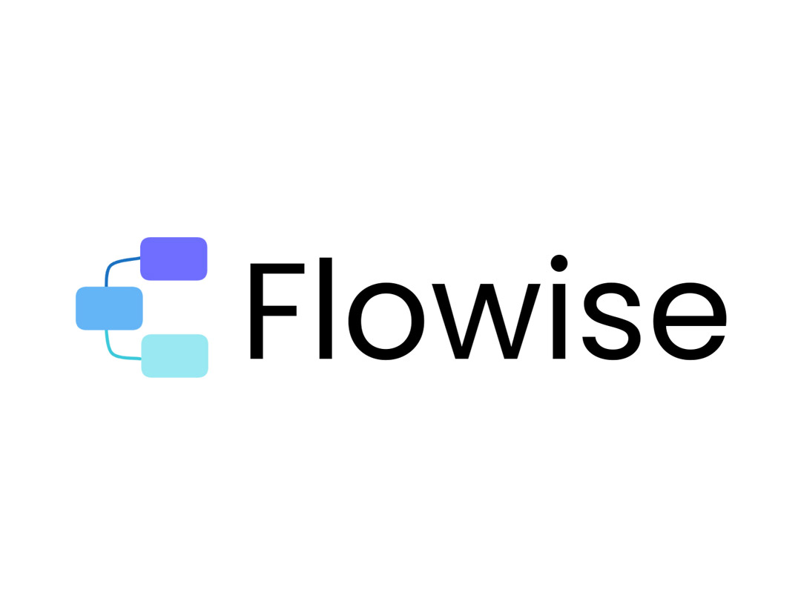


Recent Workday acquisitions, in one view
Workday’s acquisition spree looks like a focused AI catch-up plan, not a shopping list. By adding an AI front door (Sana), high-volume TA automation (Paradox), and a visual agent builder inside Build (Flowise), they close gaps fast on user experience and time to value. Net effect, fewer point tools, more native AI in the flow of work, and governance that stays inside Workday.
What it is: Conversational TA automation for apply, screening, and scheduling.
Where it fits: High-volume recruiting, frontline and seasonal roles.
Why it matters: Lower drop-off, faster cycle time, less recruiter load.
Opportunity: Automate screening and booking, improve completion rates.
What it is: AI front door for search, knowledge, and learning.
Where it fits: Employee homepage, Help, Learning, cross-app actions.
Why it matters: One entry point, faster answers, higher daily engagement.
Opportunity: Replace scattered portals, deflect tickets, unify learning and knowledge.
What it is: Visual agent builder used in the Workday Build stack.
Where it fits: Rapid prototyping of AI agents, connecting to Workday actions.
Why it matters: Build low-code agents in days, governed in one place.
Opportunity: Convert manual flows into guided agents, accelerate ROI pilots.

Slide 4
From Features to AI Agents
We are shifting from isolated AI features to governed agents that create measurable outcomes. Use Workday’s native AI where it is strong, add out-of-the-box agents for quick wins, then extend with custom agents built on Extend Pro and Flowise. Fund and track it all with Flex Credits.
AI features (selection of what’s in product now)
Custom agents and AI (Extend Pro and Flowise)
Guidance AI in key flows, suggestions, summaries, and draft generation.
Help answers and case summaries, faster triage and deflection.
Skills inference and matches, better profiles and mobility signals.
BP Optimize recommendations, find bottlenecks and fix steps.
Variance and anomaly insights in Finance and Payroll.
Journeys and Learning recommendations, targeted nudges.
And much more, most modules are getting strong AI capabilities
Flowise Agent Builder for low-code agent flows, tool calls, and guardrails.
Extend Pro for secure UIs, data models, and pro-code logic where needed.
Orchestrate to connect steps, approvals, and hand-offs end to end.
Agent System of Record to register agents, roles, scopes, and telemetry.
Developer Copilot to speed build, tests, and documentation.
Out-of-the-box agents (some ready to turn on)
Cost structure with Flex Credits
HR Case Assist, summarize, classify, and propose next actions.
Performance Check-in Coach, prep notes and strengths, draft feedback.
Financial Close Optimizer, detect delays and recommend tasks.
Payroll Variance Explain, highlight drivers and suggest corrections.
Frontline Scheduling Optimizer, balance demand, skills, and rules.
BP Optimize auto-fixes, apply safe changes with audit.
Customers get a pool of Flex Credits with their existing license, and can purchase more
One credit pool for AI usage across features and agents.
Metered by consumption, visible per agent and per population.
Plan by “Now, Next, Later,” allocate credits to priority use cases.
Track value vs spend, time saved and errors reduced per quarter.
Rebalance easily, scale high-ROI agents, pause low-impact ones.

Slide 5






Open Platform and Data Strategy
Use Workday as the secure core, then open the data for analytics and agents without brittle pipelines. Govern data and agents in one place so you can move fast, stay compliant, and prove value.
Open lake on Iceberg with direct SQL; zero-copy sharing.
Connect Snowflake, Databricks, and Salesforce easily.
Workday objects mapped to clean domain models.
Near real-time publish and subscribe for key events.
Agent Gateway and REST APIs to write back into Workday.
Event streams for HCM and Finance changes.
Federated queries where data lives, fewer ETL jobs.
Reference data sync for identities, orgs, and skills.
Workday Data Cloud
Bi-directional integration
One registry for every agent, including Microsoft and Google.
Roles, scopes, approvals, and human-in-the-loop checkpoints.
Telemetry per agent, usage, outcomes, and ROI.
Lifecycle controls, design to retire, with risk checks.
Attribute-based access, masking for PII, full audit trails.
Region and retention policies built in.
Prompt and policy library with test sets for agents.
Data quality rules and drift monitoring.
Agent System of Record
Security, privacy, and governance

Slide 6


Build Faster with Workday Build
Build components
Flowise Agent Builder to design and test agents that call apps and orchestrations. Included with Extend Professional; early access targeted first half next year.
Orchestrate as the default for new integrations, GA in 25R2, with debugger, reuse, and long-running support on the roadmap.
Workday Extend for secure UIs and data models, plus Extend Cards and AI Widgets to bring apps and genAI into the flow of work.
Developer Copilot to generate pages, WQL, scripts, and orchestrations; teams report up to 50% productivity gains.
Governance, timing, and buy vs build
Agent System of Record registers, secures, and monitors all agents, including Microsoft and Google; included with HCM and Financials.
Parts of Build move through early-adopter waves; broader agent-builder availability targets first half of 2026. Align pilots accordingly.
Marketplace momentum is strong; buy when a listed app fits, then extend where unique.
Interoperability and data
Agent Gateway and broad API coverage, REST, GraphQL, MCP, A2A, JDBC, to connect tools cleanly.
Workday Data Cloud provides zero-copy access and direct SQL over Apache Iceberg, with Snowflake, Databricks, and Salesforce patterns.
Prism in dev tenants for experimentation, even without a Prism license.
What you can turn on now
Use Orchestrate for net-new integrations, launch flows from BP events, monitor runs in BP history.
Add Extend Cards to surface key apps on Home, Hubs, Search, and Journeys; pilot AI Widgets on rich-text fields.
Stand up agents on top of your apps with Flowise in Extend Pro (coming H1 2026), governed in ASOR.
Accelerate builds with Copilot and the new CLI and reusable tenant configuration
Notes:
Examples _ common uses cases
Extend Pro
Call out webinar
How to sell to smaller organizations
Playbook
Marketing
One pager on our offer building out mockups/discovery (what is the path)

Slide 7

What does this mean for us?
Rising Strategy Co-Pilot
Use our Custom GPT to help shape the next few slides.

Slide 8
Connect Our Strategy to Workday Rising
Priority | Business outcome | Owner | Population | Baseline | Target | Timeframe | Key constraints
{P1 title} | {e.g., cut time-to-hire 20%} | {name} | {who is impacted} | {current metric} | {goal} | {Q4 2025} | {systems, budget, data}
{P2 title} | {…} | {…} | {…} | {…} | {…} | {…} | {…}
{P3 title} | {…} | {…} | {…} | {…} | {…} | {…} | {…}
Priority | Relevant theme | Sessions or sections | Feature or agent to explore | Data needed | Change impact | Next step
{P1} | {Acquisitions, Agents, Data Cloud, Build} | {session IDs or page refs} | {e.g., HR Case Assist, Paradox apply, Flowise agent} | {objects, integrations} | {who changes what} | {owner + date}
{P2} | {…} | {…} | {…} | {…} | {…} | {…}
{P3} | {…} | {…} | {…} | {…} | {…} | {…}

Slide 9
Educate Our Team
Title | Theme | Who should read/watch | Why it matters | Priority | Owner | Due date | Action items
{Session 1 title / [ID]} | {Acquisitions, Agents, Data Cloud, Build} | {Role or team} | {Outcome or problem it solves} | {High/Med/Low} | {Name} | {Date} | {Next step or artifact}
{Session 2 title / [ID]} | {…} | {…} | {…} | {…} | {…} | {…} | {…}
{Session 3 title / [ID]} | {…} | {…} | {…} | {…} | {…} | {…} | {…}
{Session 4 title / [ID]} | {…} | {…} | {…} | {…} | {…} | {…} | {…}
{Session 5 title / [ID]} | {…} | {…} | {…} | {…} | {…} | {…} | {…}
{Session 6 title / [ID]} | {…} | {…} | {…} | {…} | {…} | {…} | {…}
{Session 7 title / [ID]} | {…} | {…} | {…} | {…} | {…} | {…} | {…}
{Session 8 title / [ID]} | {…} | {…} | {…} | {…} | {…} | {…} | {…}
{Session 9 title / [ID]} | {…} | {…} | {…} | {…} | {…} | {…} | {…}
{Session 10 title / [ID]} | {…} | {…} | {…} | {…} | {…} | {…} | {…}

Slide 10
90 Day Action Plan
How to use
Capture the top actions tied to value, assign owners and dates, and note decisions, risks, and comms. Keep one line per cell.
Action | Why now | Owner | Start | Due | Dependencies | Metric to move | Status
{Action 1} | {business outcome} | {name} | {date} | {date} | {systems, data, approvals} | {e.g., time-to-resolution −20%} | {Not started / In progress}
{Action 2} | {…} | {…} | {…} | {…} | {…} | {…} | {…}
{Action 3} | {…} | {…} | {…} | {…} | {…} | {…} | {…}
{Action 4} | {…} | {…} | {…} | {…} | {…} | {…} | {…}
{Action 5} | {…} | {…} | {…} | {…} | {…} | {…} | {…}
Decision needed | By when | Owner | Options considered | Recommendation | Risk if delayed | Mitigation
{e.g., Pick agent pilot} | {date} | {name} | {Option A, B} | {chosen path} | {impact} | {plan}
{…} | {…} | {…} | {…} | {…} | {…} | {…}
{…} | {…} | {…} | {…} | {…} | {…} | {…}
Quick checks
Communications, {audiences, cadence, channels}.
Training, {assets, owners, due dates}.
Data and integration, {objects, APIs, reports}.
Governance, {ASOR roles, approvals, telemetry}.
Budget, {Flex Credits allocation Now, Next, Later}.

